Slide 1

SIAMS / RE evidence / Policy

Slide 2
Our Christian Vision
Our school vision:
“Be strong and courageous.
Do not be afraid; do not be discouraged, for the Lord your God will be with you wherever you go.”
Rooted in scripture: Joshua 9
Our vision shapes our: curriculum, policies, relationships, behaviour, inclusion.

Slide 3
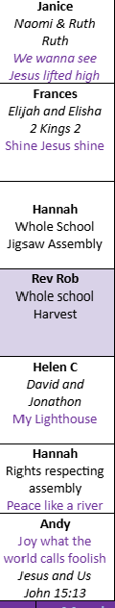
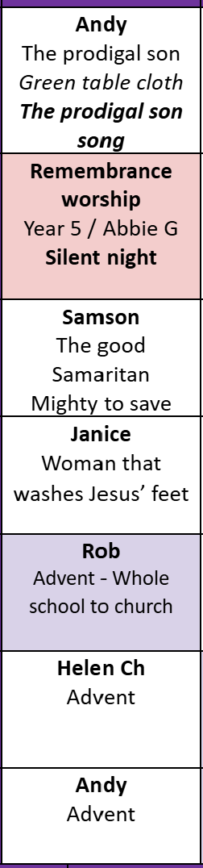
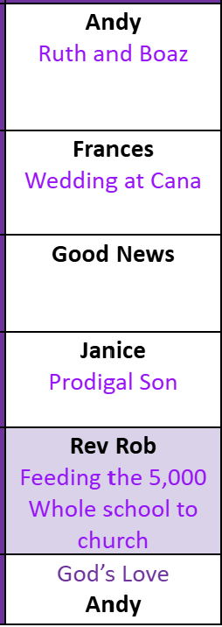
Our Christian Values
Examples of Bible stories explored:
How do you know worship has an impact?
Our Monday whole-school Collective Worship is led by Governors or members of the Senior Leadership Team. During this time, pupils listen to a story from the Bible that reflects the Christian value for that half term. The story is then explored and discussed, providing opportunities for pupils to consider its relevance today and how they can incorporate the Christian value into their daily lives.
These sessions support the spiritual, moral, social, and cultural development of pupils, by encouraging reflection on beliefs and values, promoting empathy and understanding, and helping pupils apply Christian teachings in their own lives.
HT1 - Friendship
HT2 - Compassion
HT3 - Love
HT4- Kindness
HT5 - Perseverance
HT6 - Respect

Slide 4
Our Christian values and school vision were chosen collaboratively by pupils, staff, governors, the parish, and parents through a voting process. The values are arranged throughout the year to reflect key experiences and events in pupils’ lives:
Half Term 1 – Friendship: Pupils are making new friends within their key stage, in school, and in out-of-school clubs.
Half Term 2 – Compassion: Linked to Remembrance Day, Advent, and Christmas, encouraging empathy and care for others.
Half Term 3 – Love: Reflected through events such as New Year, Valentine’s Day, and the winter season, focusing on care, inclusion, and relationships.
Half Term 4 – Kindness: Highlighting daily acts of thoughtfulness and generosity within the school community.
Half Term 5 – Perseverance: Supporting pupils during assessments such as SATs and other summative tests, encouraging resilience and determination.
Half Term 6 – Respect: Preparing pupils for transitions, including moving year groups, preparing for high school, and the summer holidays, emphasising respect for self and others.
How do you know worship has an impact? This approach ensures that our Christian values are practical, meaningful, and embedded in pupils’ everyday experiences, while linking to both the liturgical year and key developmental milestones.

Slide 5
Rationale and Curriculum Intent
Religious Education at Latchford St James is central to our deeply Christian character. It is a key way in which the school works towards ‘life in all its fullness’ through growth in body, mind and spirit. We study religion within a Christian context, reflecting the Anglican tradition of our school and aim for the highest standards of excellence. We provide a safe space for each unique individual to explore their beliefs, whatever those beliefs might be.
We aim to provide pupils with a well-developed understanding of the Christian faith as possible, alongside promoting love and understanding for people of other faiths. Children gain understanding of Christian values through their study of RE. Their studies help them to understand why values such as Love, Respect, Compassion and Kindness are important and help them to understand Christian theological teaching about these values. We hope that pupils will also be presented with challenges to some of the values that are current in modern materialistic society.

Slide 6
Rationale and Curriculum Intent
Religious Education enables children to investigate and reflect on some of the most fundamental questions asked by people. At Latchford St James we develop the children’s knowledge and understanding of the major world faiths. We enable children to develop a sound knowledge not only of Christianity but also of other world religions. Children reflect on what it means to have a faith and to develop their spiritual knowledge and understanding. We help the children learn from religions as well as about religions.

Slide 7
Rationale and Curriculum Intent
Aims of Religious Education are to help children;
Have learning opportunities and a learning environment where Christian values are central to the ethos of the school and moral development,
Develop an awareness of spiritual and moral issues in life experiences,
Develop knowledge and understanding of Christianity and other major world religions and value systems found in Britain and the wider world,
Develop an understanding of what it means to be committed to a religious tradition
To be able to reflect on their own experiences,
Develop an understanding of religious traditions and to appreciate the cultural differences in Britain today,
Develop investigative and research skills and to enable them to make reasoned judgments about religious issues,
Have respect for other people’s views and to celebrate the diversity in society.

Slide 8
Curriculum Implementation
RE that is inclusive for all.
Religious Education at Latchford St James supports our commitment to meeting the needs of each unique individual. It is inclusive of all. We encourage pupils to share with us in our faith journey.. We are committed to nurturing pupils who have a faith commitment as they develop their theological thinking. However, we also respect the differing views represented in our school and we are aware that we may all have differing views which are respected.
Our classrooms are spaces for thinking where all, including the teacher, are engaged on a learning journey. We start and finish the journey in different places but respect the viewpoints and beliefs of all who share the journey. We encourage pupils to wrestle with challenging questions about God, faith and our world. We are committed to showing ‘care’ through being inclusive as Jesus was inclusive, ‘challenge’ by prompting questioning as Jesus prompted questioning and ‘celebrate’ the learning pupils make as they evaluate issues for themselves.

Slide 9
Curriculum Impact
Knowledge & Understanding
Pupils gain a deep understanding of Christianity and other faiths/worldviews; improve religious vocabulary; gain a better grasp of beliefs, practices, and how faith shapes people’s lives.
Enquiry & Critical Thinking
Pupils should be able to ask reflective and challenging questions; engage with “ultimate questions” (meaning, purpose etc.); analyze, interpret and evaluate religious and ethical issues.
Spiritual, Moral, Social, Cultural (SMSC) Development
The syllabus contributes significantly to spiritual growth; moral development; cultural understanding; respect and empathy for others; personal reflection.
Attitudes & Behaviour
Greater respect for diversity; improved tolerance; pupils more open-minded; able to see others’ perspectives; more confident expressing views about religion and belief.
Identity & Belonging
Pupils connect learning to their own lives; sense of belonging in religious & secular worlds; development of their own spiritual beliefs and values.
Preparation for Later Life / Citizenship
Pupils better equipped to live in a multi-faith society; ability to engage in respectful dialogue; moral and ethical awareness; sense of responsibility; understanding of global religion issues

Slide 10
Christian Values and UNICEF Rights
Friendship
Compassion
Love
Kindness
Perseverance
Respect
Article 14 (Freedom of Thought, Belief, and Religion)
Article 12 (Respect for the Views of the Child)
Article 29 (Goals of Education)
Article 2 (Non-Discrimination)
Article 13 (Freedom of Expression)

Slide 11
Professional Development
WHEN | WHAT | WHO | IMPACT/ NEXT STEPS

Slide 12
SEND How does the school help all pupils to flourish?
EAL How does the school help all pupils to flourish?
Through inclusion for all, we strive to ensure that every child fulfils their own potential. We want all children to develop a sense of themselves as unique and precious. Teachers will plan RE sessions with children’s needs and abilities in mind. As with all areas of the curriculum, differentiation ensures that children will receive further support if needed.
Through inclusion for all, we strive to ensure that every child fulfils their own potential. We want all children to develop a sense of themselves as unique and precious. Teachers will plan RE sessions with children’s needs and abilities in mind. As with all areas of the curriculum, differentiation ensures that children will receive further support if needed.

Slide 13



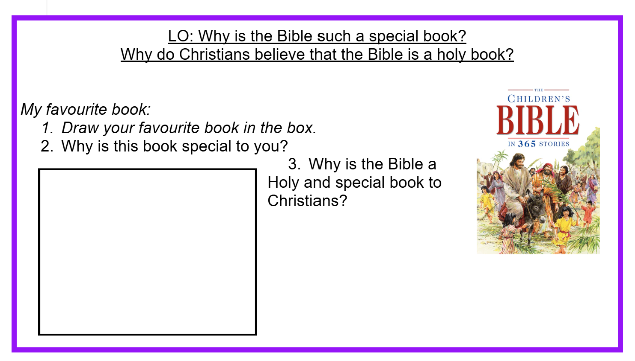
RE curriculum
Expectations:
Front cover of book
Title page
Knowledge organisers
Pride and presentation
Purple border around worksheets
Assessment sheets
EYFS - both need an RE scrap book with evidence.
Rec - LSJ RE curriculum,
Nur - evidence of world faiths studies ect.

Slide 14
LSJ RE curriculum

Slide 15
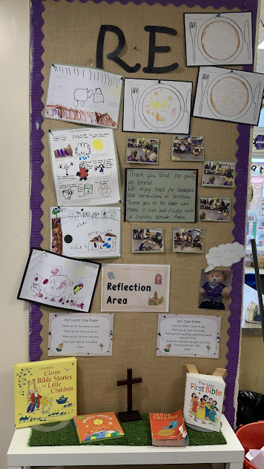
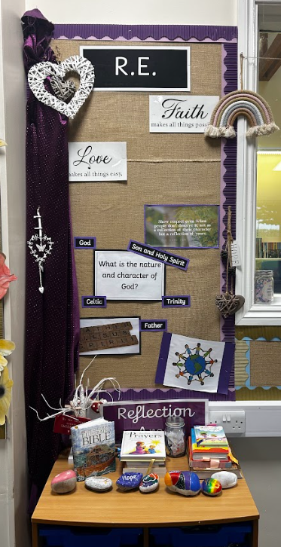
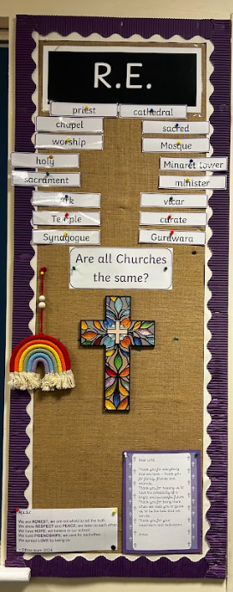
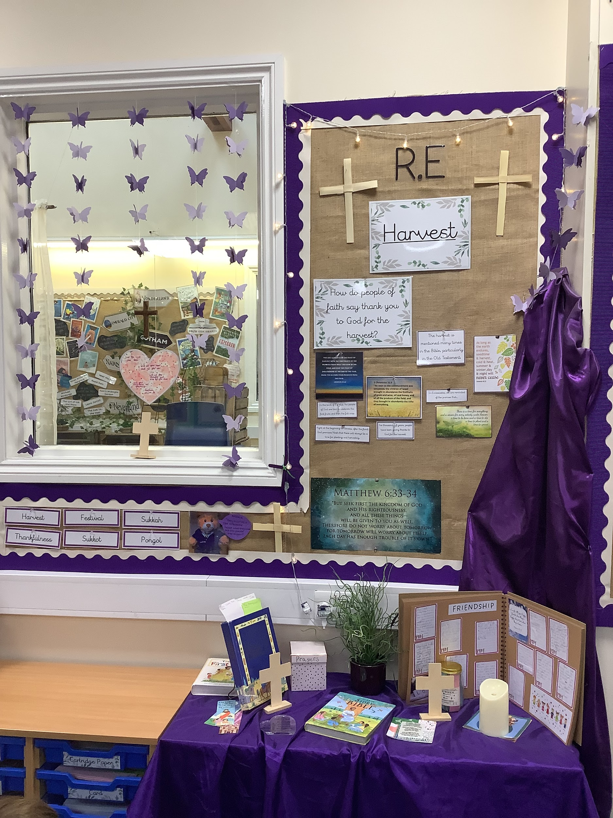
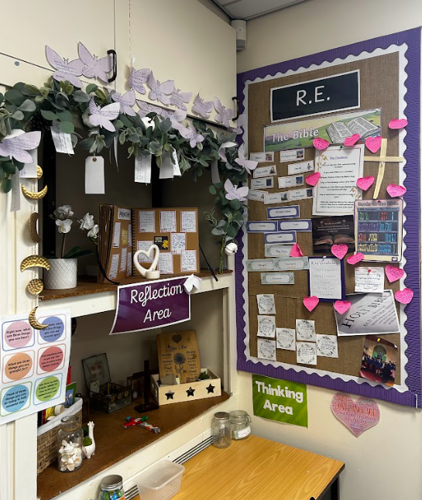
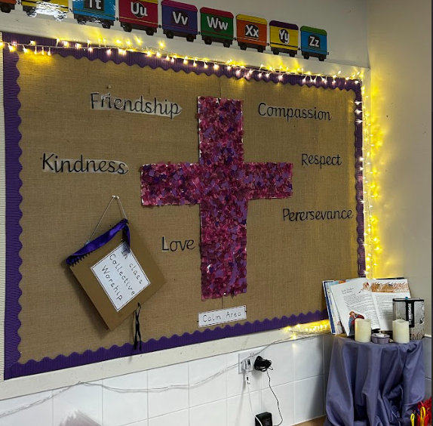
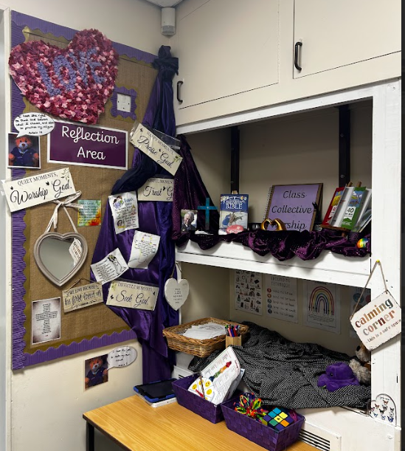
Displays

Slide 16
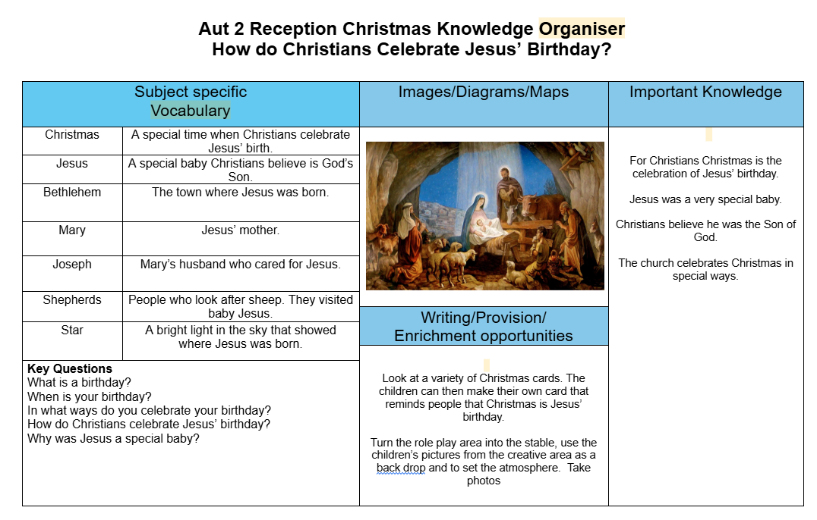
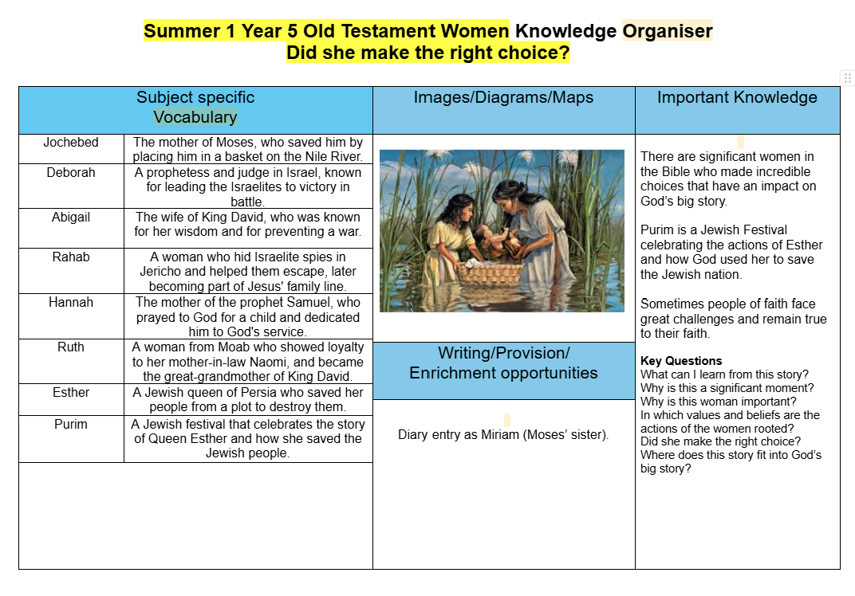
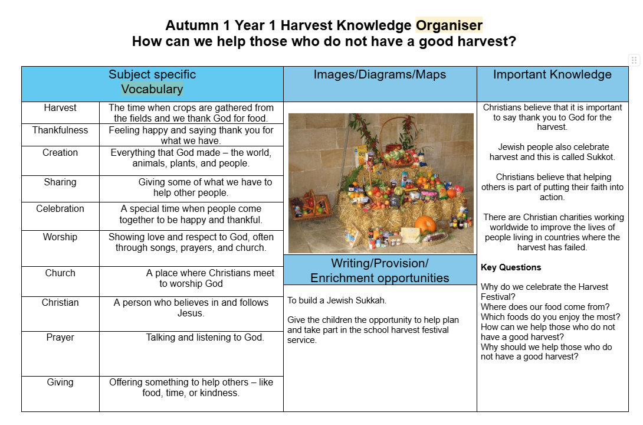
Knowledge organisers
Each unit of learning is supported by a knowledge organiser, which pupils refer to at the start of the unit and revisit throughout.

Slide 17
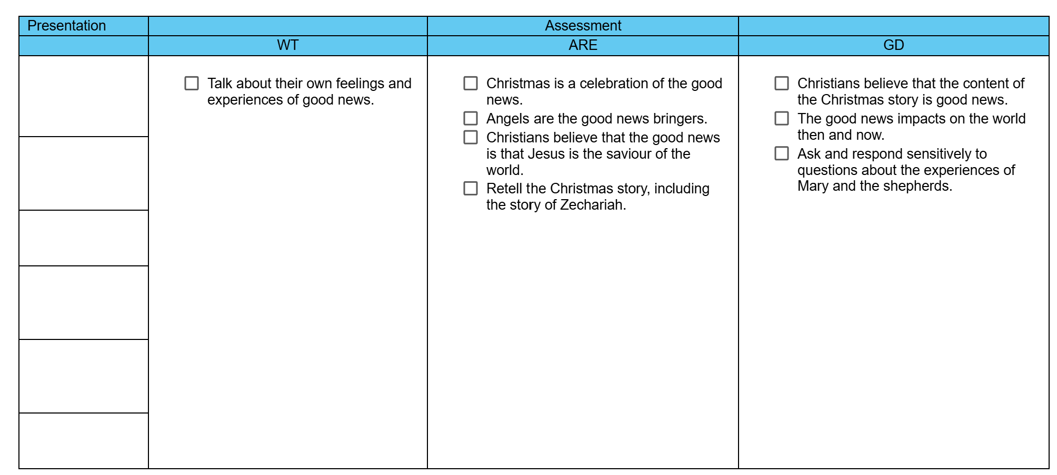
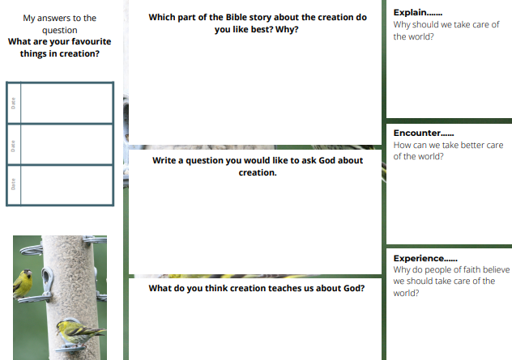
Assessment and Progress
How is RE assessed and monitored?
Assessment takes place both informally and formally throughout the year. We assess children’s work in RE by making informal judgments as we observe them during lessons - this is recorded (highlighted) on the assessment grid.
Presentation is recorded and monitored on the assessment grids also.
On completion of a unit of work, children complete the questful learning map as a summary of their knowledge and understanding of the unit. Teachers then make judgements in line with the expected unit outcomes.

Slide 18
Monitoring
Autumn | Spring | Summer
Drop in sessions SLT/ RE lead PP, SEND, EAL | Drop in sessions SLT / RE lead LA, MA, HA | Drop in sessions SLT/ RE lead Based on previous findings
Termly data collection Book looks Pupil Voice | Termly data collection Book looks Pupil Voice | Yearly data analysis Book looks Pupil Voice
Annual update for Governors/SLT

Slide 19
Subject Action Plan
Action | When | Who | Resources | Success criteria | Evaluation
To ensure all teachers teach with fidelity to the scheme and expectations of books. | See monitoring cycle | All teachers | Monitoring sheet Pupils’ books | Objective checklist Subject lead audit Monitoring cycle
Collect, monitor and analyse RE assessment data every half term. | Half termly | RE lead | Pupils’ books Policy Assessment grids Assessment table | To ensure pupil data is constantly good across the school and the RE curriculum is having an impact on Religious understanding.
Successfully implement the new christian vision and up to date values across school and the community. | 2025/26 | RE lead Governors SLT Teachers Staff | Collective Worship Books Staff meetings Inset day | To ensure all staff and pupils have an understanding of the vision on a deep level and can actively live the christian values,

Slide 20
Data Autumn
 | Autumn 1
 | Working towards | Working at | Working above
Rec | 29% | 54% | 17%
Y1 | 20% | 65% | 15%
Y2 | 24% | 52% | 28%
Y3 | 11% | 75% | 14%
Y4 | 29% | 54% | 17%
Y5 | 15% | 63% | 21%
Y6 | 26% | 61% | 13%
 | Autumn 2
 | Working towards | Working at | Working above
Rec | % | % | %
Y1 | % | % | %
Y2 | % | % | %
Y3 | % | % | %
Y4 | % | % | %
Y5 | % | % | %
Y6 | % | % | %

Slide 21
Strengths
Autumn | Spring | Summer
A clear mix of writing, practical, photos, children’s ideas and class discussions. High quality writing. Wider opportunities for children eg visit by member of the parish, Church visits and Harvest celebrations.

Slide 22
Next steps
Autumn | Spring | Summer
Ensure RE books have high standards of presentation. Year 1 is using the correct assessment grid in line with RE curriculum expectations

Slide 23
Pupil Voice - Autumn
Autumn 1 - taken by RE lead
EG - Year 1: I enjoy colouring in RE. I know that a bad harvest is not enough rain.
HV- Year 3 - I really enjoy the combination of drawing and writing. We explored how different religions celebrate harvest.
TM - Year 5 - SEND We explored different part of the Bible because it is a library of books and what they’re about. I really enjoyed translating Christian Values into different languages using the Ipads because the Bible is translated into lots of different languages across the world.

Slide 24
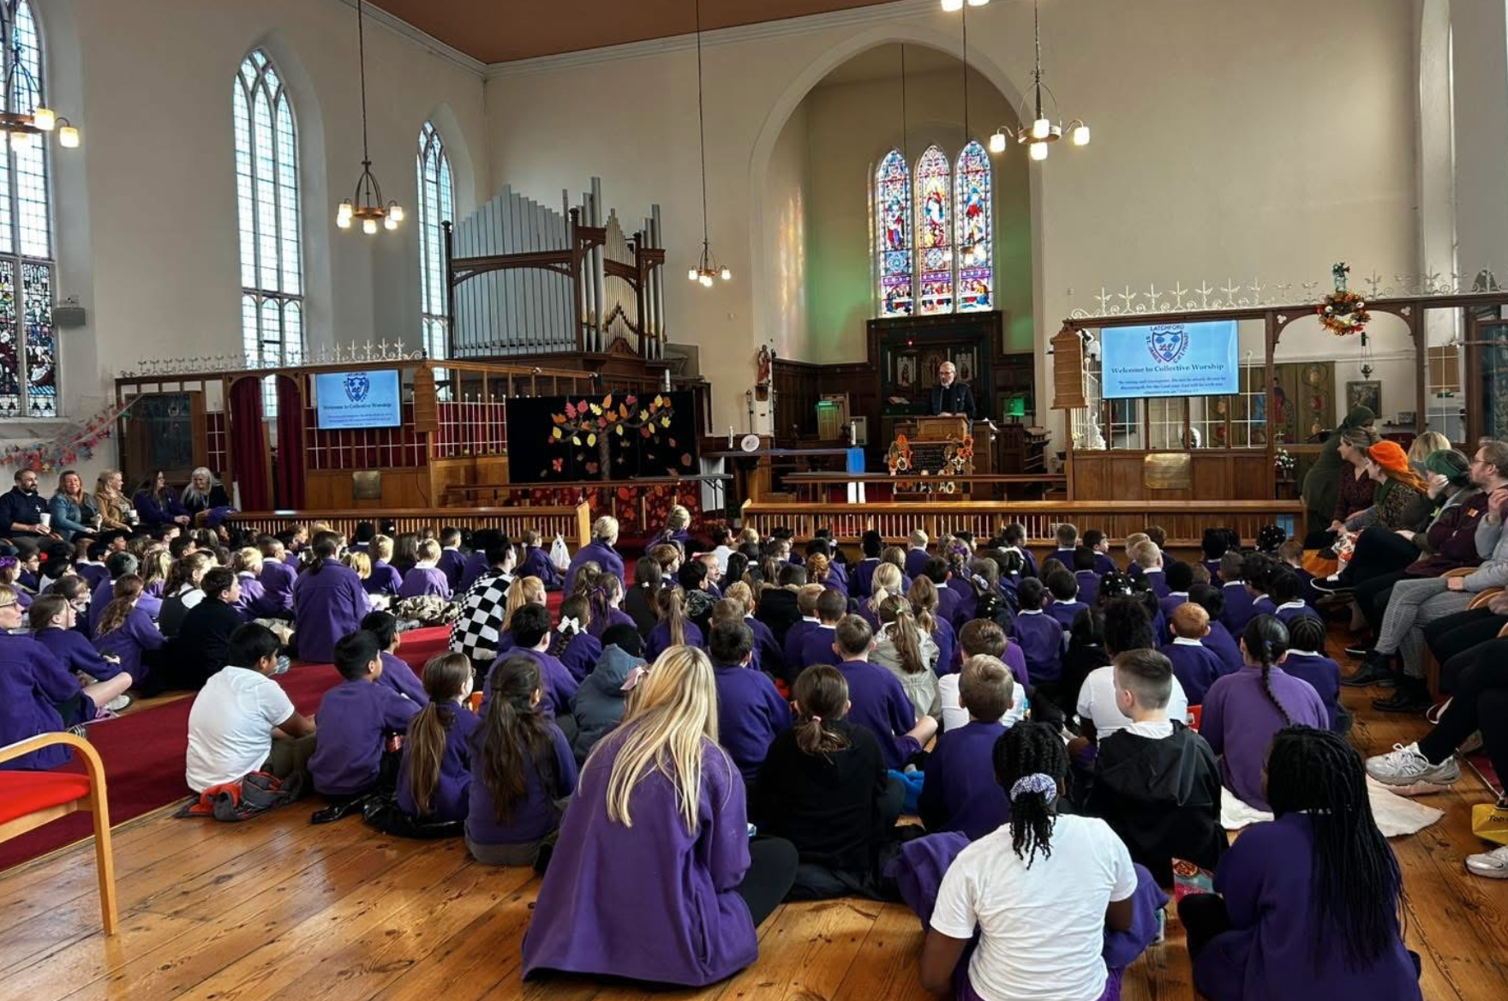
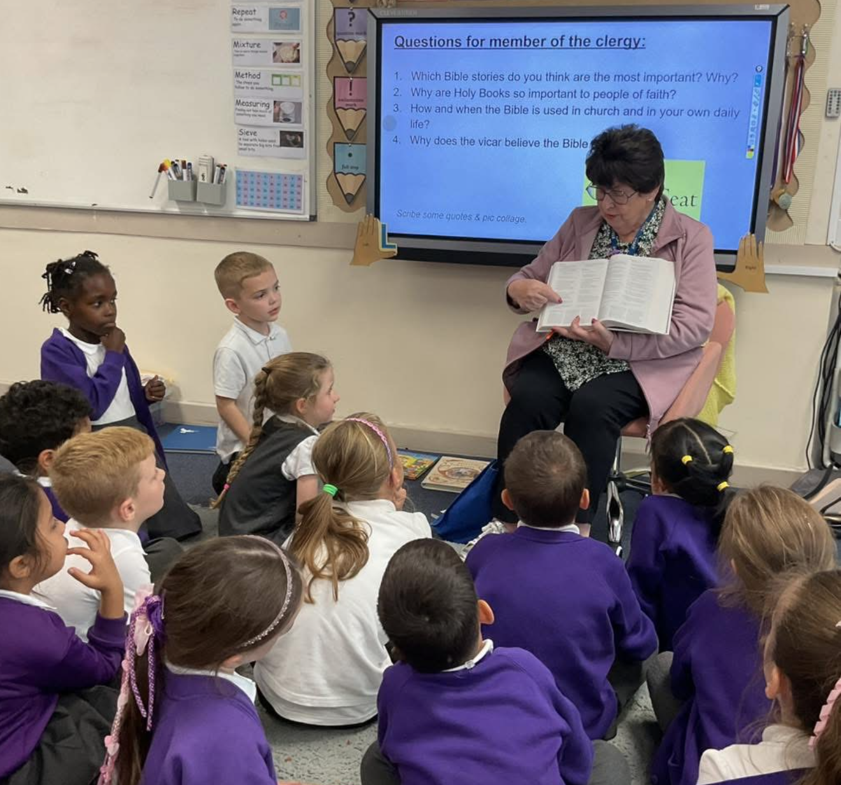

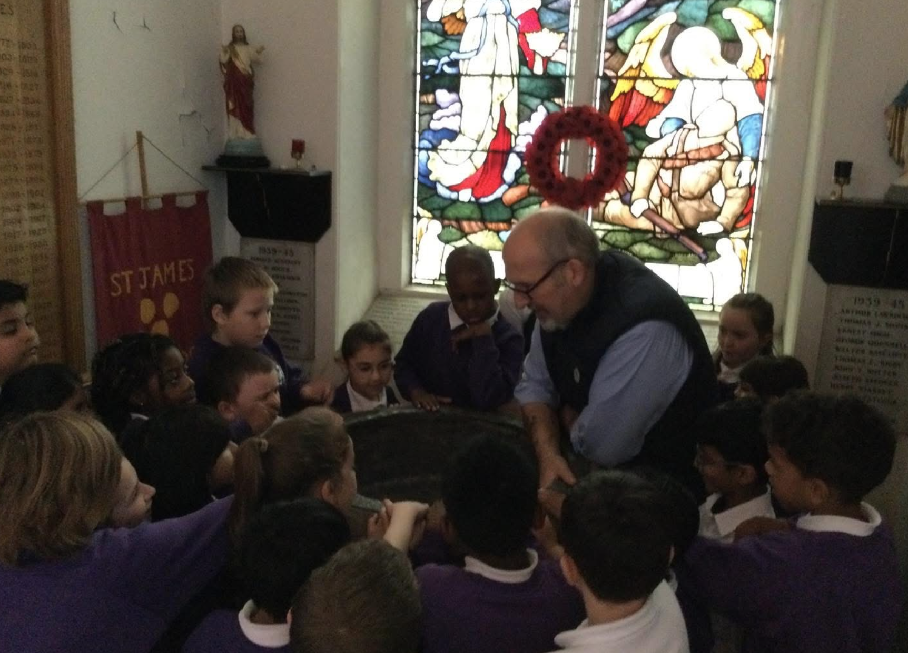

Autumn 1 Parish connections
Shared on social media
02.10.25
As part of their RE topic this half term, year 4 visited St James’ Church ⛪️✝️
#Rightsrespecting - all children have the RIGHT to a religion (14) #rightsrespectingschool
29.09.25
This morning, the whole school gathered in church to celebrate our Harvest Festival. Pupils shared their creativity through poems, songs and artwork, making it a truly beautiful occasion of thanksgiving. 🍂🍁We are especially grateful to our parents for your generous food donations, which will be given to the foodbank on behalf of LSJ.💜
#Rightsrespecting - all children have the RIGHT to a religion (14)
#Rightsrespecting - all children have the RIGHT to have access to adequate food. #rightsrespectingschool
07.10.25
Year 2 would like to say a huge thank you to Mrs Ireland for coming in this afternoon to share why the Bible is so special to her. She showed us a wonderful variety of Bibles and explained the importance of the Bible in her faith. One of her well-loved Bibles was missing its front cover from being read so often, so we designed a brand new cover, fit for a very special Holy Bible! ✝️📖⛪️#Rightsrespecting - all children have the RIGHT to a religion (14) #rightsrespectingschool

Slide 25
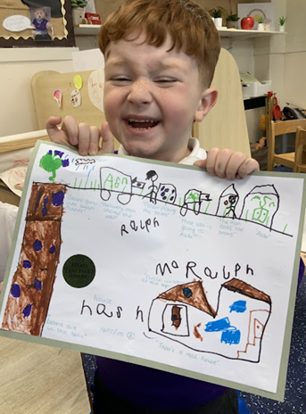
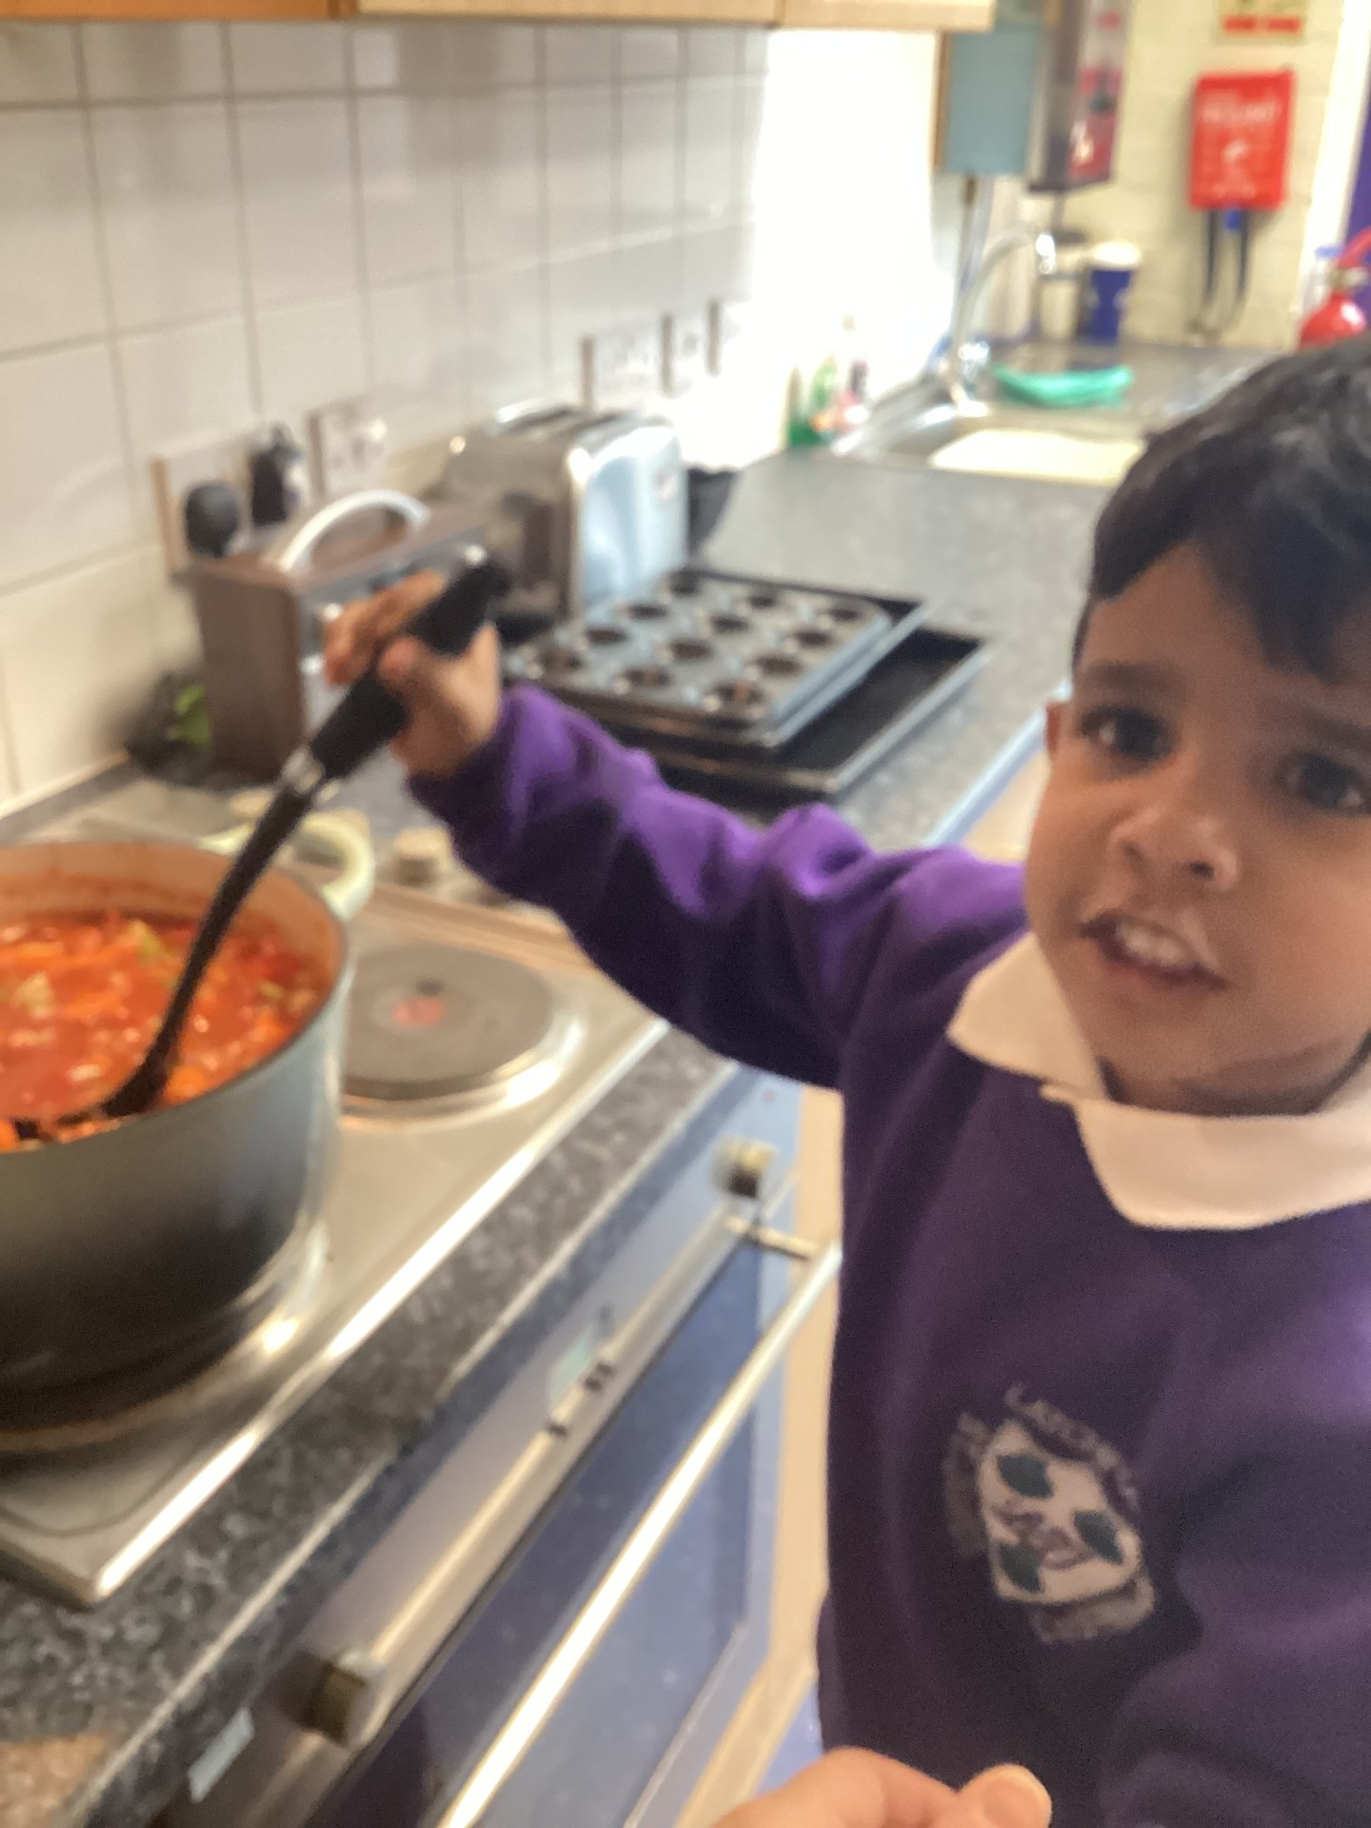
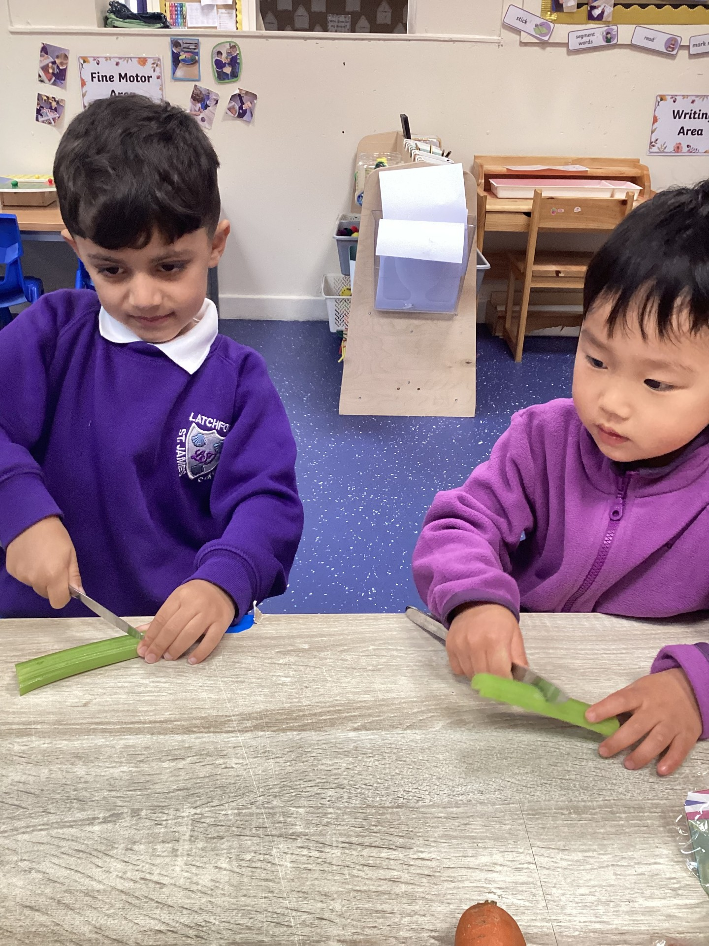
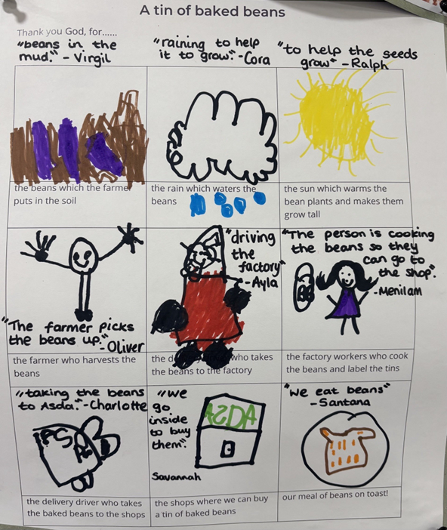
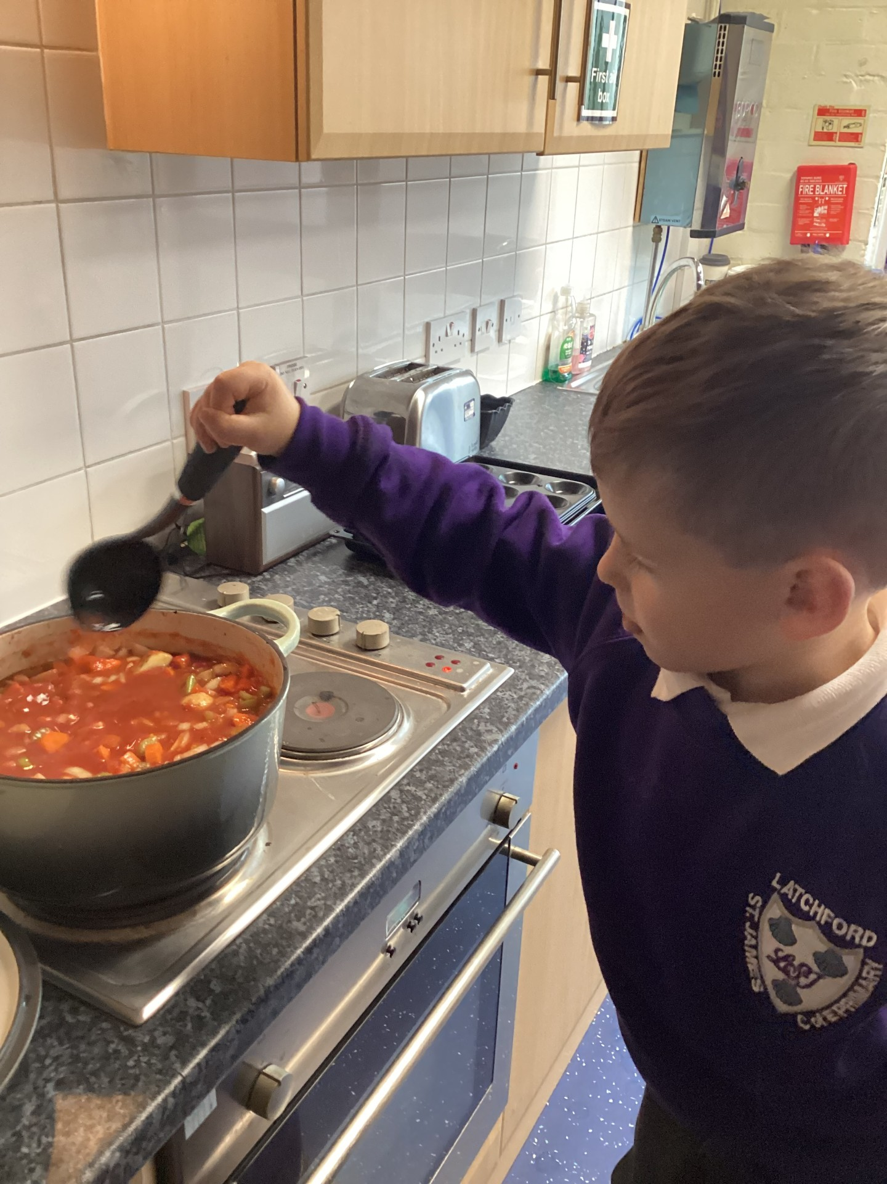
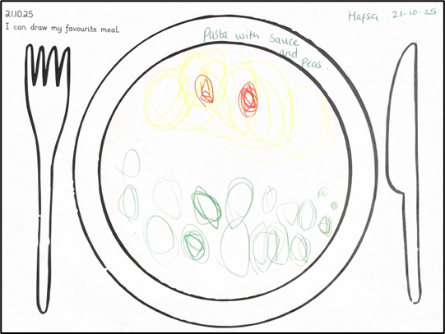
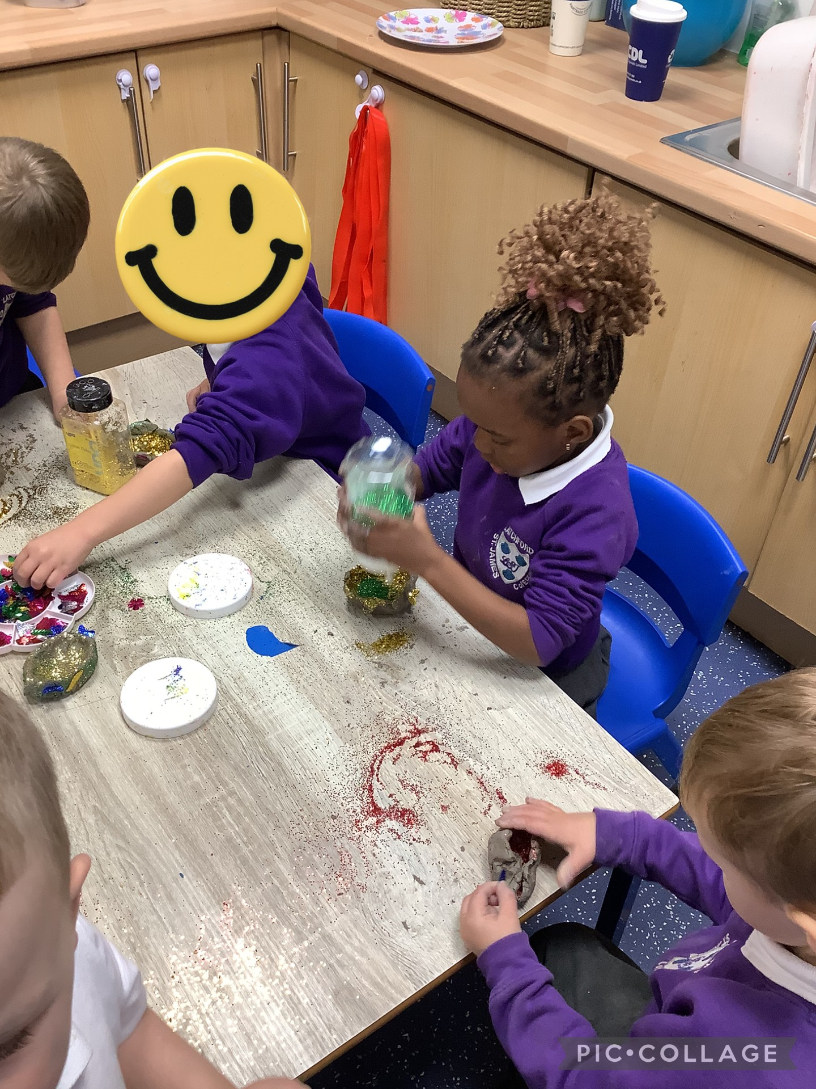
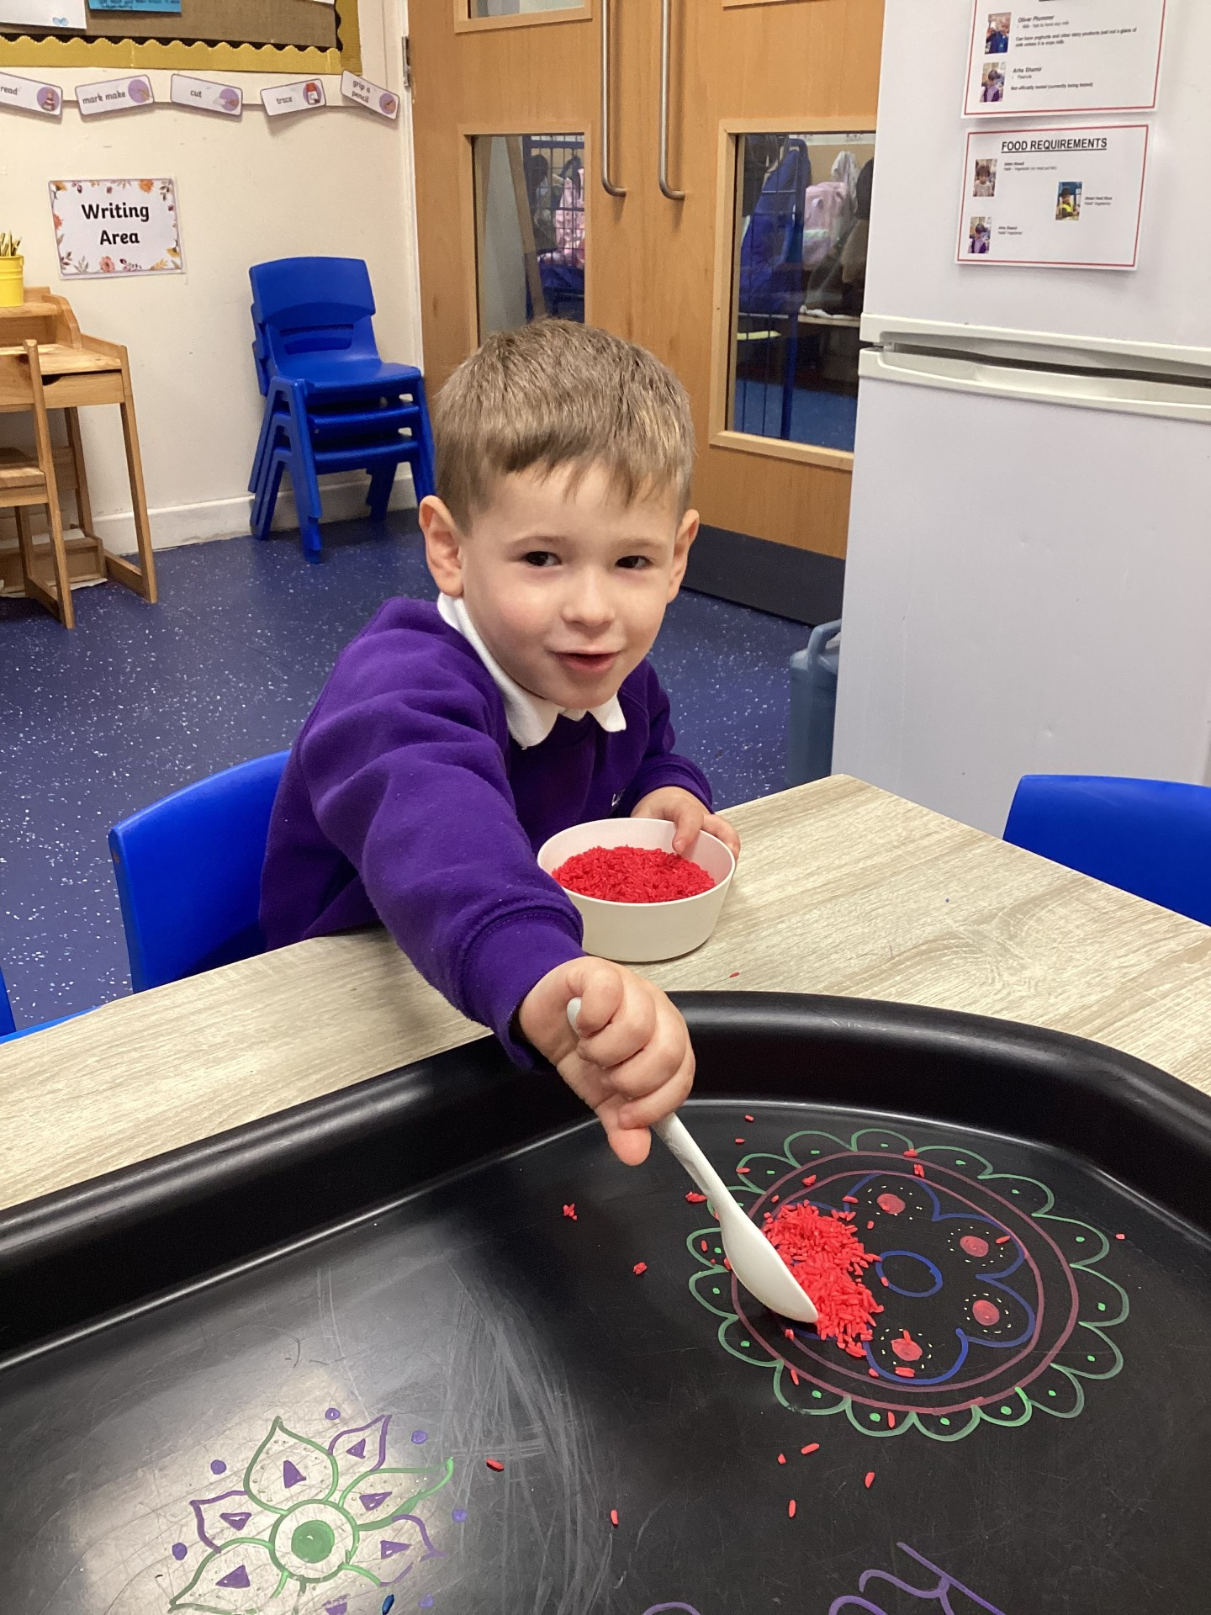
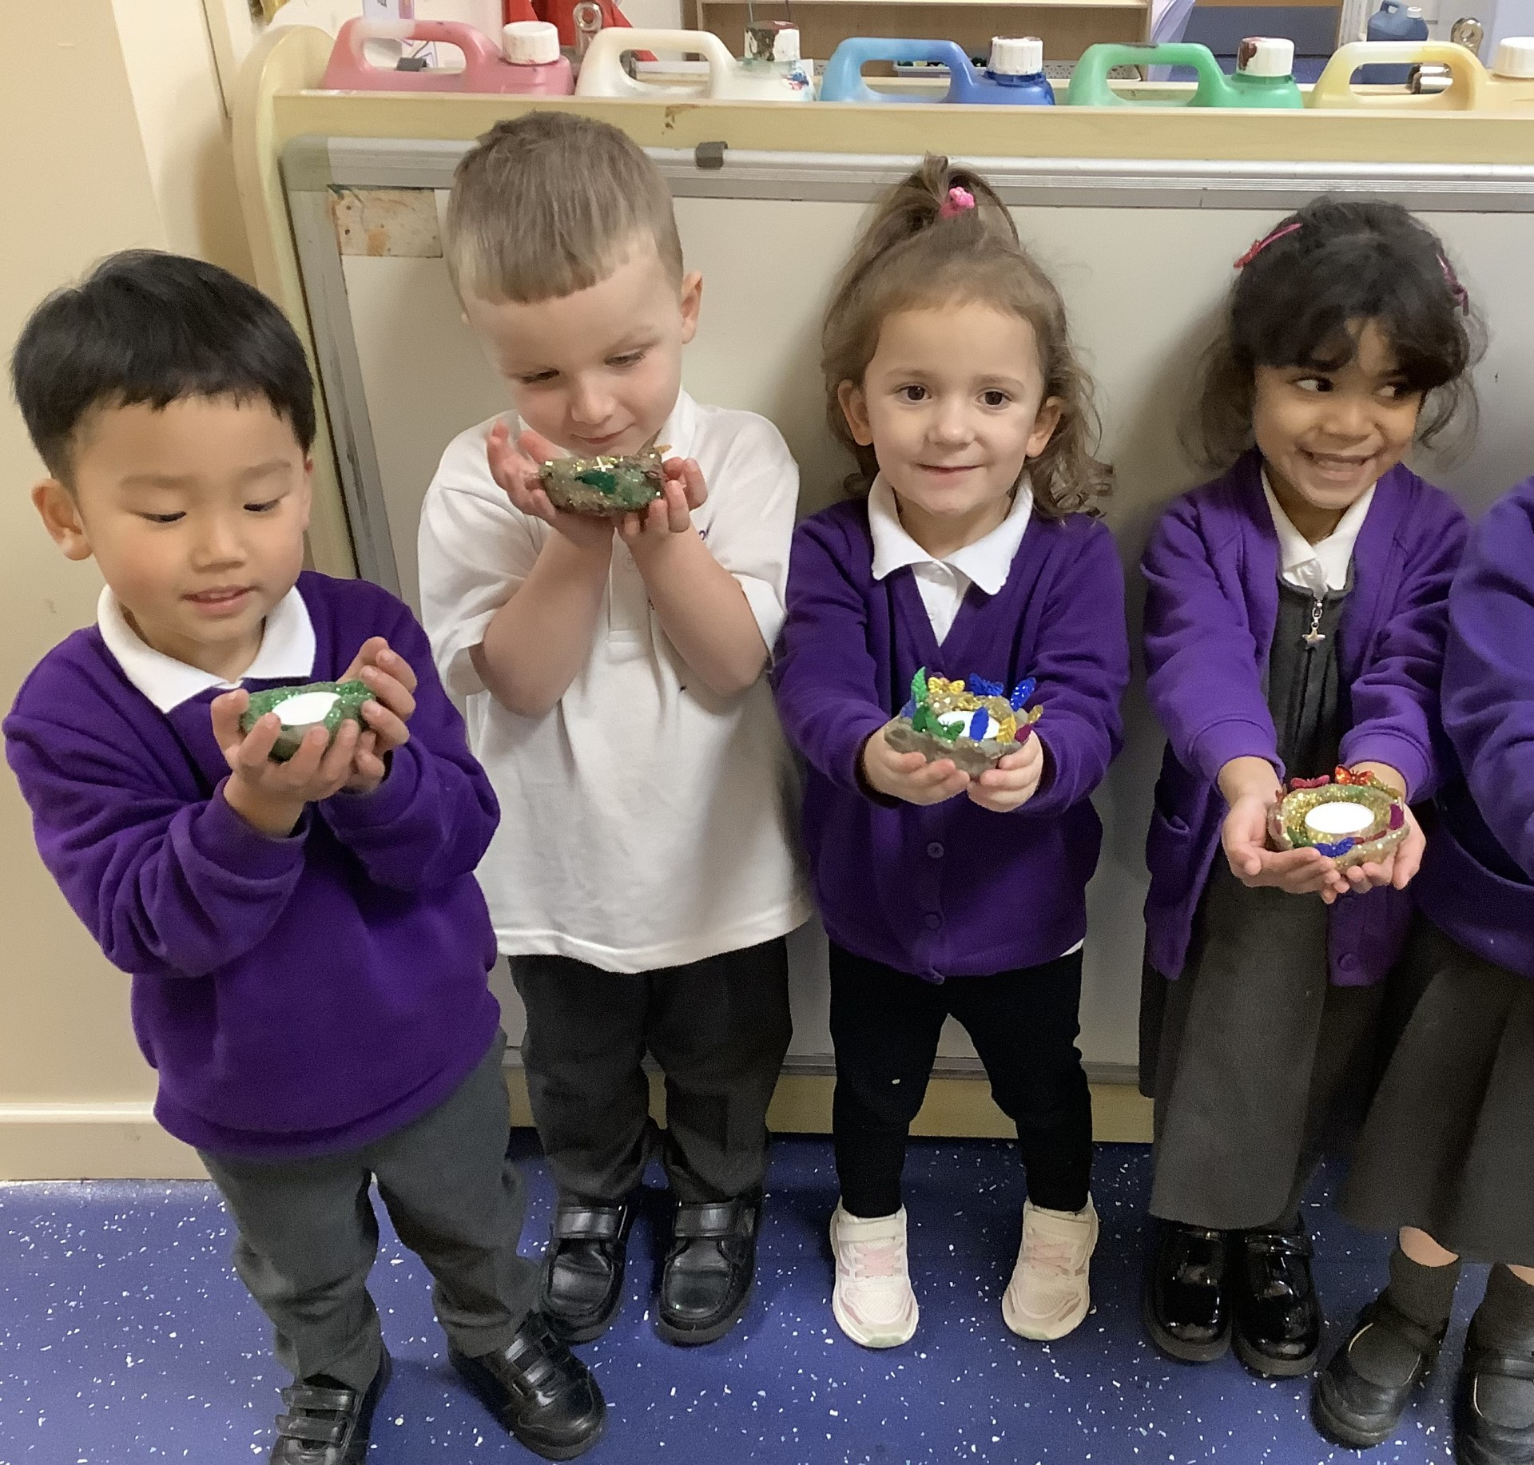
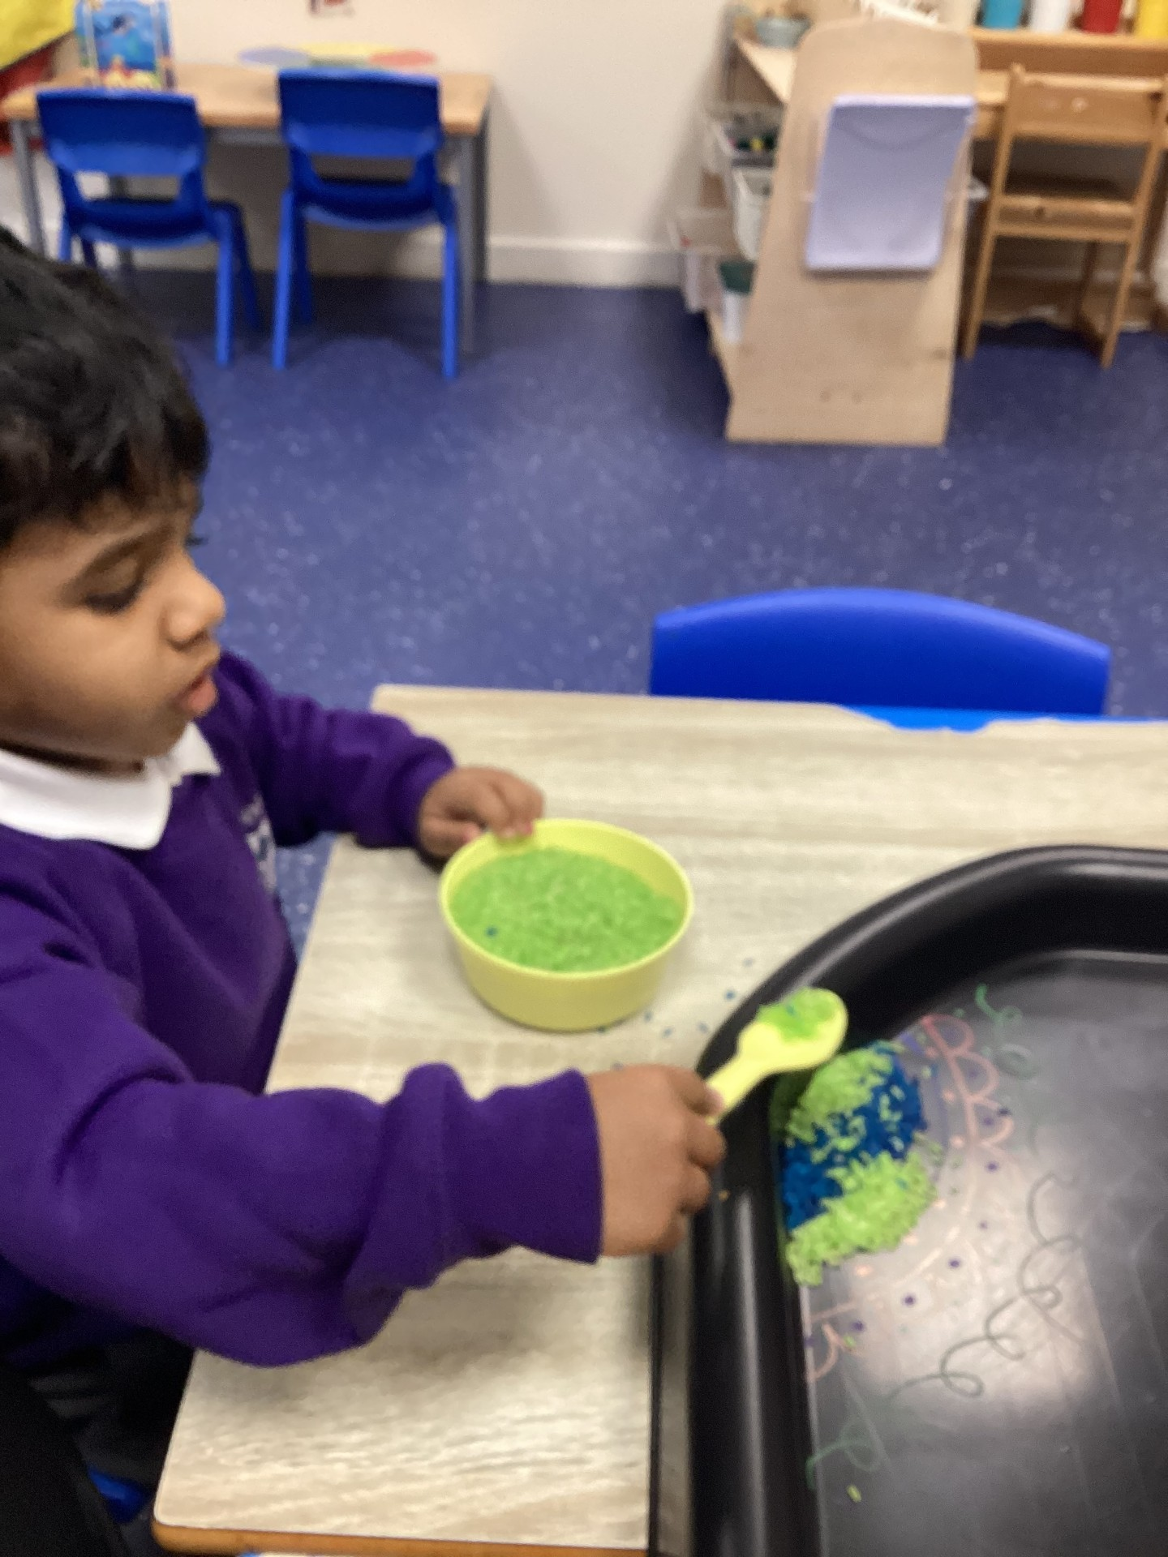
High Quality Work
EYFS
Nursery have explored harvest through making harvest soup. We spoke about the different ingredients and how we cut and chop vegetables and what order we need to put them in the pan. We developed lots of language to describe what the vegetables feel like and look like as well as linking this to the harvest festival.
Mix
Rishaan
“Pasta with sauce and peas”
Hafsa
Stir soup
Leo
Cut celery with knife
Hadi

Slide 26
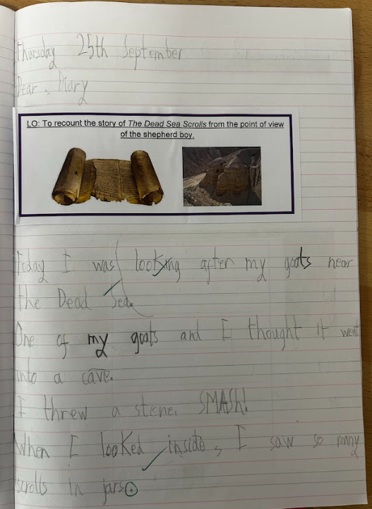
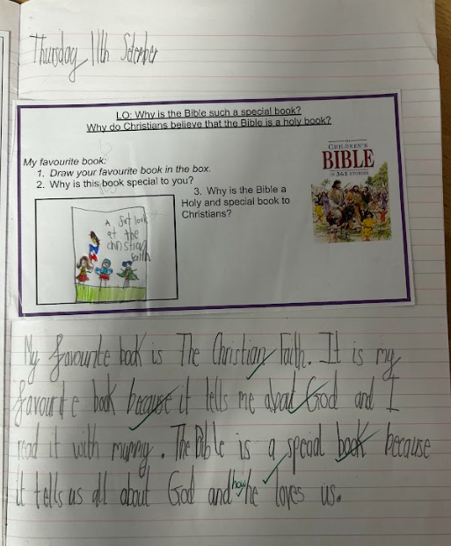
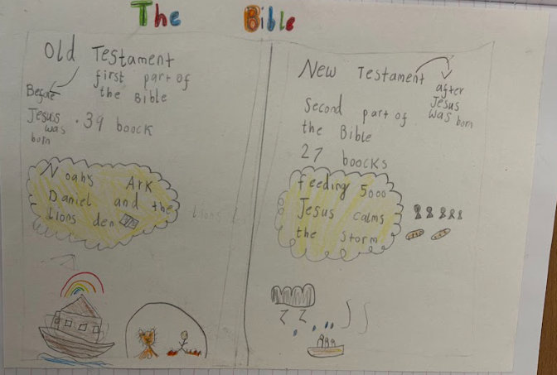
High Quality Work
KS1

Slide 27
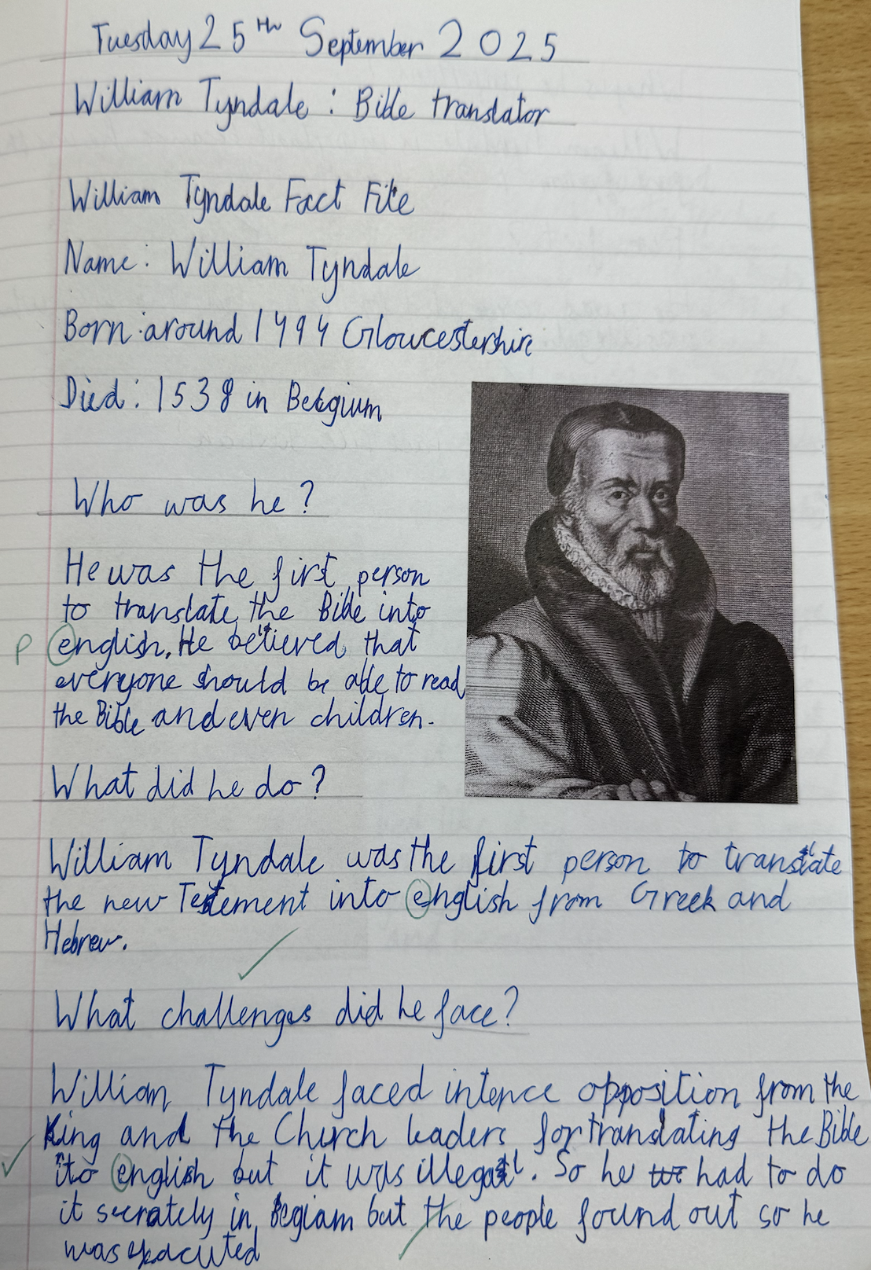
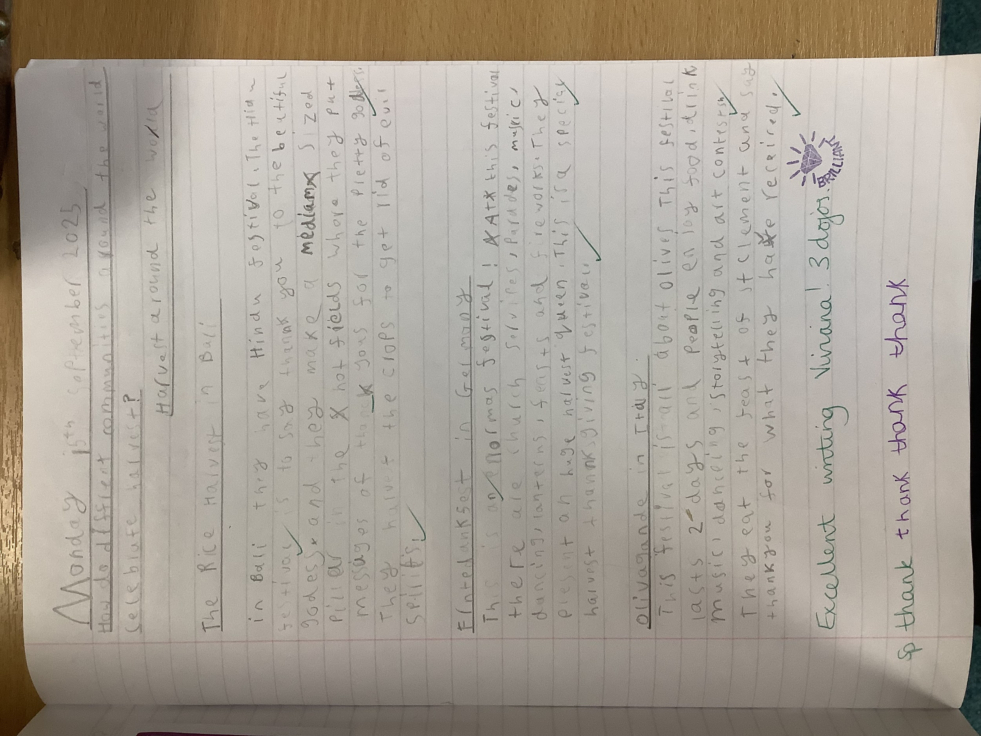
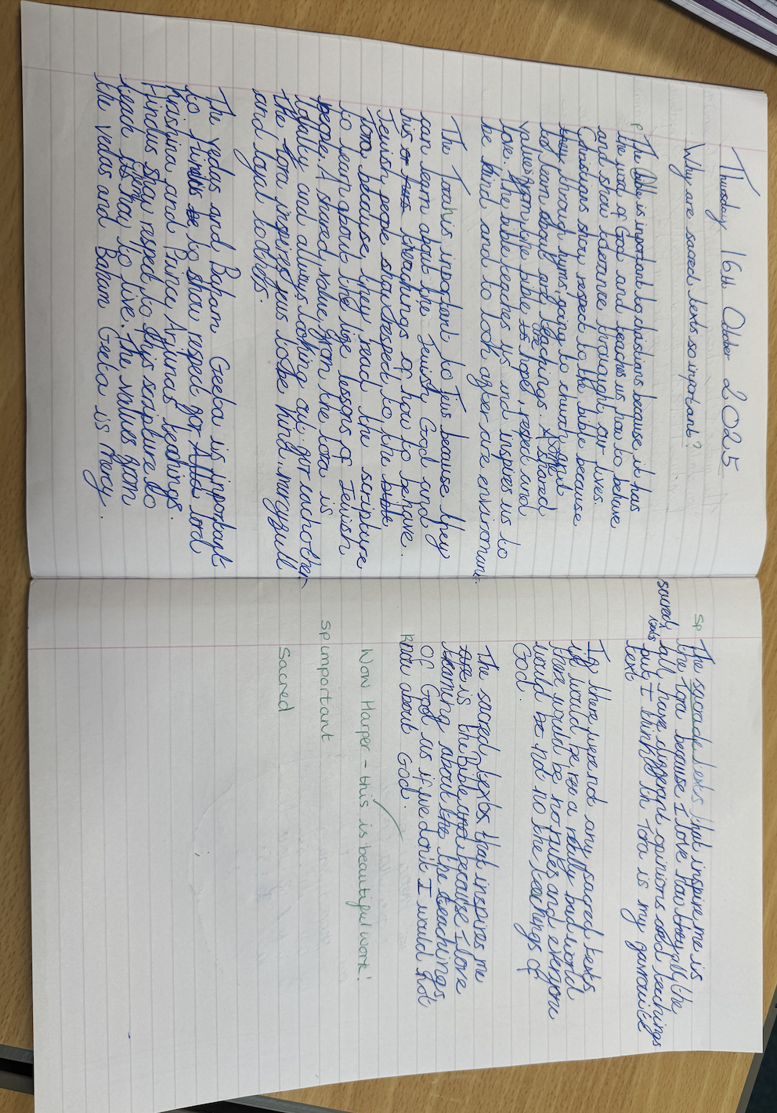
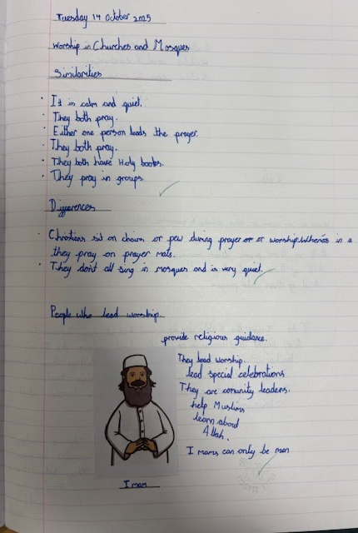
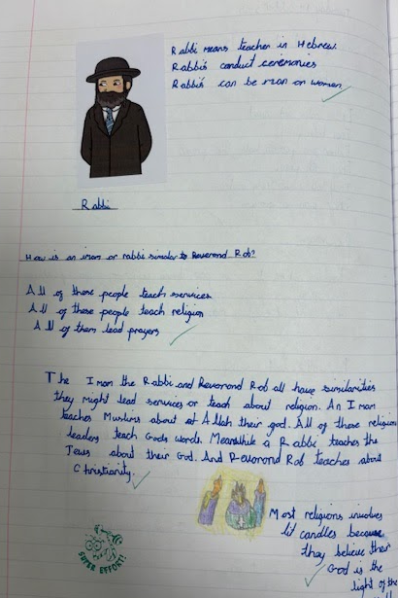
High Quality Work
KS2

Slide 28
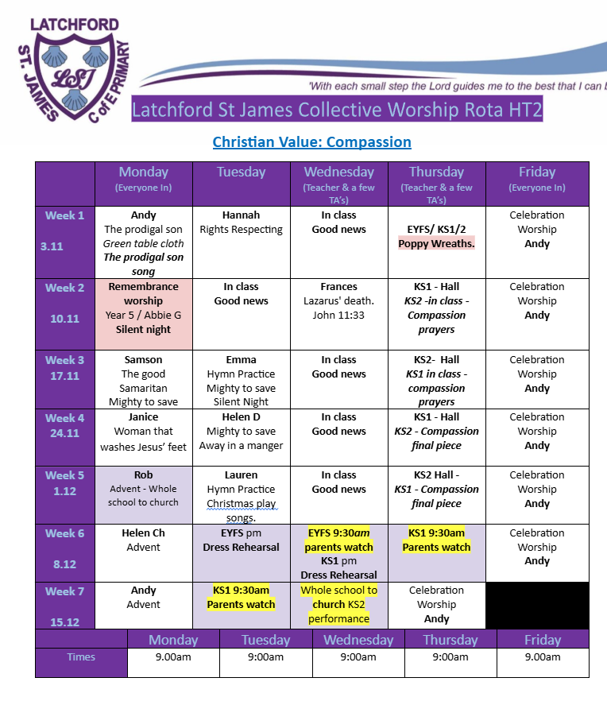
Collective Worship timetable
Monday - SLT/ Gov - Bible story
Tuesday - Hymn practice/ Rights respecting
Wednesday - In class ‘Good News’ oracy discussion time.
Thursday - alternate between KS hall & in class
KS lead lead hall CW in relation to Mondays Bible story)
In class CW links to CV.
Friday - Celebration worship
Rev Rob/ Samson - Church

Slide 29

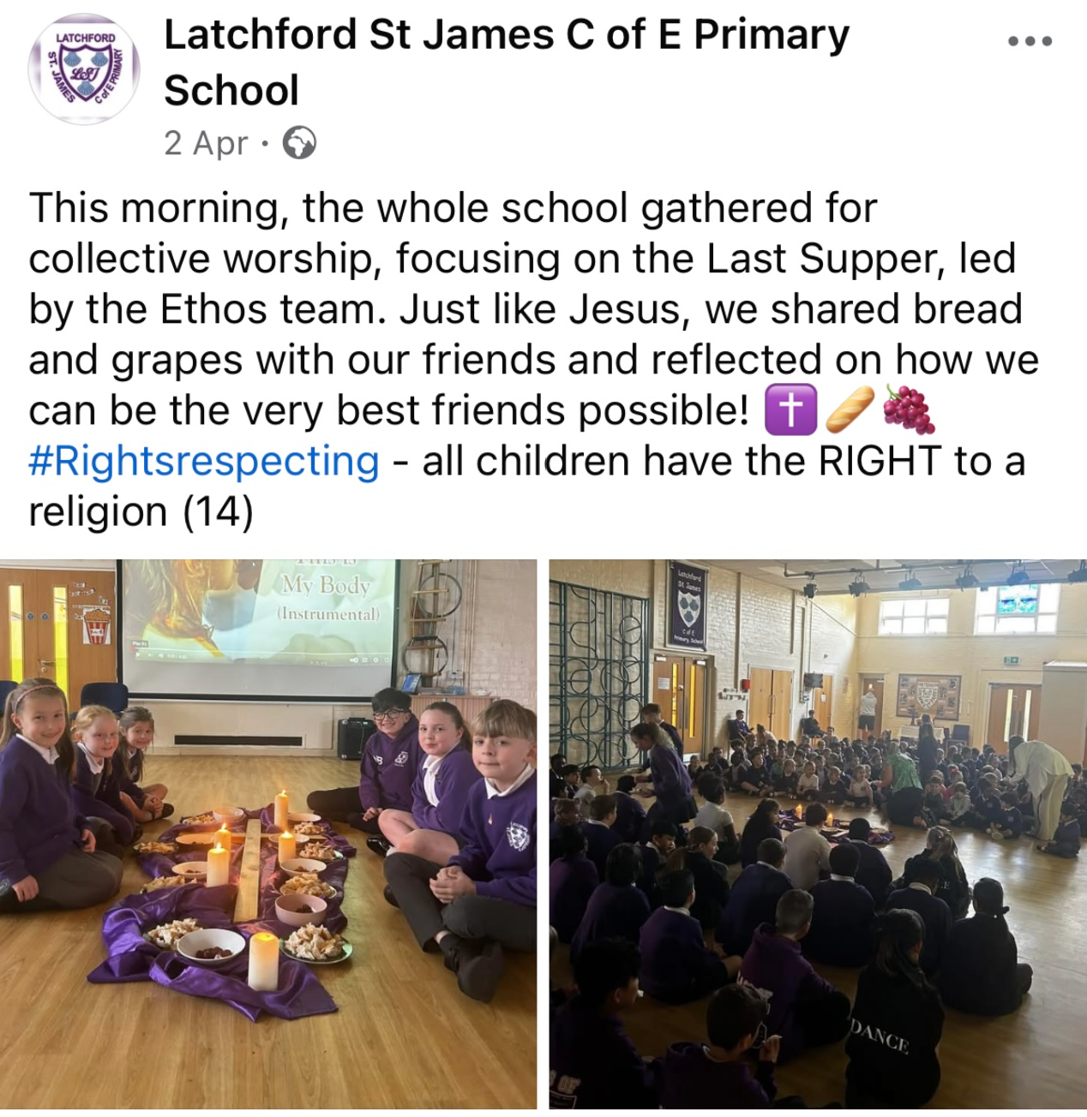
Ethos Team
Active roles:
Opening the doors & welcoming into collective worship.
Ethos team badges to be worn with pride.
3 opening slides of CW (both in class and whole school).
To lead the annual whole school collective worship of Maundy Thursday.
2024/25:
Ethos team 2025/26
Nominated by their class as someone who lives the school christian values.
Year 1: Bernard
Year 2: Kerindu
Year 3: Theodore
Year 4: Eliza
Year 5: Aishat (EAL)
Year 6: Israel (EAL)

Slide 30
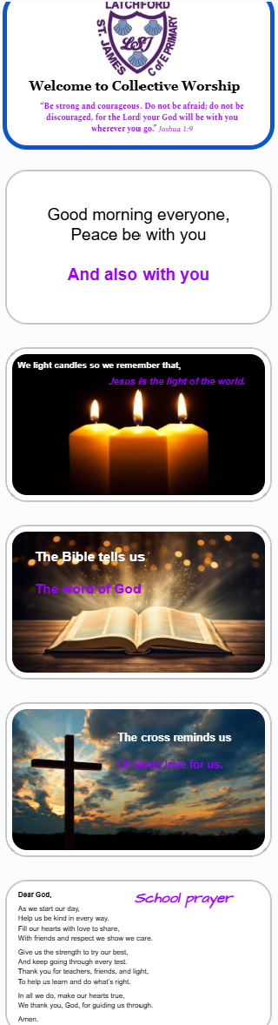
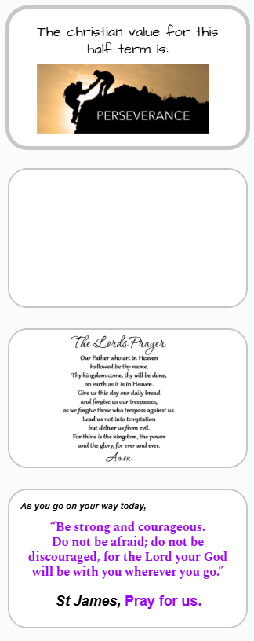
In class
Collective Worship/ Good news oracy discussion.

Slide 31








What opportunities do pupils have to serve others / act for justice?
29.09.25
This morning, the whole school gathered in church to celebrate our Harvest Festival. Pupils shared their creativity through poems, songs and artwork, making it a truly beautiful occasion of thanksgiving. 🍂🍁We are especially grateful to our parents for your generous food donations, which will be given to the foodbank on behalf of LSJ.💜
#Rightsrespecting - all children have the RIGHT to a religion (14) #Rightsrespecting - all children have the RIGHT to have access to adequate food. #rightsrespectingschool
18.10.25
Latchford St James C of E Primary School was recognised through UNICEF UK’s Rights Respecting School programme, which honours schools that place children’s rights at the heart of their ethos and daily practice.

Slide 32

Justice, stewardship, and global issues
Children watch Newsround daily to develop their understanding of the wider world and current events. Helping pupils engage with issues of social justice, global awareness, and moral responsibility, enabling them to reflect on how Christian values and teachings can inform their responses to real-life situations.
18.10.25
Latchford St James C of E Primary School was recognised through UNICEF UK’s Rights Respecting School programme, which honours schools that place children’s rights at the heart of their ethos and daily practice. Achieving Gold - First school in waarrington to achieve this.

Slide 33

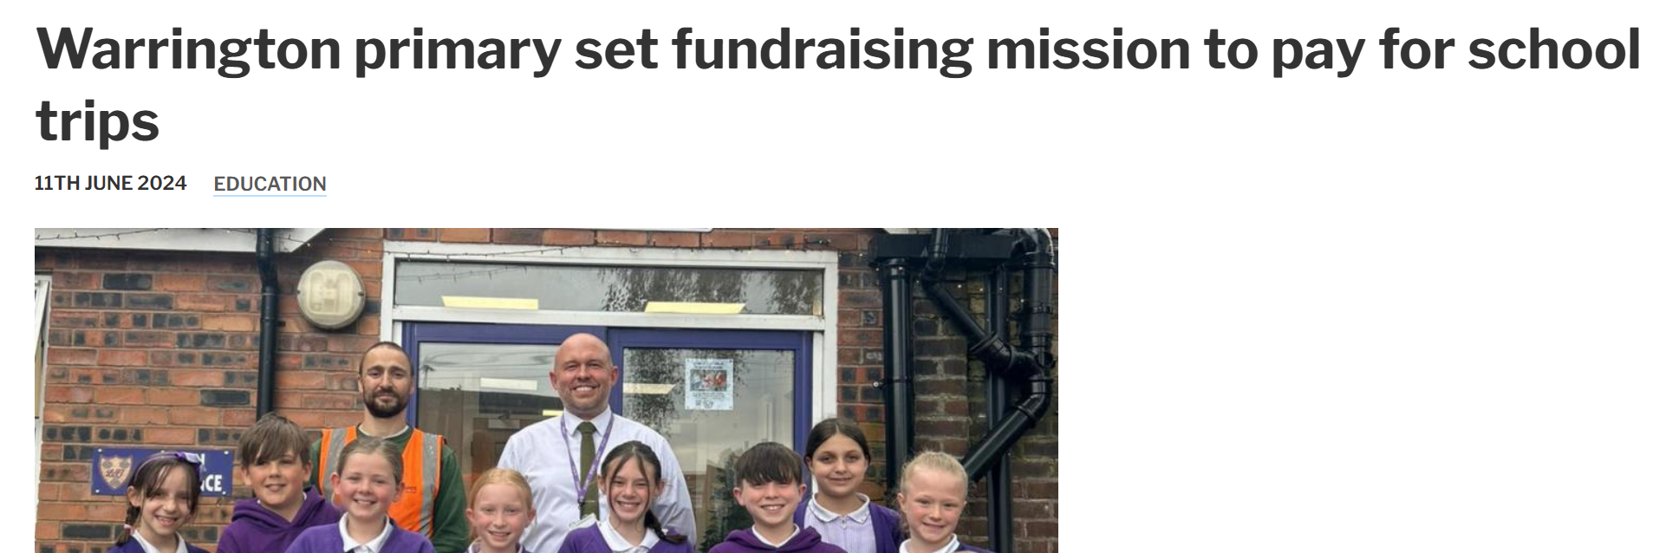

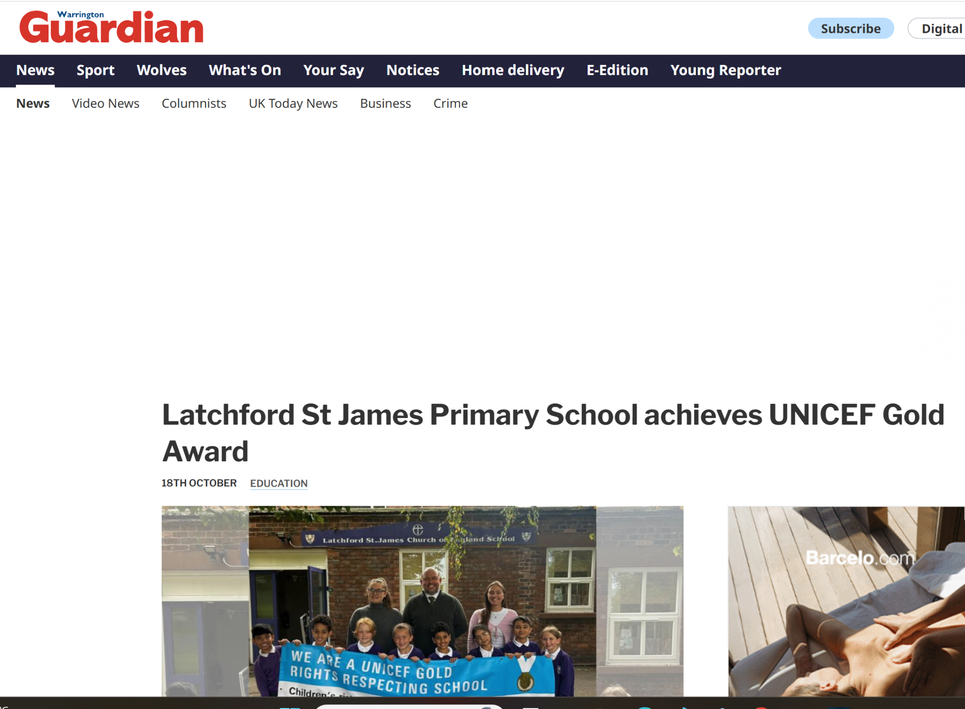
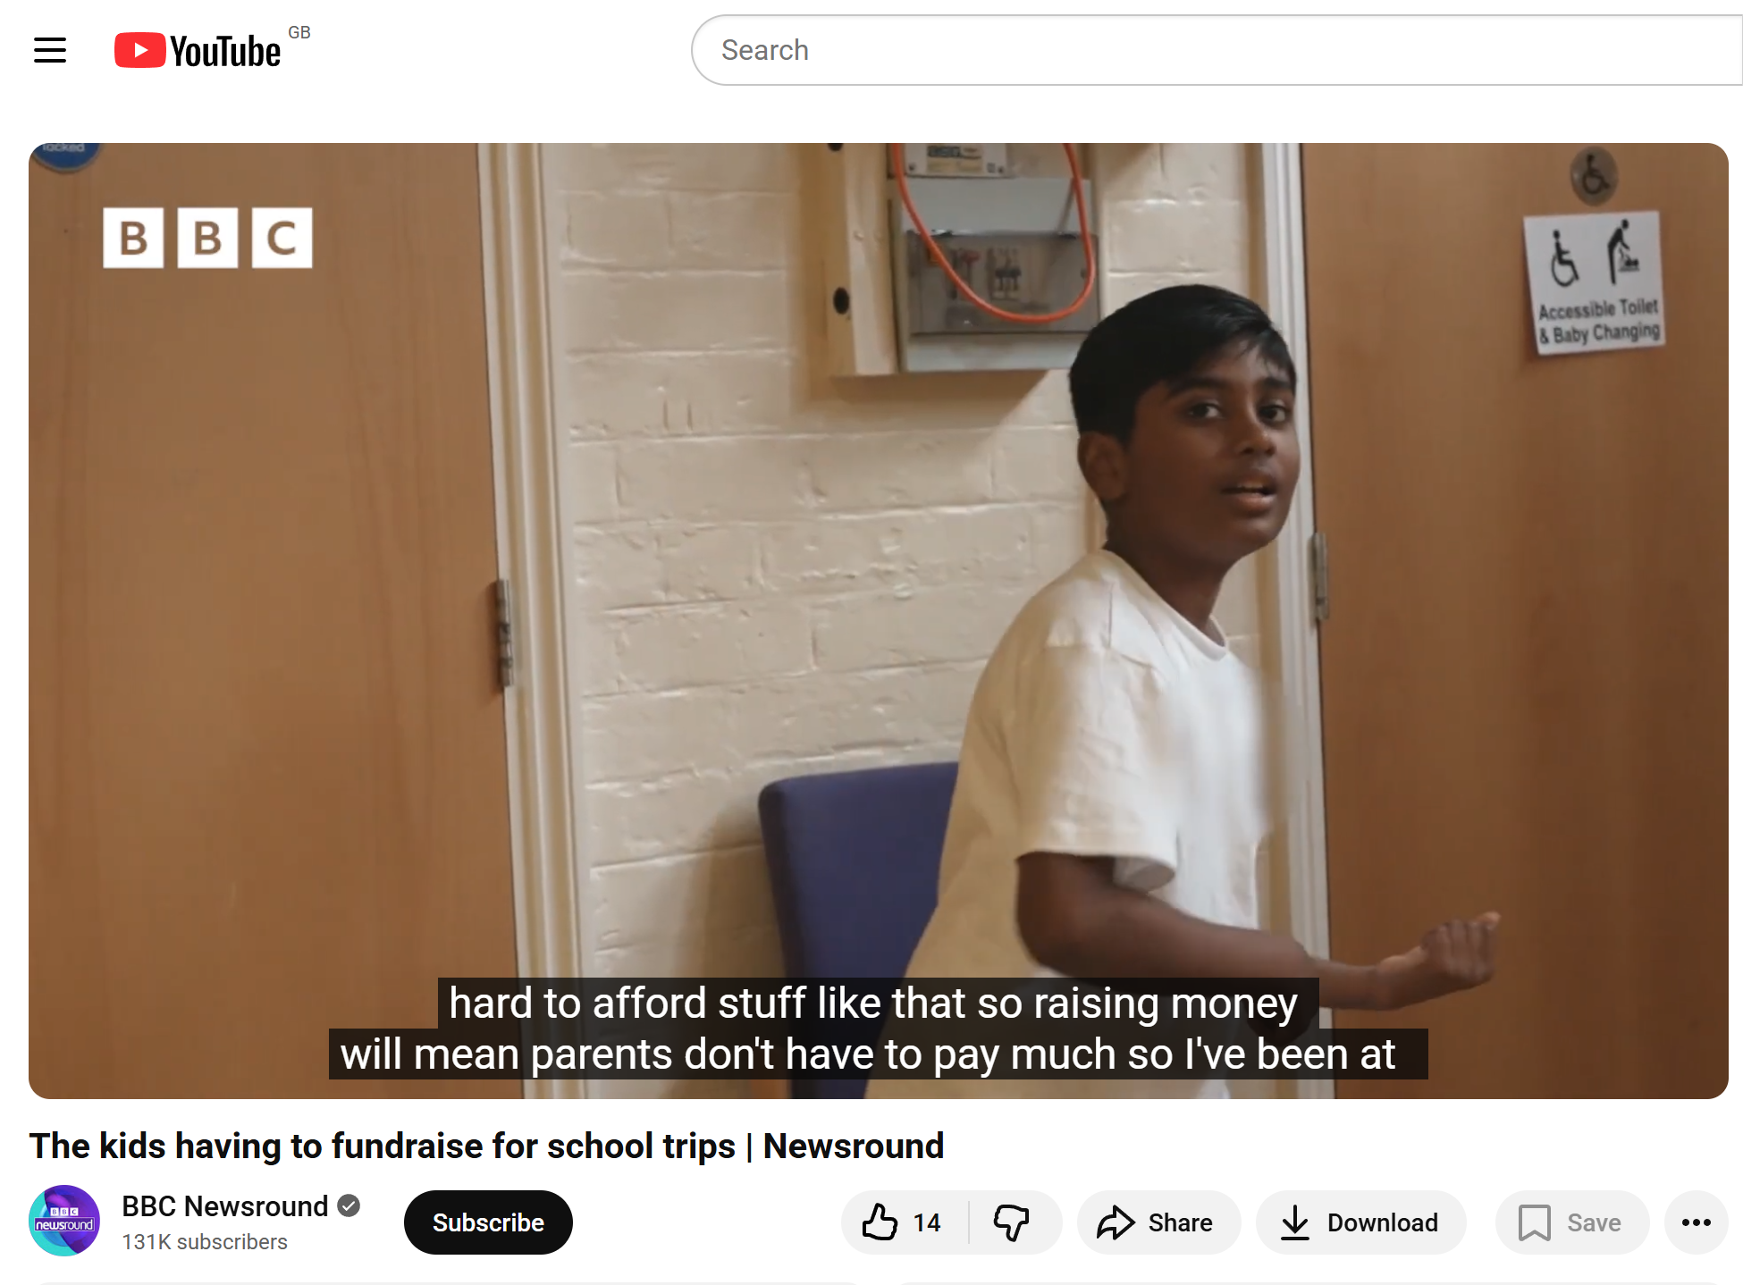

Justice, stewardship, and global issues.
https://chesterdbe.co.uk/news/latchford-st-james-fundraising-activities
https://www.warringtonguardian.co.uk/news/24377017.warrington-primary-set-fundraising-mission-pay-school-trips/
https://www.youtube.com/watch?v=Ca7vxqDFKbI
https://www.warringtonguardian.co.uk/news/25549040.latchford-st-james-primary-school-achieves-unicef-gold-award/

Slide 34
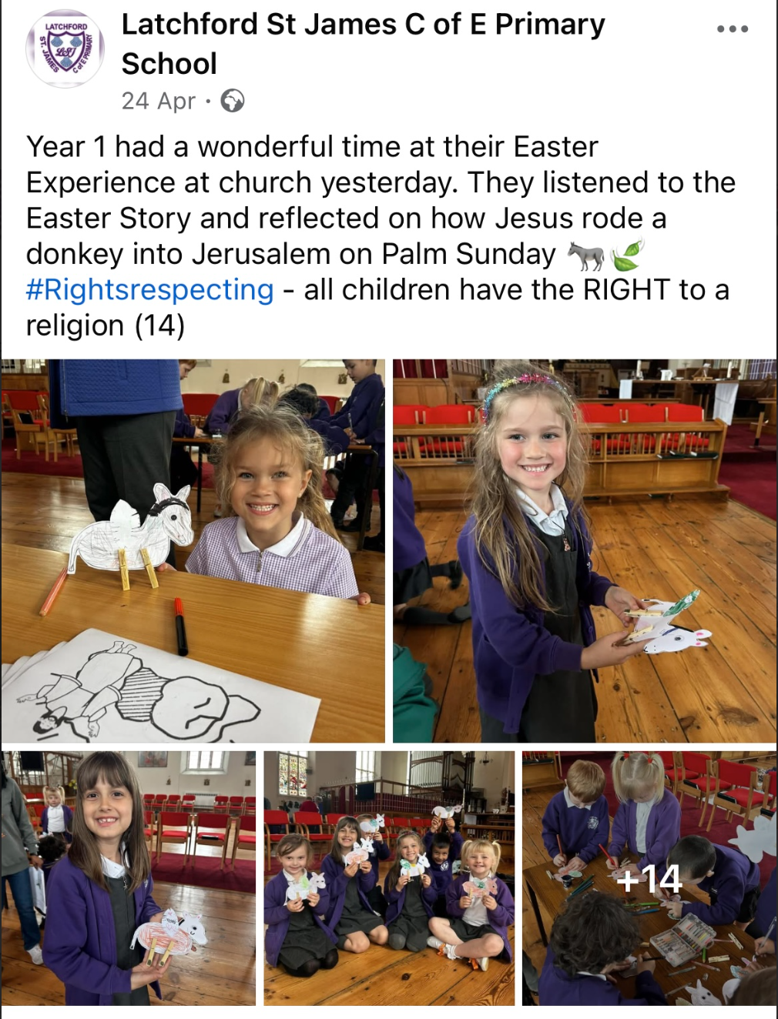
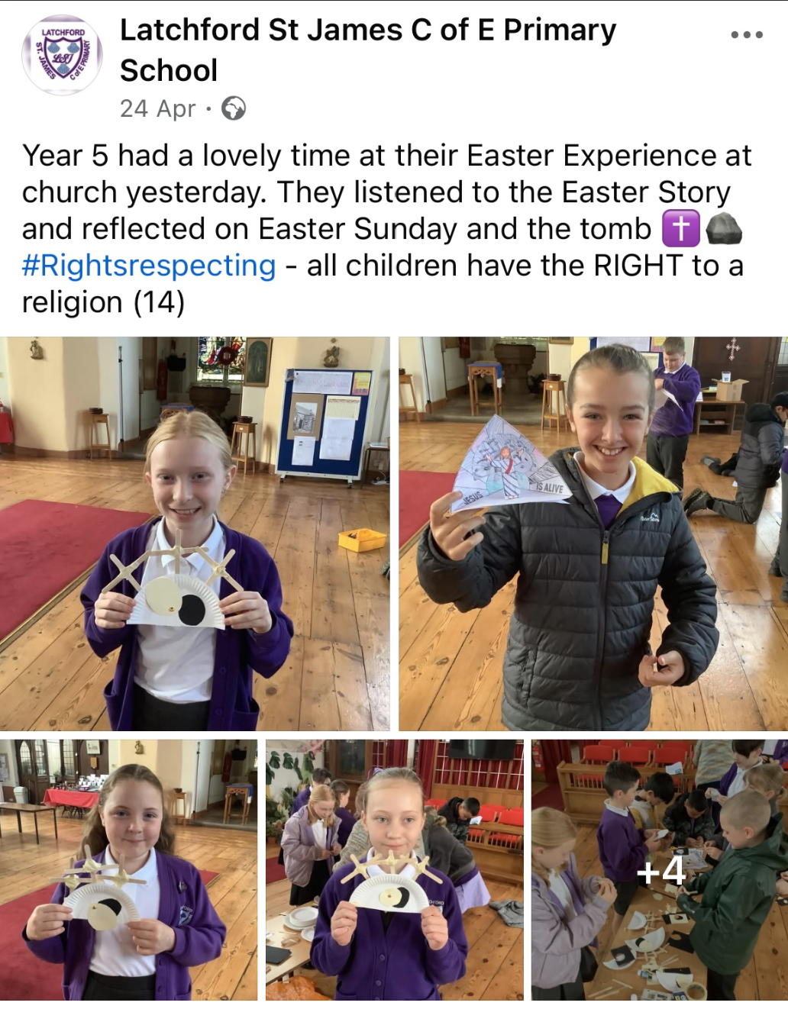
Parish links
Easter Experience 2024/25
Annually, years 1–6 visit St James’ Church for their Easter Experience, exploring the story with the Parish and Vicar through discussion and hands-on activities. Pupils reflected on the meaning of Easter and enjoyed learning in this church setting.

Slide 35
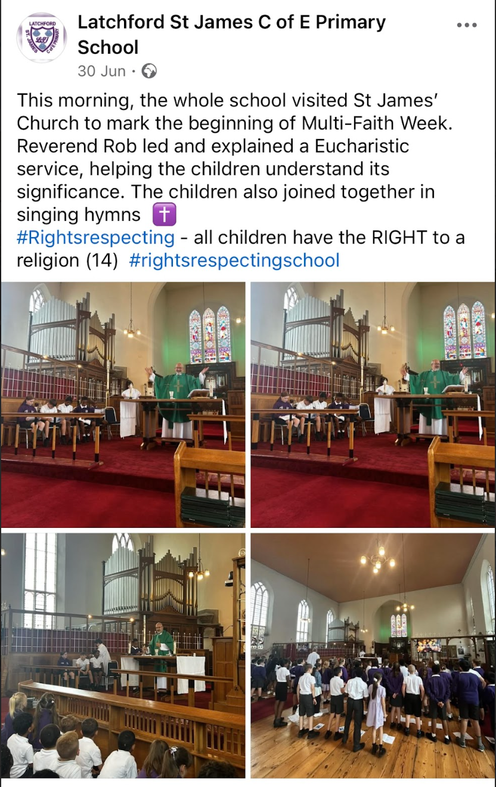
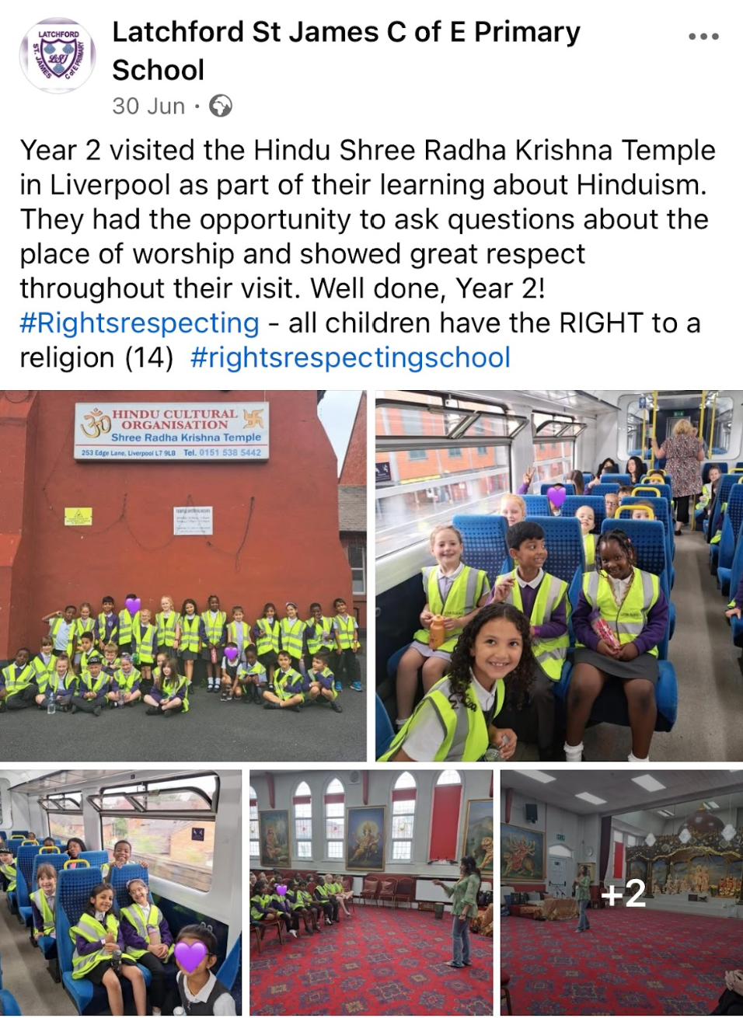
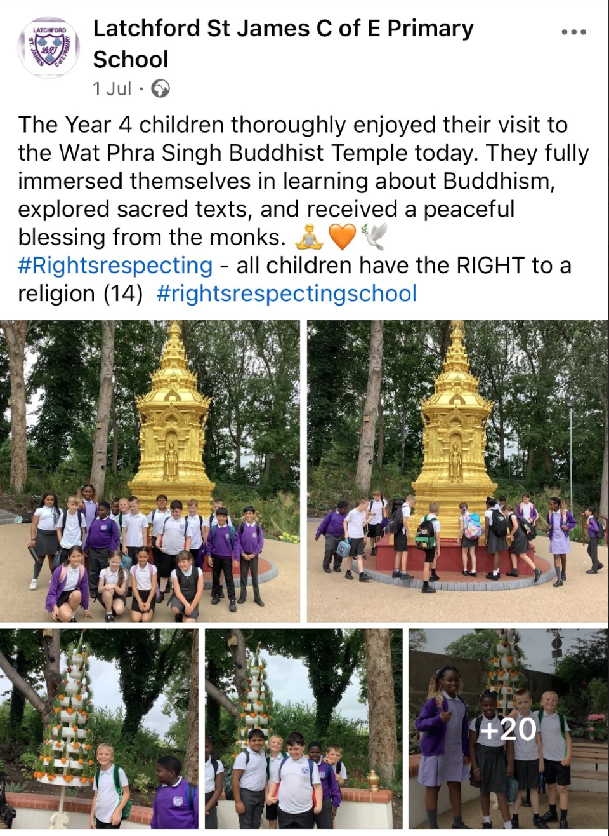
Multi Faith week
2024/ 2025

Slide 36
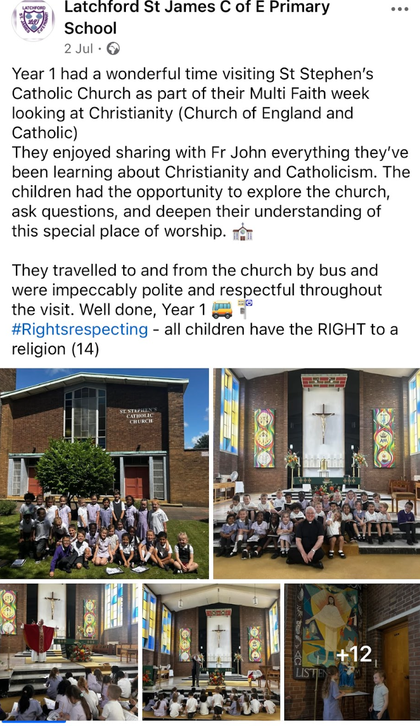



During an RE PDM, teachers contacted local places of worship and organised visits to enhance pupils’ learning and provide opportunities for them to experience first-hand the religion they were studying. Pupils travelled on foot, by bus, and by train. These visits support the RE national curriculum by enabling pupils to: Explore beliefs, teachings, and practices through direct experience, in line with the requirement to study a range of religions and worldviews. Engage with religious communities to develop their understanding of how beliefs are lived out in daily life. Develop skills of enquiry and reflection by observing and questioning, thereby deepening their understanding of the diversity within and between religions.

Slide 37





Nursery acts of random kindness (ARK)
The nursery talked about how they could spread joy and happiness, and their answer was to bake cakes and deliver them to members of staff.

