Slide 2
Teacher: Miss Mellor
Support: Miss Bennet
Sign up to class dojo to contact us!
PPA/ECT
Tuesday afternoon - Mrs Jevans
Thursday afternoon - Mrs Bates

Slide 3
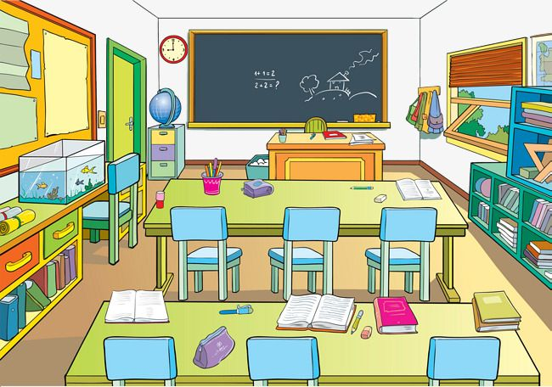
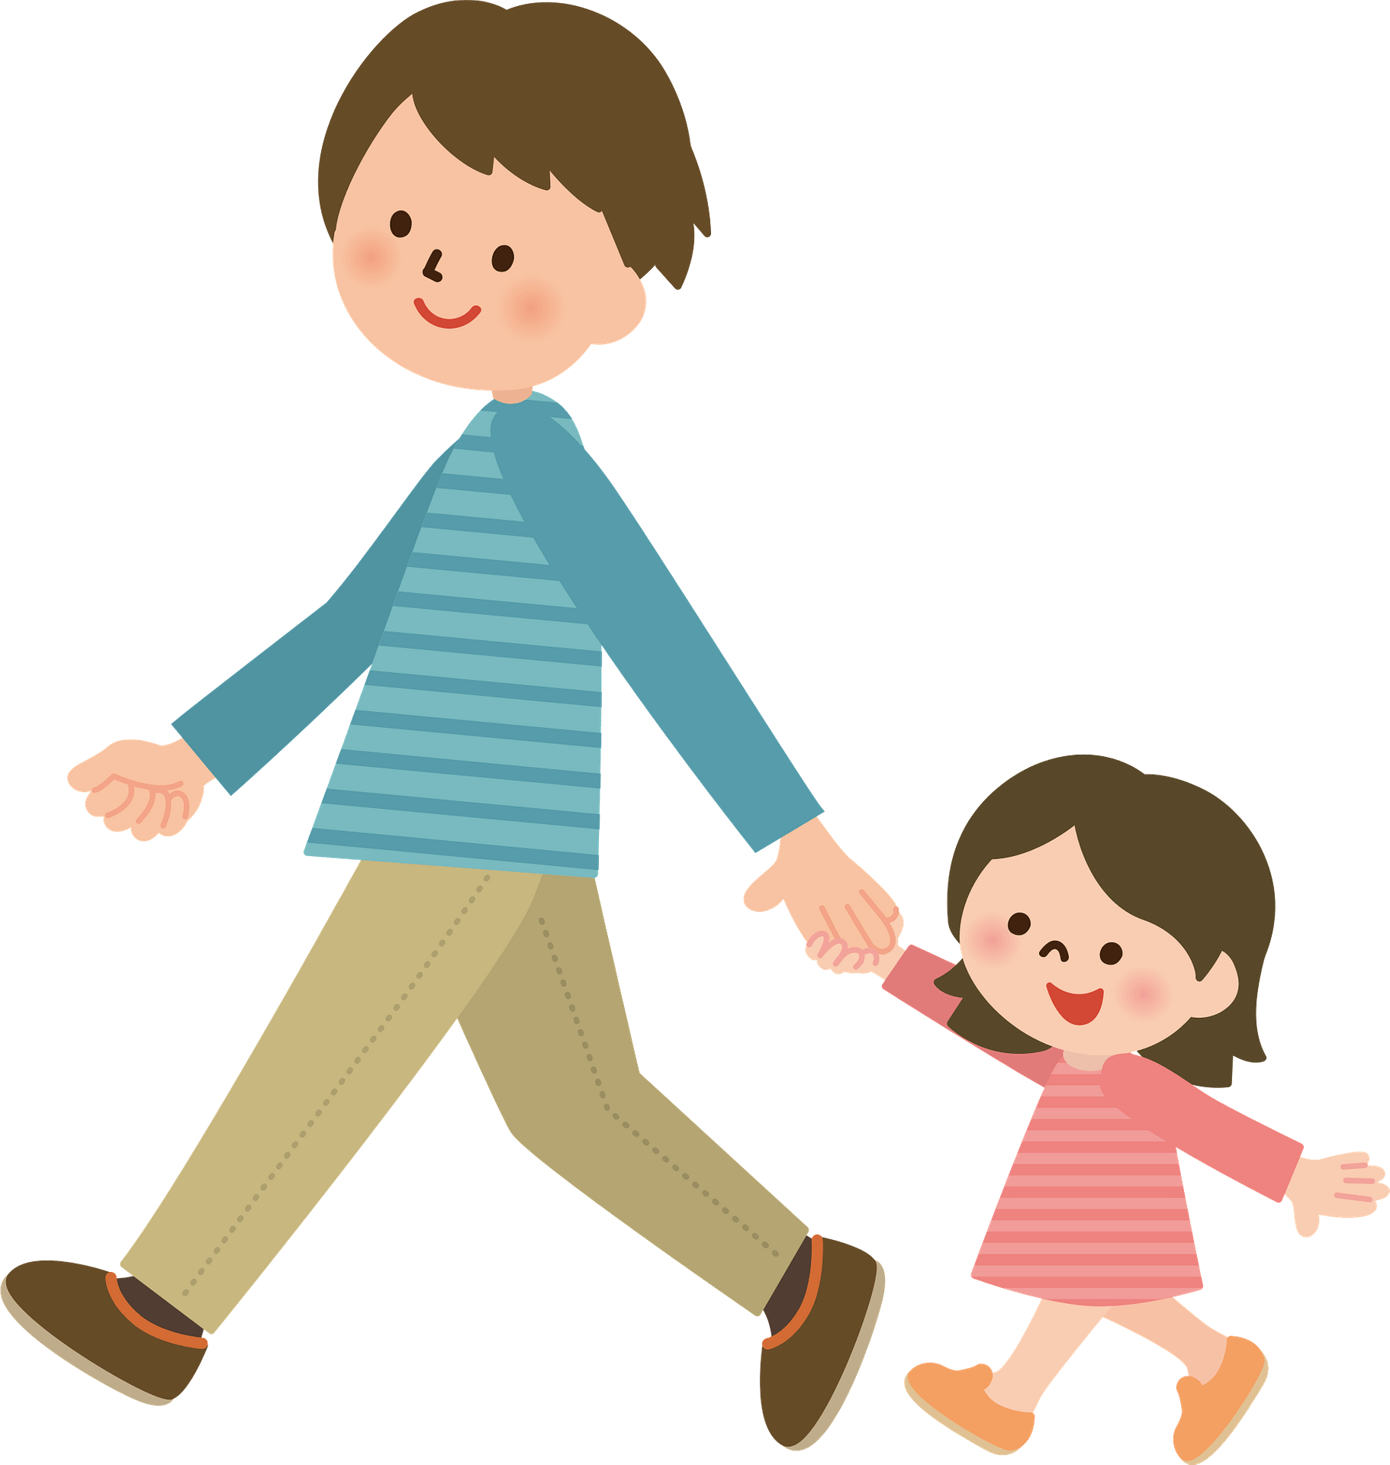
Classroom doors open at 8:50am
Pick up time is 3:20pm
Please ensure you inform the class teacher/ office if your child is being collected by someone else. We are unable to release your child to another adult without this communication.

Slide 4
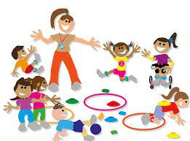
All expectations for uniform, PE kits and other general school information was sent to parents in an email last week.
Most PE sessions will be outside and it's starting to get colder so children will need:
Navy/ black tracksuit bottoms
Jumper
PE days:
Monday and Friday afternoons

Slide 5
Dojos are given and we have a weekly award of taking Pebbles home.
Certificates available:
Always club
&
Learner of the week
Parents of the children will be invited to attend assembly on Friday morning.

Slide 6
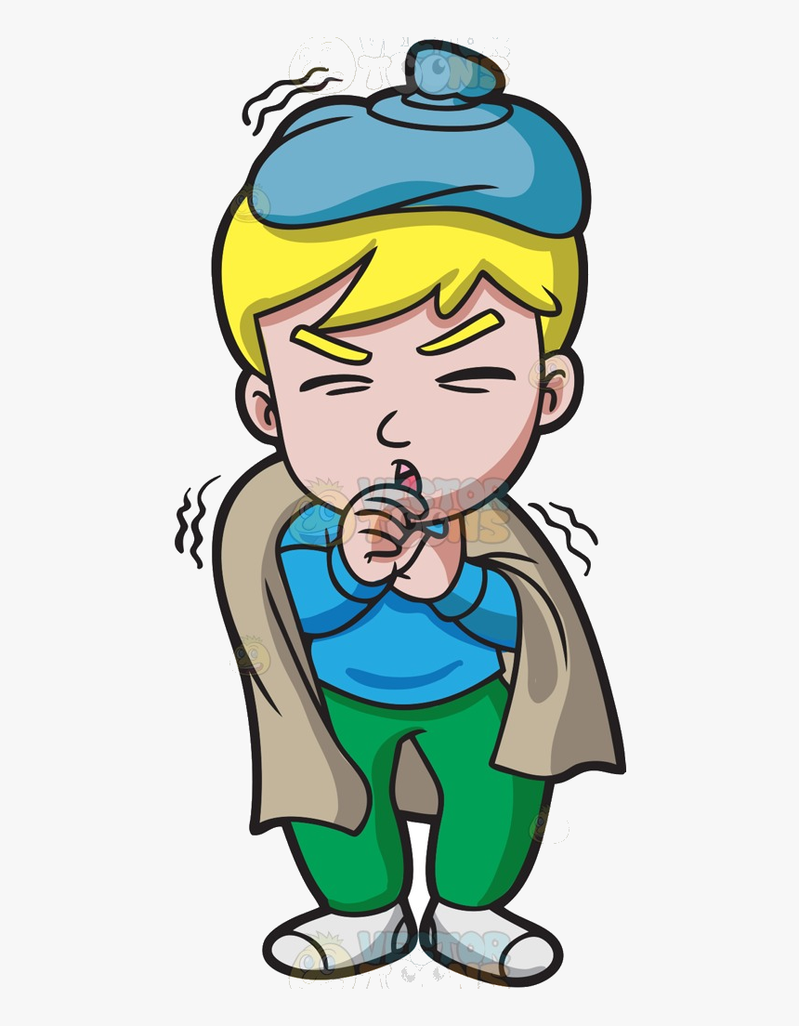
Playtime is 10:30 am -10:45 am
Lunch time is 12:30 pm - 1:15 pm
Children need everyday:
Water bottle
Lunch (unless school dinner)
Reading book.
Prescribed medicines to be taken to the office.
If your child is ill, you must communicate this to the school office- you can leave a voicemail message.
01925 634 967

Slide 7
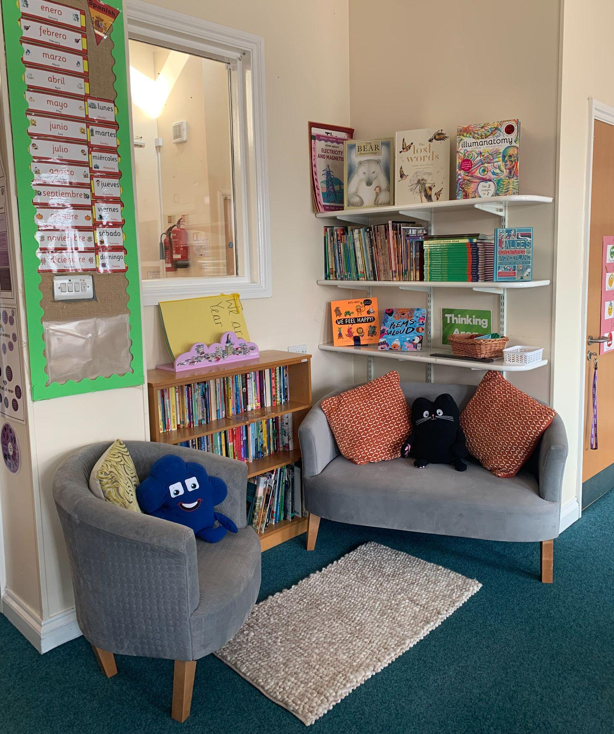
Please ensure your child reads at home for 20 minutes at least, 3 times per week– record on Boomreader (log in details).
They should all have a reading book which they bring in each day and take home each evening (this will be kept with their belongings at all times and not shared with others)
Children have been assessed to make sure they have the most appropriate book band.

Slide 8
Fostering a pleasure for reading – it all adds up!
Children who enjoy reading are three times more likely to have good mental wellbeing than children who don’t enjoy it
Children who read books often gain higher results in maths, vocabulary and spelling

Slide 9
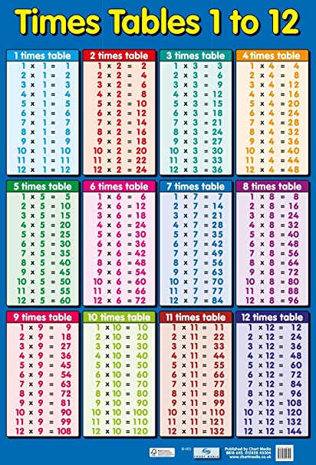
All children will be required to know all 12 times tables in year 4 so let’s get ahead of the game!
We will be practicing throughout the year to improve confidence and homework to learn times tables will be sent out.
Please encourage TT-Rockstars at home.

Slide 10
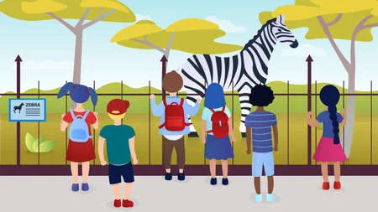
Romans trip to chester
Fantastically great women who changed the world - theatre
Yet to confirm 1 or 2 more…

Slide 12
