Slide 1
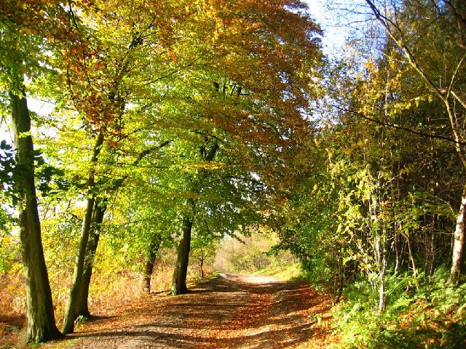
Foxhowl 2023

Slide 2
Staffing
Miss Lea, Miss Bates and Mrs Forshaw are attending and staying overnight with the children.

Slide 3
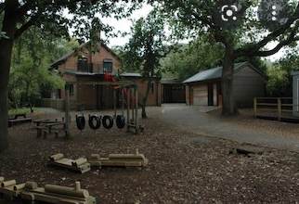
About The Centre
Originally known as Foxhowl, the building used to be a Youth Hostel and it is well known for its homely appeal. 
Available within the grounds is a well established nature pond.
Security: The centre site is fully secure with boundary fencing and coded accommodation access.
Notes:
1066 is the code
Set up campfire while playing outside
Ask where firelighters are?

Slide 4
There is safe access to Delamere Forest where children can participate in activities such as orienteering, den building, survival skills, stream dipping, environmental games, forest art and walks which study animal habitats and the different flora and fauna of the forest.
Children as young as reception age to older juniors visit Conway Centres: Delamere for what may be their first stay away from home.
Notes:
1066 is the code
Set up campfire while playing outside
Ask where firelighters are?

Slide 5
The purpose of our visit is to link to our Science learning ‘Living Things and Their Habitats’.
We are learning about habitats, micro-habitats and what living things need to survive in their habitats.
Foxhowl provides a fantastic opportunity to explore some different living things and their habitats, whilst also developing our team-building skills.
Notes:
1066 is the code
Set up campfire while playing outside
Ask where firelighters are?

Slide 6
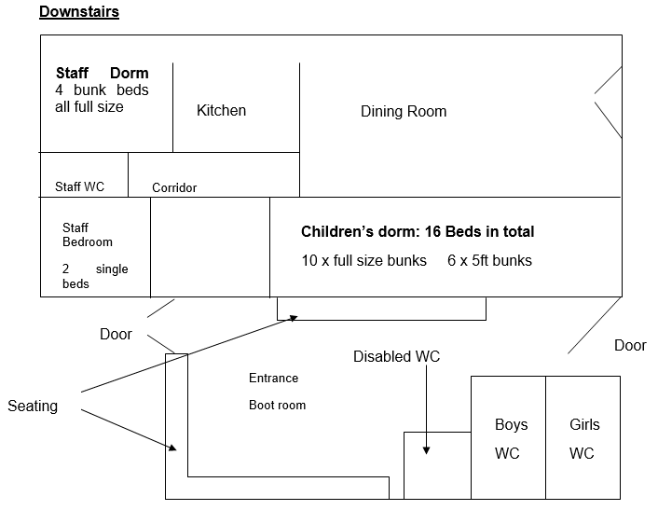
Notes:
1066 is the code
Set up campfire while playing outside
Ask where firelighters are?

Slide 7
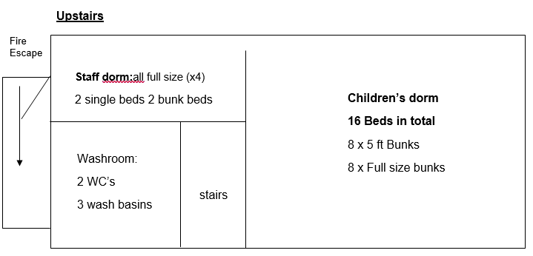
Notes:
1066 is the code
Set up campfire while playing outside
Ask where firelighters are?

Slide 8
The Bedrooms - Boys

Slide 9
The Bedrooms - Girls
Notes:
Take flip flops for shower

Slide 10
Dining Room

Slide 11
Food Hatch

Slide 12
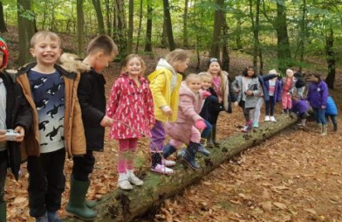
Day 1
Arrive at school at 8:30 – must be in wellies!
9:00 Leave school
9:45 Arrive at Fox Howl
10:00 Have snack and leave bags in centre
10:30 – Pond dipping / Stream walking
11:30 - Health and Safety talk
12:30 Lunch – packed lunch in the centre* Please inform us if you would like a school packed lunch to be provided
1:30 Den building
3:30 Walk around the forest, exploring different habitats and looking for mini-beasts
5:30 Evening meal in the centre
6:15 Play outside
7:00 Campfire and toasted marshmallows
8:00 Prepare for bed
Notes:
1066 is the code
Set up campfire while playing outside
Ask where firelighters are?

Slide 13
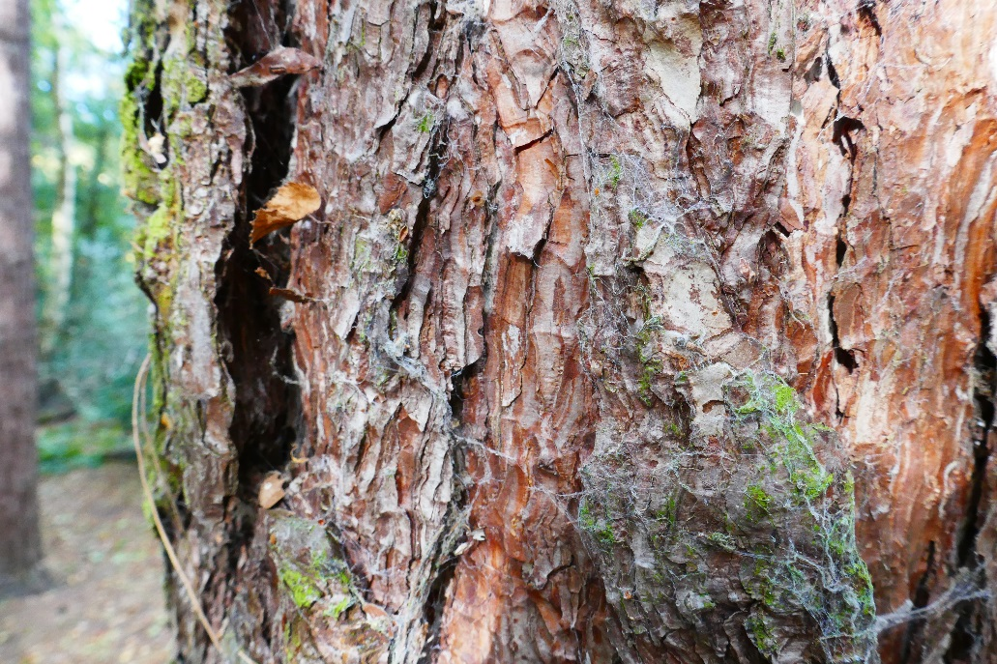
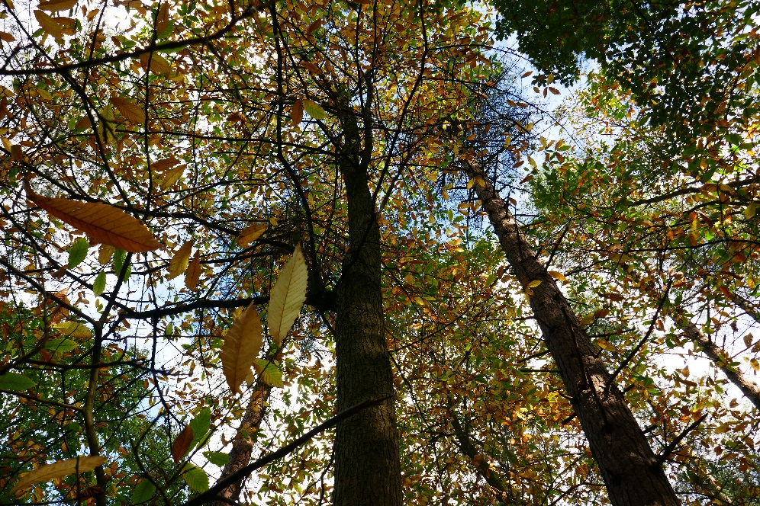
Looking for signs of animals…

Slide 14
Stream Walking

Slide 15
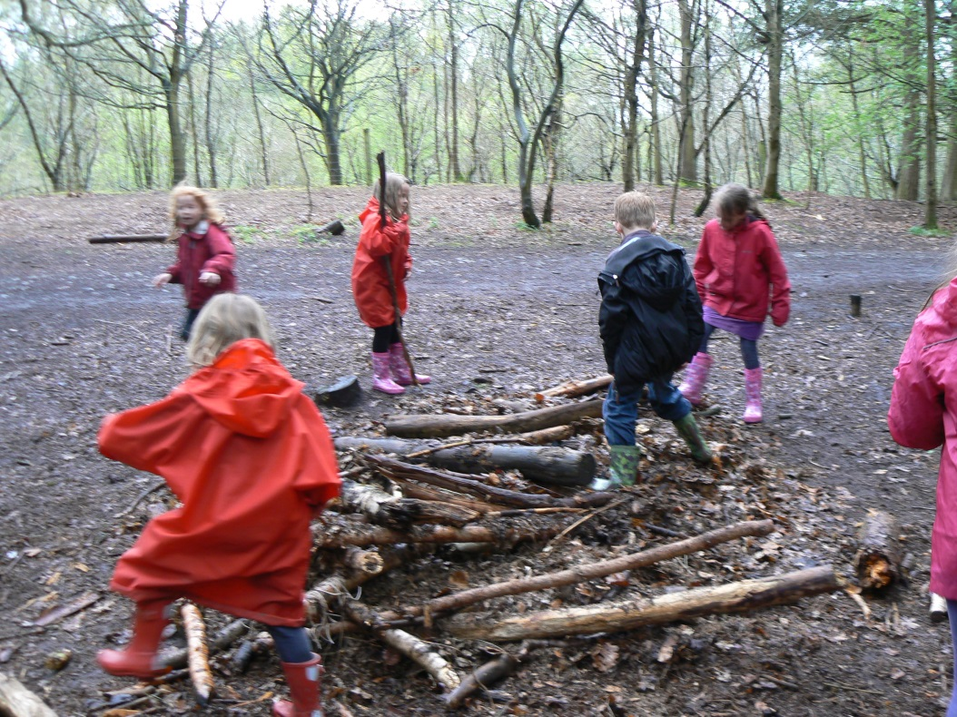
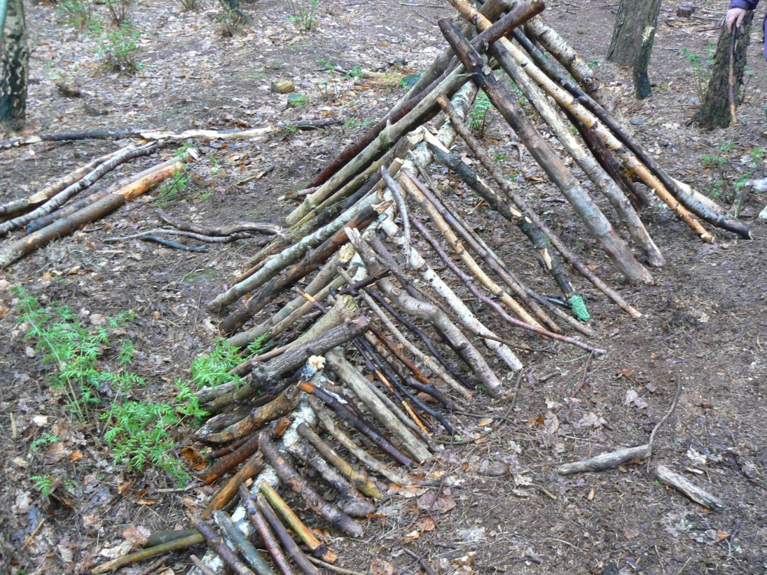
Den Building

Slide 16
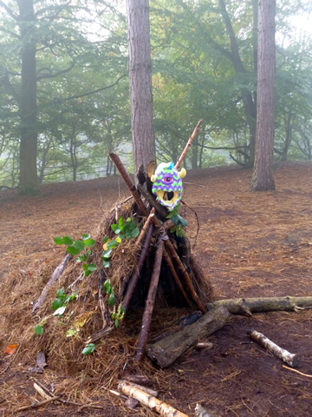
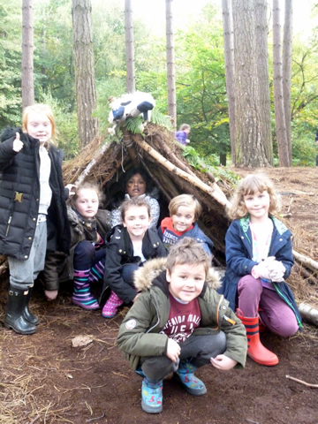
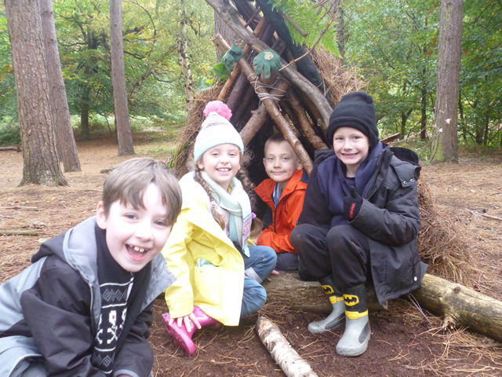
The Finished Den

Slide 17
Day 2
7:00-7:30 wake up!
8:00 Breakfast
9:00 Prepare everything for home
9:15 Forest art and forest games
12:00 Lunch
1:00 Depart for school
2:00 Arrive at school – children should be collected early

Slide 18
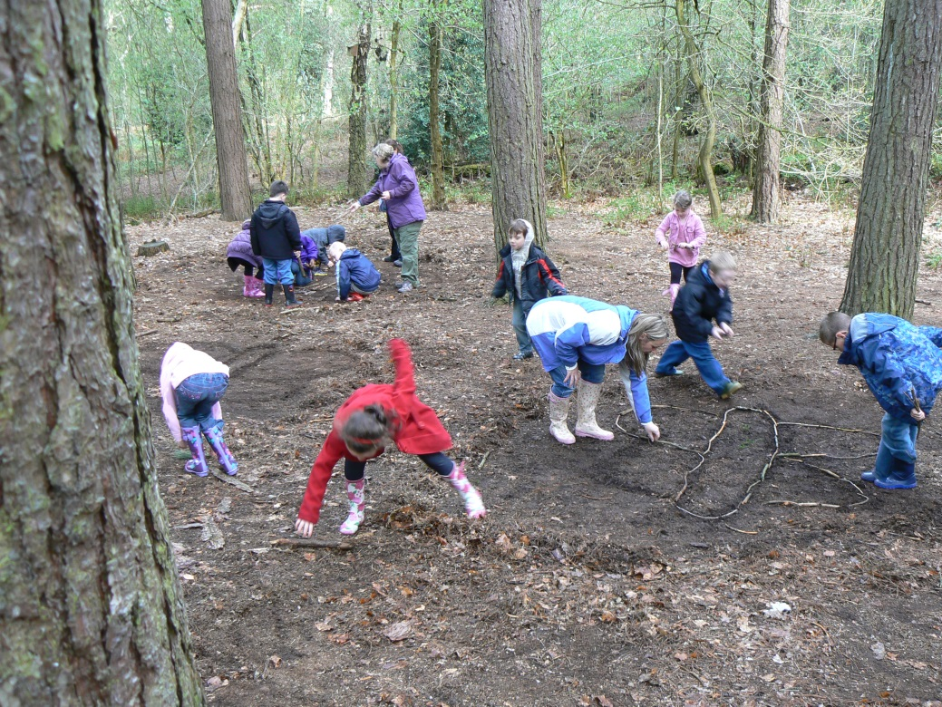
Forest Art

Slide 19
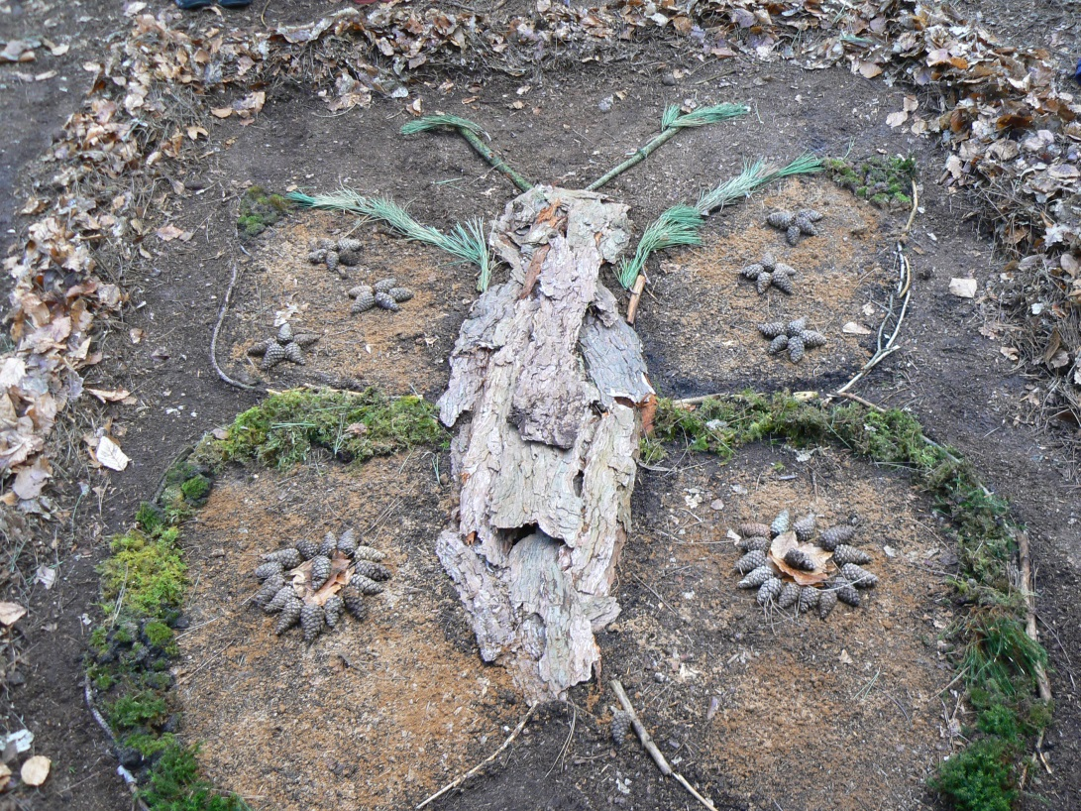
Forest Art

Slide 20
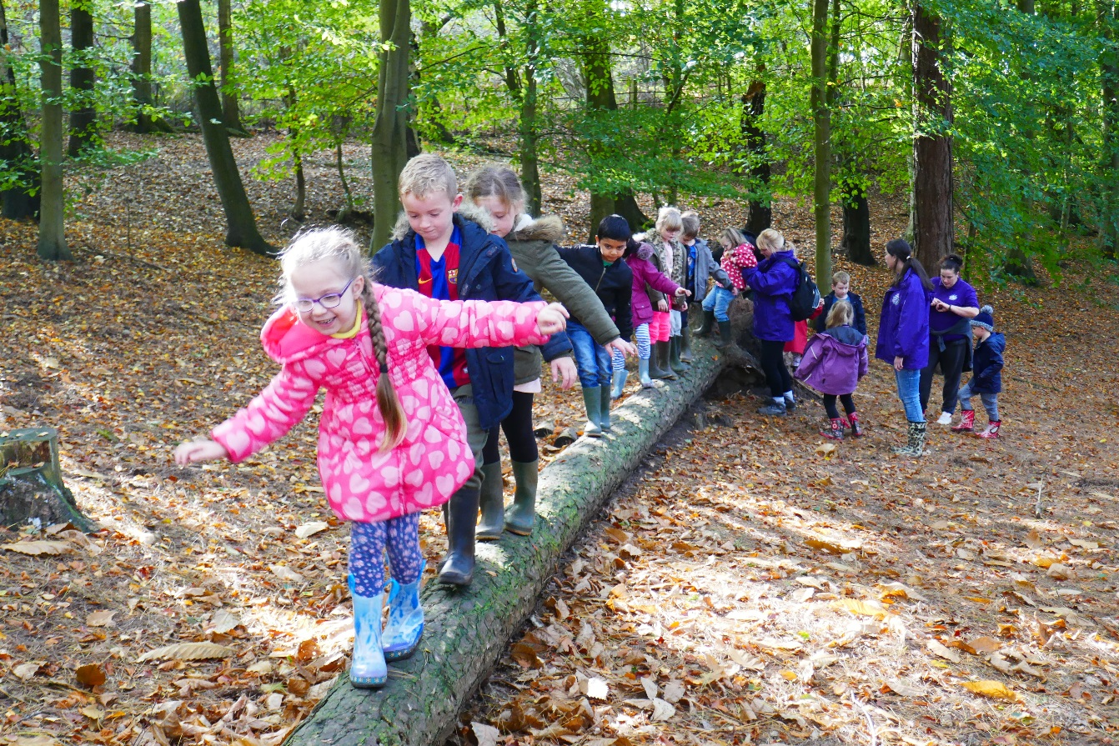
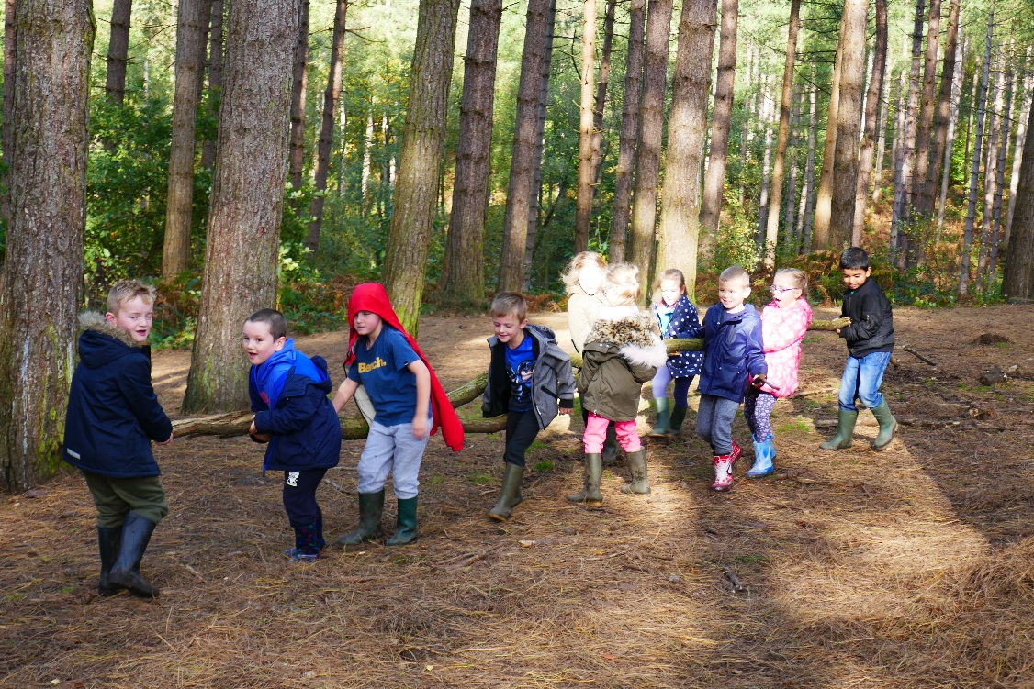
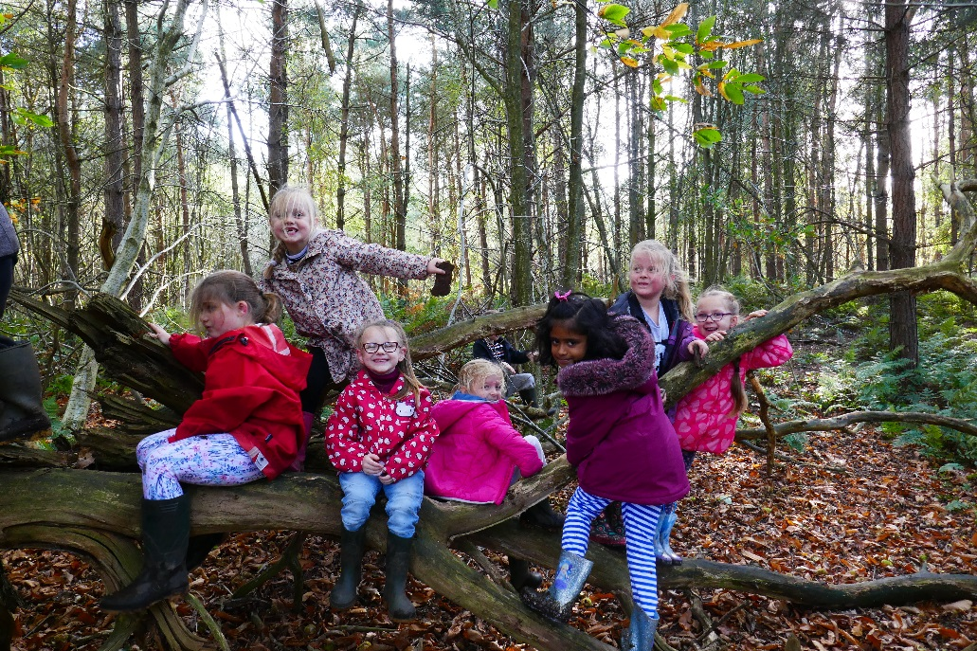

Slide 21
The Day We Leave
Children need to come to school wearing:
- Warm clothes that are not new and can get dirty
- Layers of t-shirts and jumpers/sweatshirts
- A warm coat, *hat and gloves
- Warm trousers such as joggers (not jeans)
- Wellies
They will also need:
-Rucksack with their packed lunch in a carrier bag and a small overnight bag that children can carry themselves (full kit list available to take home today)

Slide 22
Please no electronics

Slide 23
Any Emergencies?
Mrs Forshaw and Miss Bates are our first aiders.
All members of staff will have mobile phones available to contact school and contact numbers for parents in an emergency.
Please ensure medical information and permission to administer medication forms are completed today.

Slide 24
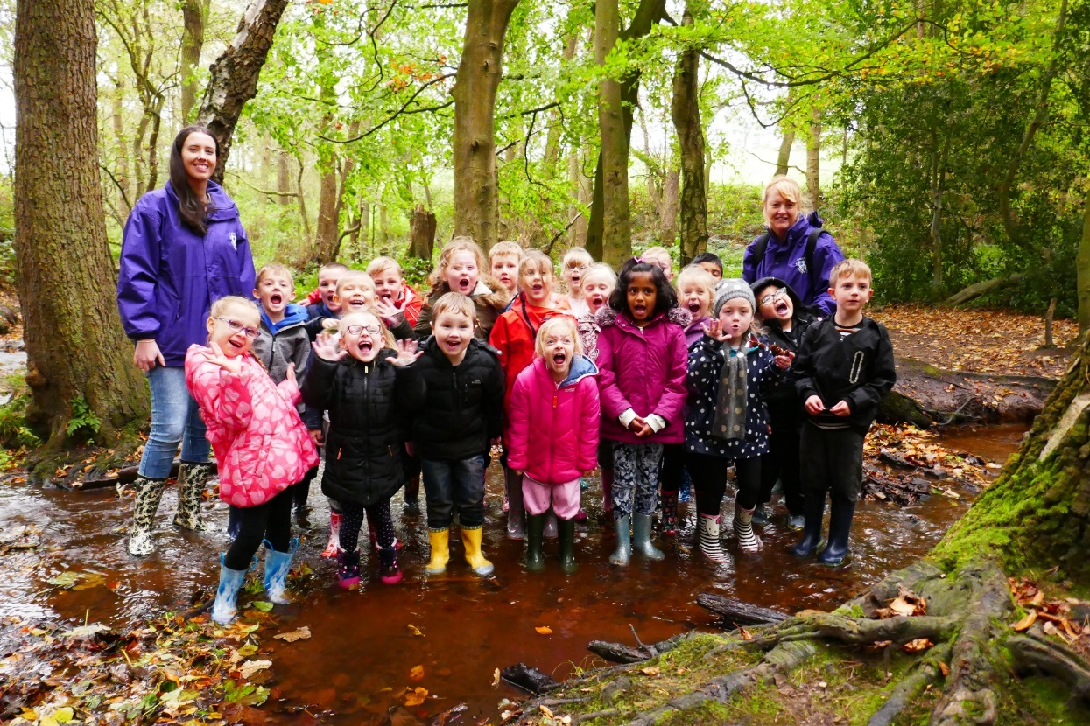
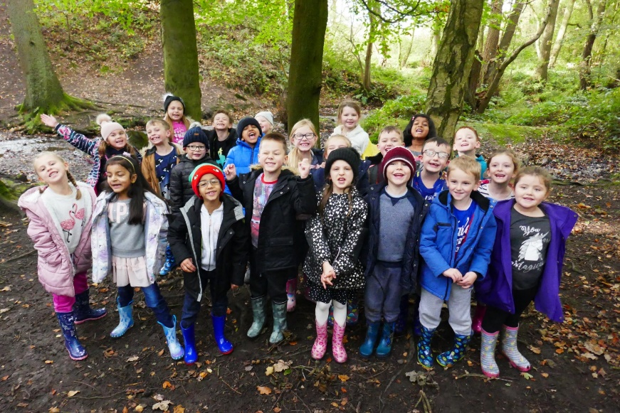
We had an amazing time hiding in the forest in our camouflage with our faces painted!
The food was delicious!
The best trip ever!

Slide 25
Before you leave today, please complete and return the following forms –
Whether you require a school packed lunch for Day 1 of the visit or will be providing your own
Medical Information sheet
Any additional information you need us to know
Parental agreement form for school to administer medication
Please take home a full kit list

