Slide 1
Rights Respecting School Award:
Are you Ready?!
Notes:
Introductory Slide: Explain that the school is starting something new that involves everyone in the school. You would like them to watch the video as this will give them a clue about what is going to be happening. After the video (1 min long) ask them if they have any thoughts about what they might be doing.
Be positive about the responses they give.
Link to the video: http://www.bing.com/videos/search?q=unicef+rights+of+the+child+celebrate&&view=detail&mid=0694C001EC94C887313F0694C001EC94C887313F&FORM=VRDGAR

Slide 2
What might you have in common with the children in the video?
Notes:
Next, ask them what they think they might have in common with the children in the video. Children might say they are happy, are playing, like drawing and painting, working together, having fun and so on.
After their responses explain that they will be learning about something that is important to every one of them and EVERY other child in the world.
It’s something that connects all children.
They will be learning about how all children are special and have something called Children’s RIGHTS that help them have the best possible childhood in which they are safe, listened to, have good food, learn and have time to play.
Rights are precious and need to be protected and respected by everyone.

Slide 3
OUR School
Notes:
Learning about children’s rights will involve them exploring how to make their school the best possible place for children to learn, play and grow – a place where everyone respects each other and treats each other fairly.
Ask them for ideas:
What would their ideal school look like? Feel like?:
How would children treat each other?
How would adults treat children?
How would children treat adults?
How could they be more involved in their learning and life in school?
Learning about rights and respecting the rights of others will take them on a journey to be a Rights Respecting School.
They will be finding out how they can make a difference to children’s lives by knowing their own rights and the rights of all children in the school, in the local community and across the world

Slide 4
Notes:
Explain that children and adults in the school are going to be working together with an organisation called Unicef (United Nations Children’s Fund - that works with children across the world) to be a Right Respecting School!
The next slide is a message from the Rights Respecting Schools Award team.

Slide 5
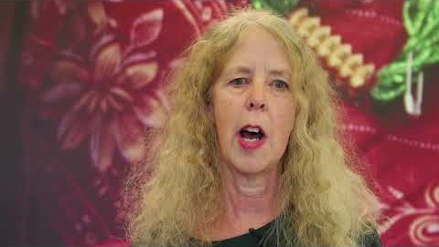
A message from
Unicef UK …
Frances Bestley,
RRSA Programme Director
Notes:
Watch video: https://youtu.be/QBGA3FmoUJ0

Slide 6
Add your content
Personalise your message at the end by asking questions like:
Who would like to know more?
Who would like to be involved?
Who might like to be part of the Rights Respecting group/team at…. (name of school)?
The RRSA website has lots of information: www.unicef.org.uk/rrsa
Notes:
Personalise your message at the end – e.g. by asking who would like to be involved; when the first meeting will be etc.
You might like to show this video: RRSA Video: Talking about being a Rights Respecting School - https://www.youtube.com/watch?v=1DOPyjKSUxo
The RRSA website has lots of information: www.unicef.org.uk/rrsa

Slide 7
Thank you

