Slide 1

RE
GRACE MELLOR
2025/2026
REVIEWED AND UPDATED TERMLY
“Be strong and courageous. Do not be afraid; do not be discouraged, for the Lord your God will be with you wherever you go.” Joshua 1:9

Slide 2
AIMS
As part of our ‘Leadership and Management’ and Quality of Education School Development Plan, this presentation is designed to share information regarding the intent, implementation and impact of the curriculum, including but not limited to:
  Rationale and curriculum intent
  Subject monitoring
  Professional development
  Assessment, tracking and progress
  Action plan

Slide 3
Rationale and Curriculum Intent
Religious Education at Latchford St James is central to our deeply Christian character. It is a key way in which the school works towards ‘being strong and courageous, not afraid or discouraged’ through growth in body, mind and spirit. We study religion within a Christian context, reflecting the Anglican tradition of our school and aim for the highest standards of excellence. We provide a safe space for each unique individual to explore their beliefs, whatever those beliefs might be.
We aim to provide pupils with a well - developed understanding of the Christian faith as possible, alongside promoting love and understanding for other faiths. Children gain understanding of Christian values through their study of RE. Their studies help them to understand why values such as Love, Respect, Compassion and Kindness are important and help them to understand Christian theological teaching about these values. We hope that pupils will also be presented with challenges to some of the values that are current in modern materialistic society.

Slide 4
Rationale and Curriculum Intent
Religious Education enables children to investigate and reflect on some of the most fundamental questions asked by people. At Latchford St James we develop the children’s knowledge and understanding of the major world faiths. We enable children to develop a sound knowledge not only of Christianity but also of other world religions. Children reflect on what it means to have a faith and to develop their spiritual knowledge and understanding. We help the children learn from religions as well as about religions.

Slide 5
Rationale and Curriculum Intent
Aims of Religious Education are to help children;
Have learning opportunities and a learning environment where Christian values are central to the ethos of the school and moral development,
Develop an awareness of spiritual and moral issues in life experiences,
Develop knowledge and understanding of Christianity and other major world religions and value systems found in Britain and the wider world,
Develop an understanding of what it means to be committed to a religious tradition
To be able to reflect on their own experiences,
Develop an understanding of religious traditions and to appreciate the cultural differences in Britain today,
Develop investigative and research skills and to enable them to make reasoned judgments about religious issues,
Have respect for other people’s views and to celebrate the diversity in society.

Slide 6
Curriculum Implementation
RE that is inclusive for all.
Religious Education at Latchford St James supports our commitment to meeting the needs of each unique individual. It is inclusive of all. We encourage pupils to share with us in our faith journey. We are committed to nurturing pupils who have a faith commitment as they develop their theological thinking. However, we also respect the differing views represented in our school and we are aware that we may all have differing views which are respected.
Our classrooms are spaces for thinking where all, including the teacher, are engaged on a learning journey. We start and finish the journey in different places but respect the viewpoints and beliefs of all who share the journey. We encourage pupils to wrestle with challenging questions about God, faith and our world. We are committed to showing ‘care’ through being inclusive as Jesus was inclusive, ‘challenge’ by prompting questioning as Jesus prompted questioning and ‘celebrate’ the learning pupils make as they evaluate issues for themselves.

Slide 7
Curriculum Impact
Knowledge & Understanding
Pupils gain a deep understanding of Christianity and other faiths/worldviews; improve religious vocabulary; gain a better grasp of beliefs, practices, and how faith shapes people’s lives.
Enquiry & Critical Thinking
Pupils should be able to ask reflective and challenging questions; engage with “ultimate questions” (meaning, purpose etc.); analyze, interpret and evaluate religious and ethical issues.
Spiritual, Moral, Social, Cultural (SMSC) Development
The syllabus contributes significantly to spiritual growth; moral development; cultural understanding; respect and empathy for others; personal reflection.
Attitudes & Behaviour
Greater respect for diversity; improved tolerance; pupils more open-minded; able to see others’ perspectives; more confident expressing views about religion and belief.
Identity & Belonging
Pupils connect learning to their own lives; sense of belonging in religious & secular worlds; development of their own spiritual beliefs and values.
Preparation for Later Life / Citizenship
Pupils better equipped to live in a multi-faith society; ability to engage in respectful dialogue; moral and ethical awareness; sense of responsibility; understanding of global religion issues

Slide 8
Christian Values and UNICEF Rights
Friendship
Compassion
Love
Kindness
Perseverance
Respect
Article 14 (Freedom of Thought, Belief, and Religion)
Article 12 (Respect for the Views of the Child)
Article 29 (Goals of Education)
Article 2 (Non-Discrimination)
Article 13 (Freedom of Expression)

Slide 9
Planning

Slide 10
Early Years

Slide 11
Professional Development
WHEN | WHAT | WHO | IMPACT/ NEXT STEPS

Slide 12
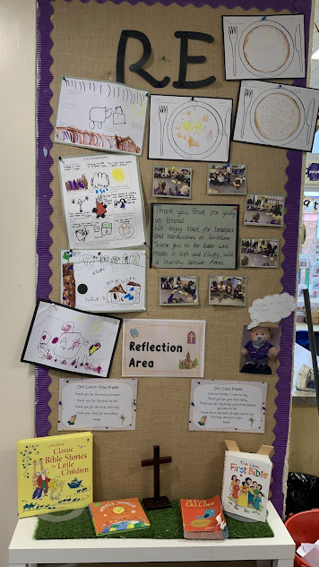
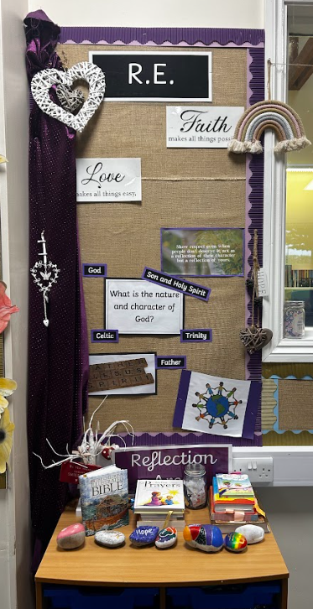
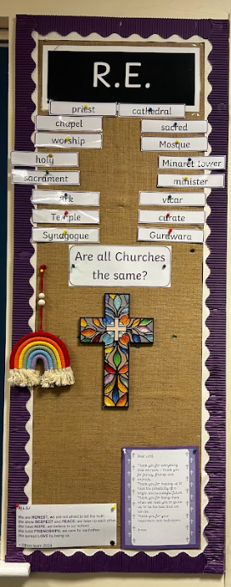
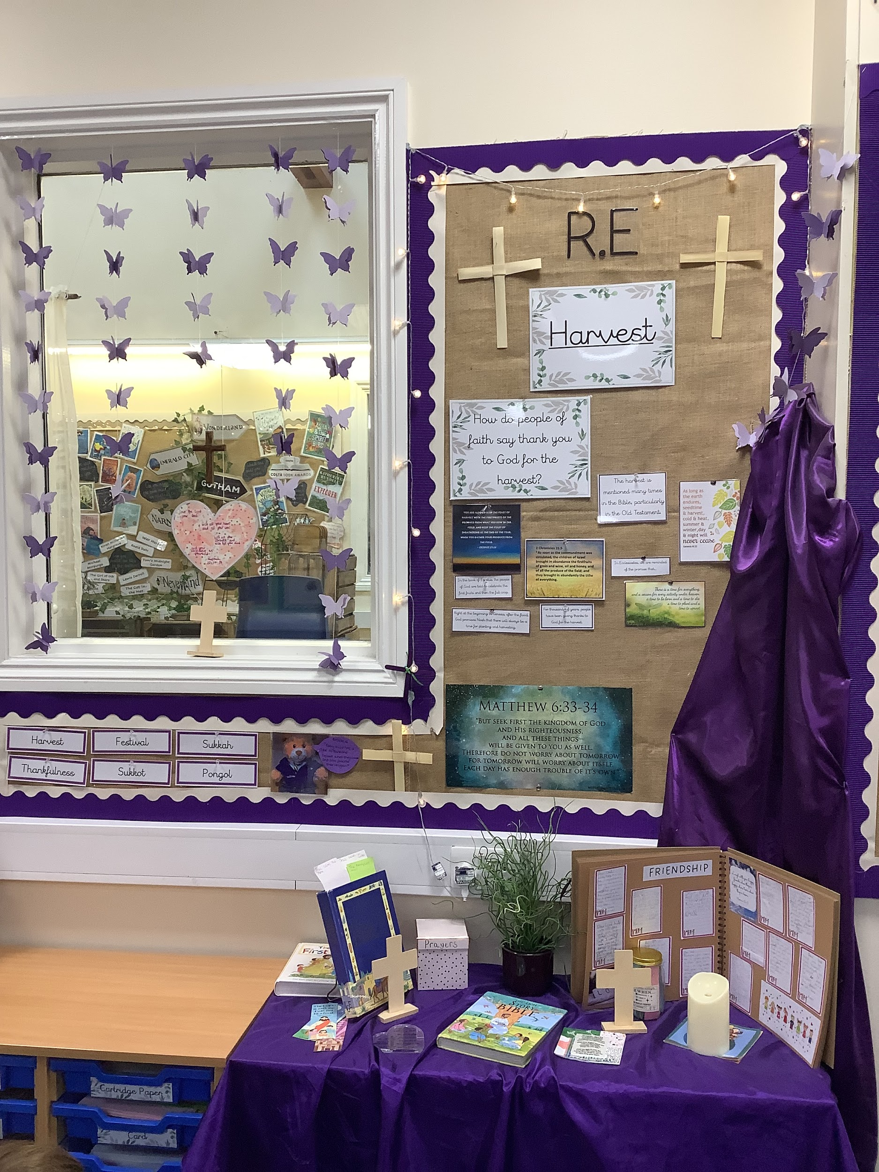
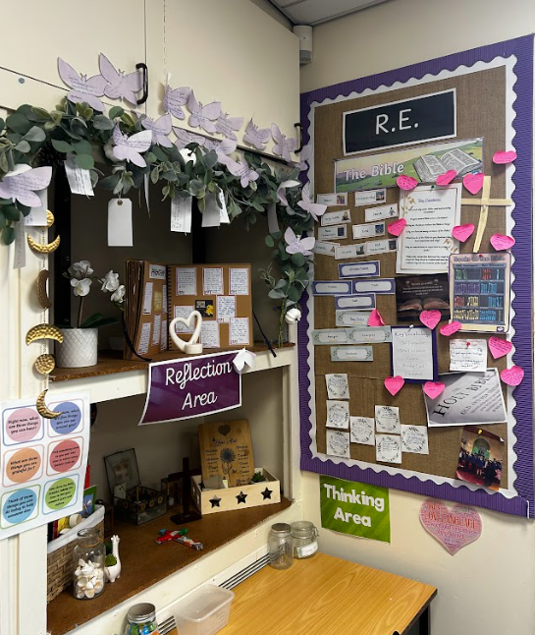
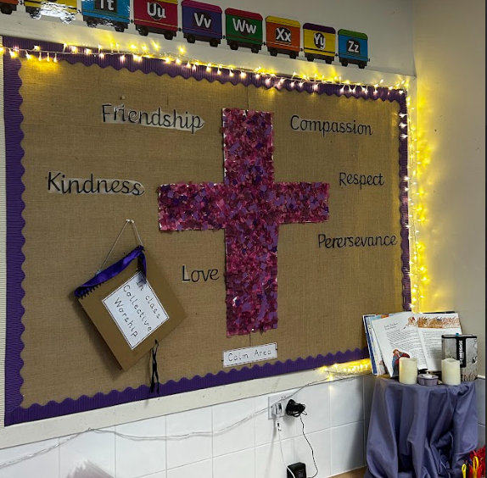
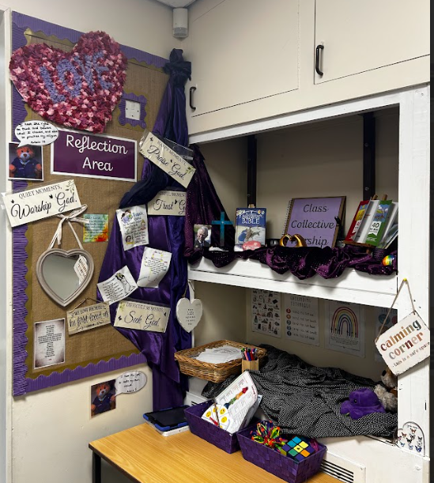
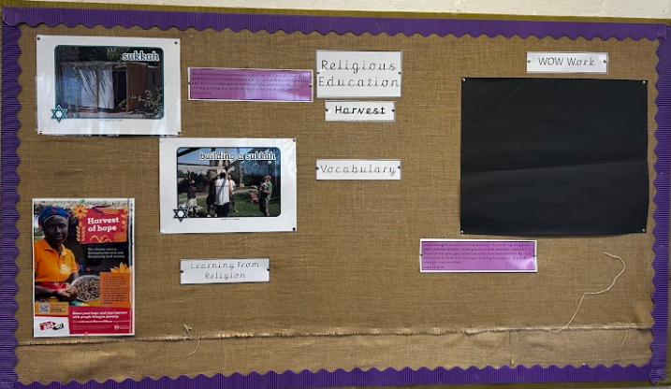
Displays

Slide 13
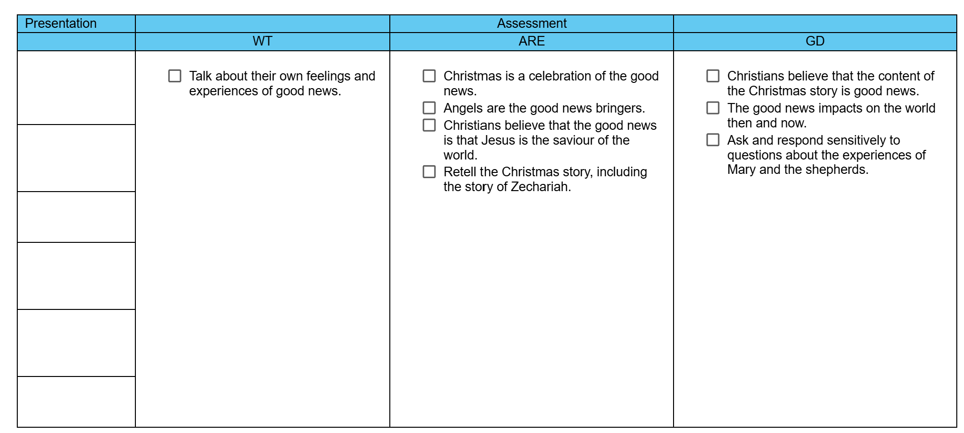
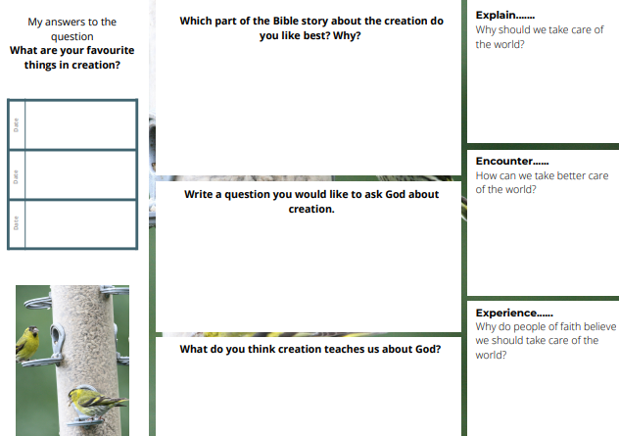
Assessment and Progress
Assessment takes place both informally and formally throughout the year. We assess children’s work in RE by making informal judgments as we observe them during lessons - this is recorded (highlighted)on the assessment grid.
Presentation is recorded and monitored on the assessment grids also.
On completion of a unit of work, children complete the questful learning map as a summary of their knowledge and understanding of the unit. Teachers then make judgements in line with the expected unit outcomes.

Slide 14
SEND
Through inclusion for all, we strive to ensure that every child fulfils their own potential. We want all children to develop a sense of themselves as unique and precious. Teachers will plan RE sessions with children’s needs and abilities in mind. As with all areas of the curriculum, differentiation ensures that children will receive further support if needed.

Slide 15
EAL
Through inclusion for all, we strive to ensure that every child fulfils their own potential. We want all children to develop a sense of themselves as unique and precious. Teachers will plan RE sessions with children’s needs and abilities in mind. As with all areas of the curriculum, differentiation ensures that children will receive further support if needed.

Slide 16
Monitoring
Autumn | Spring | Summer
Drop in sessions x4 RE lead PP, SEND, EAL | Drop in sessions x4 RE lead LA, MA, HA | Drop in sessions x4 RE lead Based on previous findings
Termly data collection | Termly data collection | Yearly data analysis
Annual update for Governors/SLT

Slide 17
Data
 | Autumn 1
 | Working towards | Working at | Working above
Rec | 29% | 54% | 17%
Y1 | 20% | 65% | 15%
Y2 | 24% | 52% | 28%
Y3 | 11% | 75% | 14%
Y4 | 29% | 54% | 17%
Y5 | 15% | 63% | 21%
Y6 | 26% | 61% | 13%
 | Autumn 2
 | Working towards | Working at | Working above
Rec | % | % | %
Y1 | % | % | %
Y2 | % | % | %
Y3 | % | % | %
Y4 | % | % | %
Y5 | % | % | %
Y6 | % | % | %

Slide 18
 | Spring 1
 | Working towards | Working at | Working above
Rec | % | % | %
Y1 | % | % | %
Y2 | % | % | %
Y3 | % | % | %
Y4 | % | % | %
Y5 | % | % | %
Y6 | % | % | %
 | Spring 2
 | Working towards | Working at | Working above
Rec | % | % | %
Y1 | % | % | %
Y2 | % | % | %
Y3 | % | % | %
Y4 | % | % | %
Y5 | % | % | %
Y6 | % | % | %

Slide 19
 | Summer 1
 | Working towards | Working at | Working above
Rec | % | % | %
Y1 | % | % | %
Y2 | % | % | %
Y3 | % | % | %
Y4 | % | % | %
Y5 | % | % | %
Y6 | % | % | %
 | Summer 2
 | Working towards | Working at | Working above
Rec | % | % | %
Y1 | % | % | %
Y2 | % | % | %
Y3 | % | % | %
Y4 | % | % | %
Y5 | % | % | %
Y6 | % | % | %

Slide 20
Subject Action Plan
Action | When | Who | Resources | Success criteria | Evaluation
To ensure all teachers teach with fidelity to the scheme | See monitoring cycle | All teachers | Monitoring sheet Pupils’ books | Objective checklist Subject lead audit Monitoring cycle
Collect, monitor and analyse RE assessment data every half term. | Half termly | RE lead | Pupils’ books Policy Assessment grids Assessment table | To ensure pupil data is constantly good across the school and the RE curriculum is having an impact on Religious understanding.
Successfully implement the new christian vision and up to date values across school and the community. | 2025/26 | RE lead Governors SLT Teachers Staff | Collective Worship Books Staff meetings Inset day | To ensure all staff and pupils have an understanding of the vision on a deep level and can actively live the christian values,

Slide 21
Strengths
Autumn | Spring | Summer
A clear mix of writing, practical, photos, children’s ideas and class discussions. High quality writing. Wider opportunities for children eg visit by member of the parish, Church visits and Harvest celebrations.

Slide 22
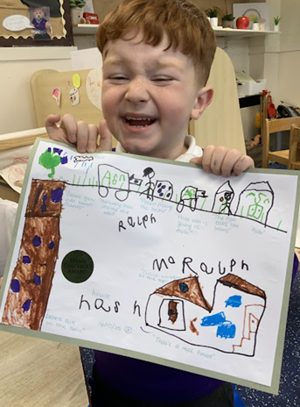
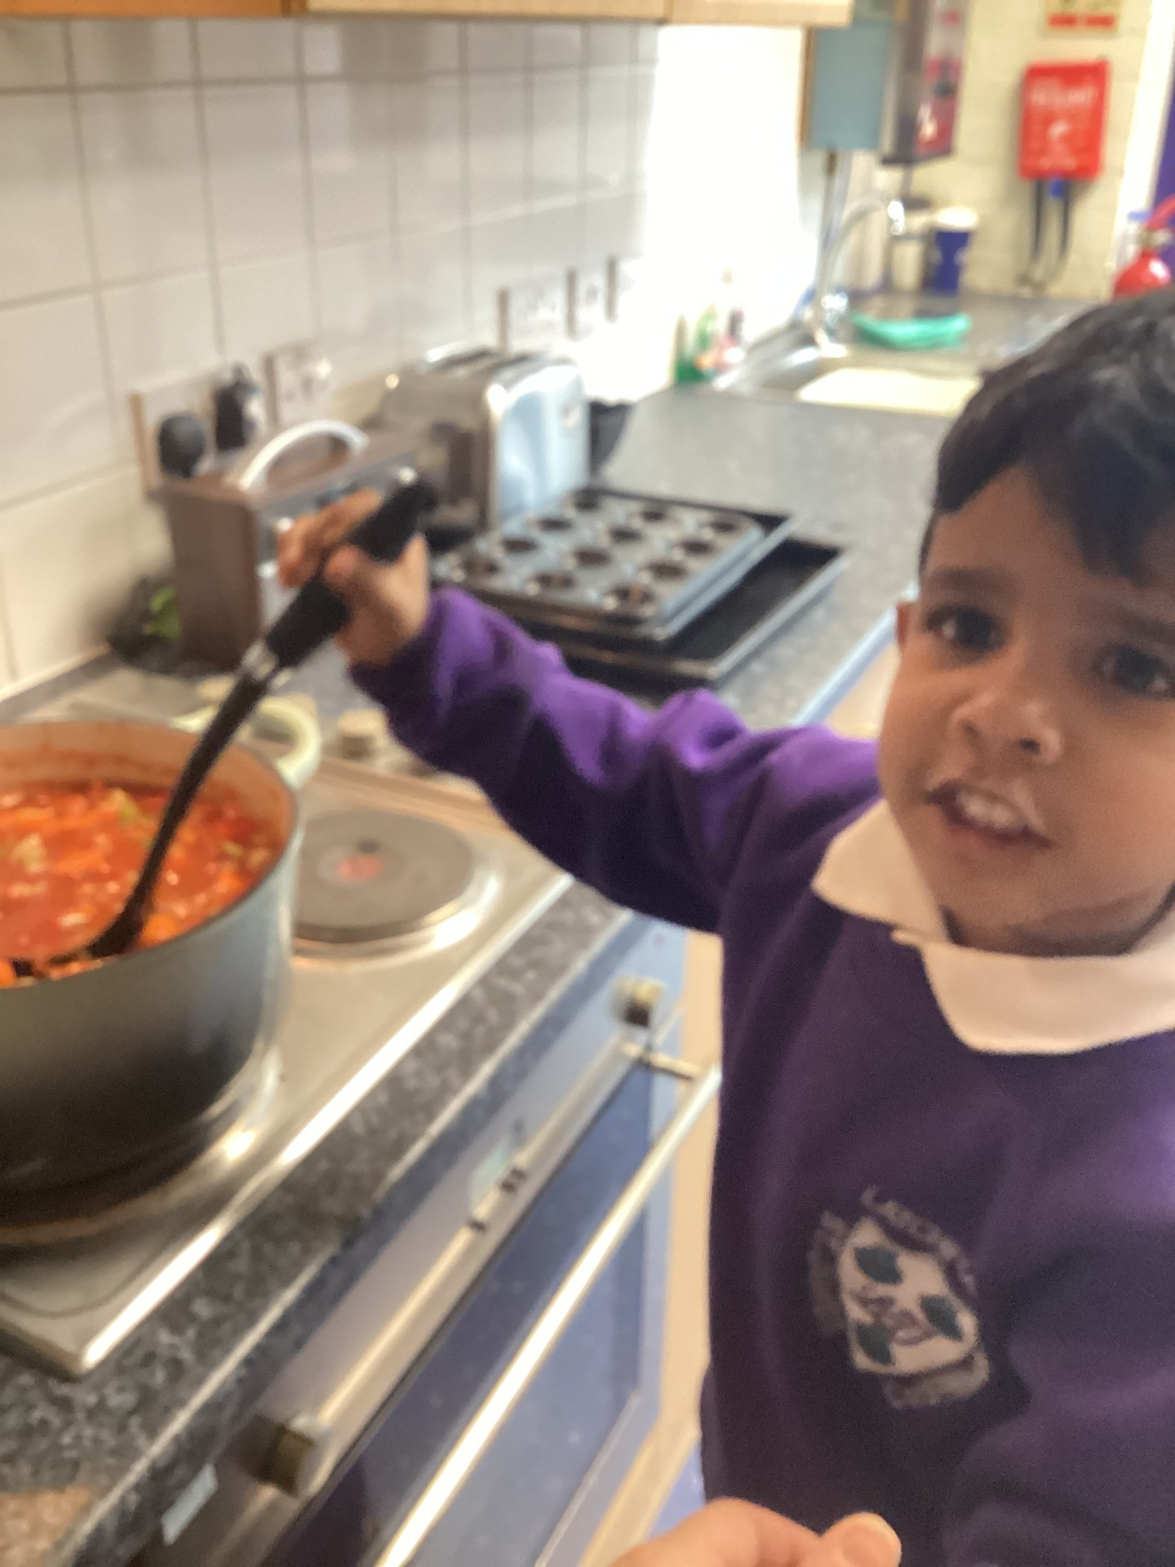
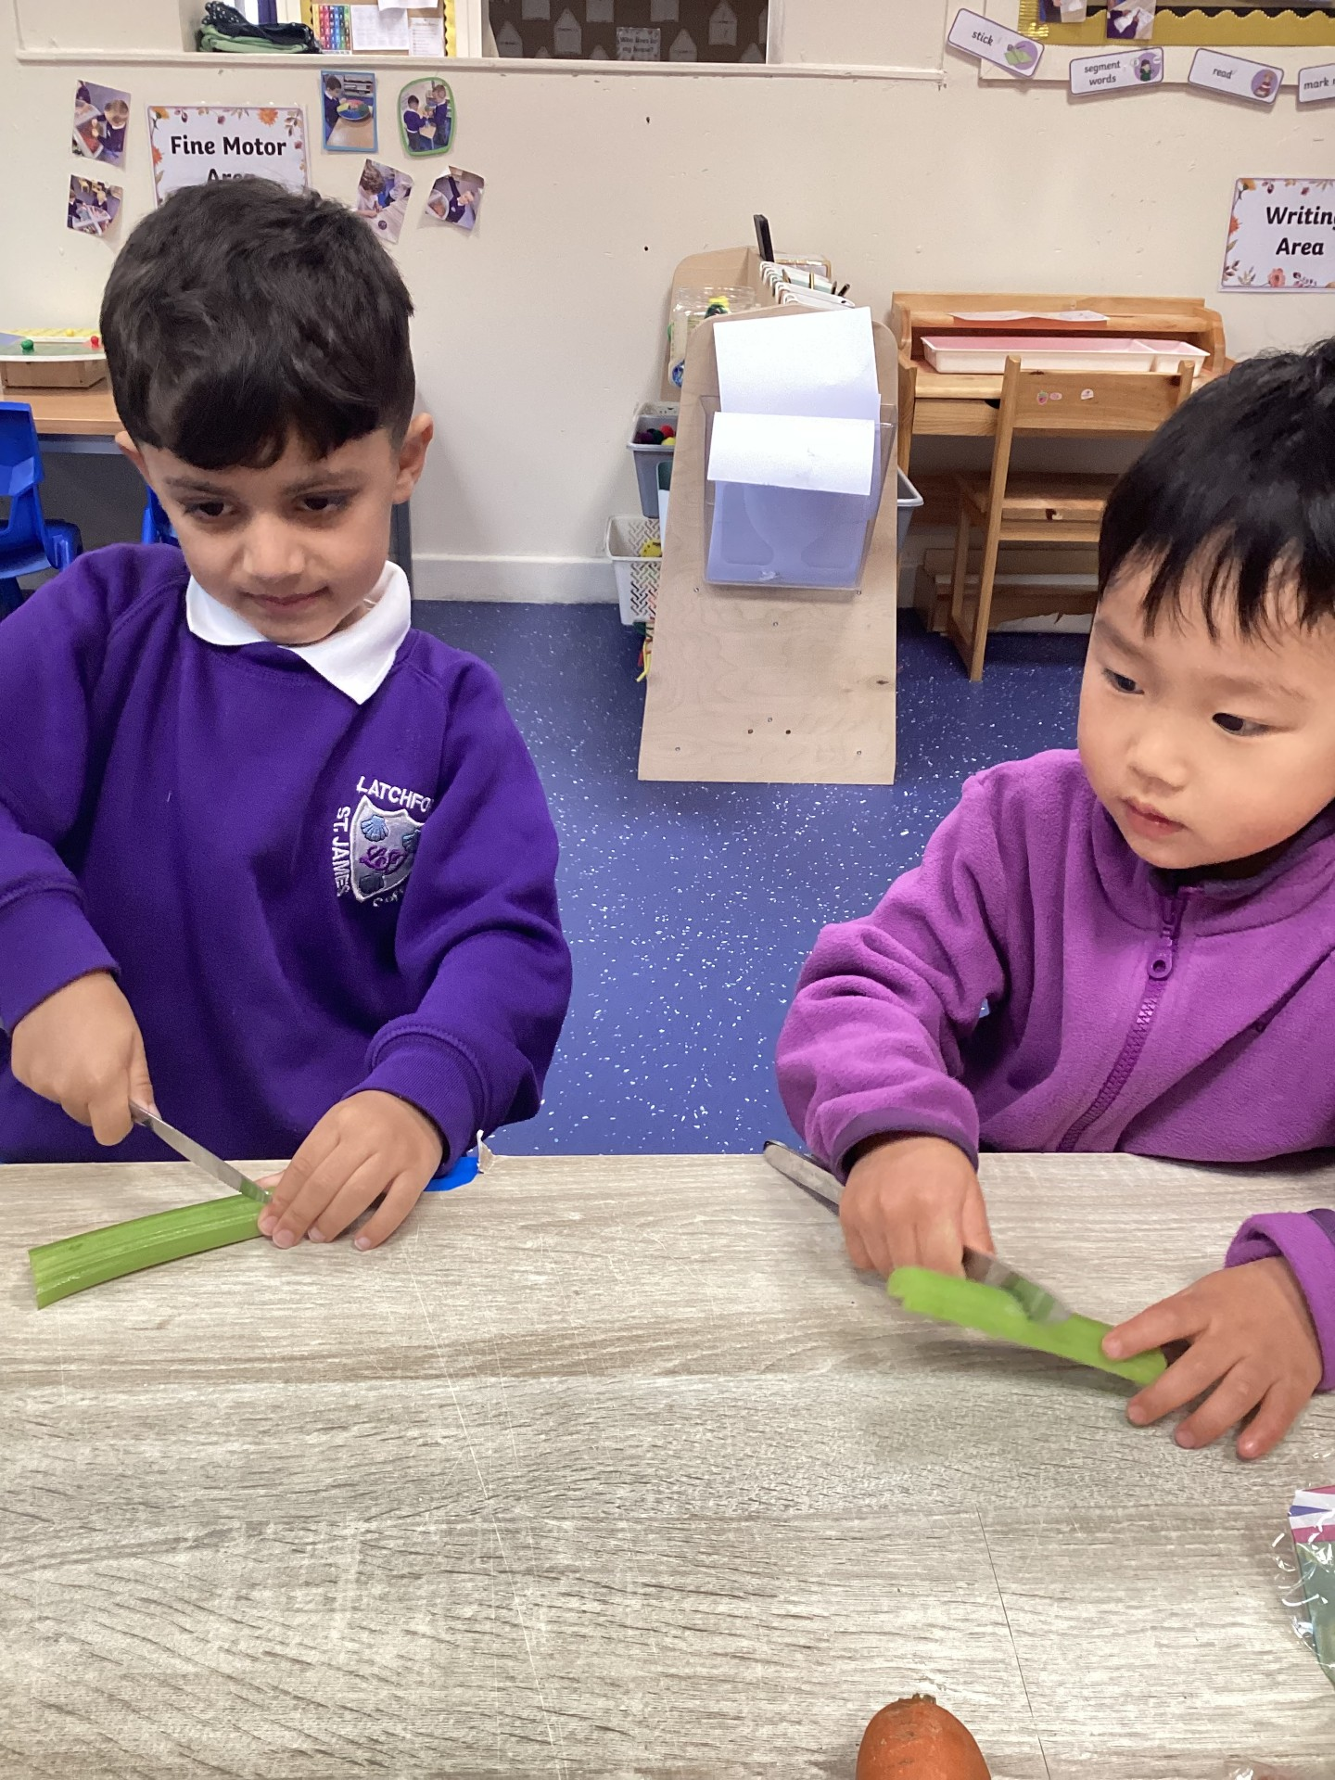
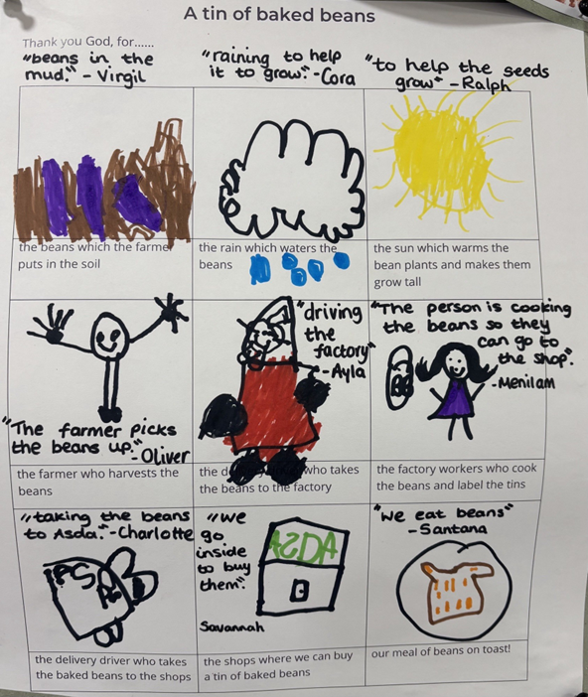
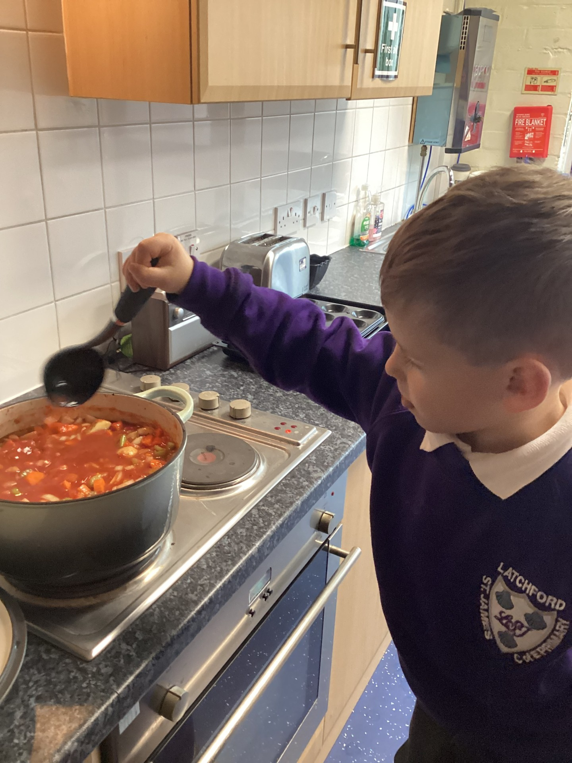
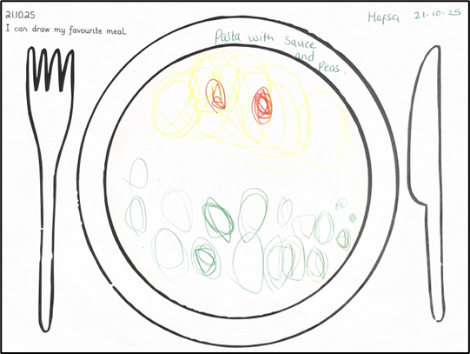
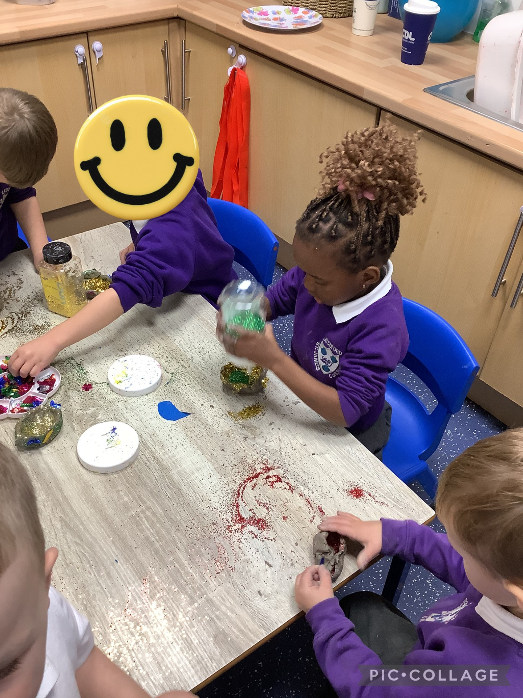
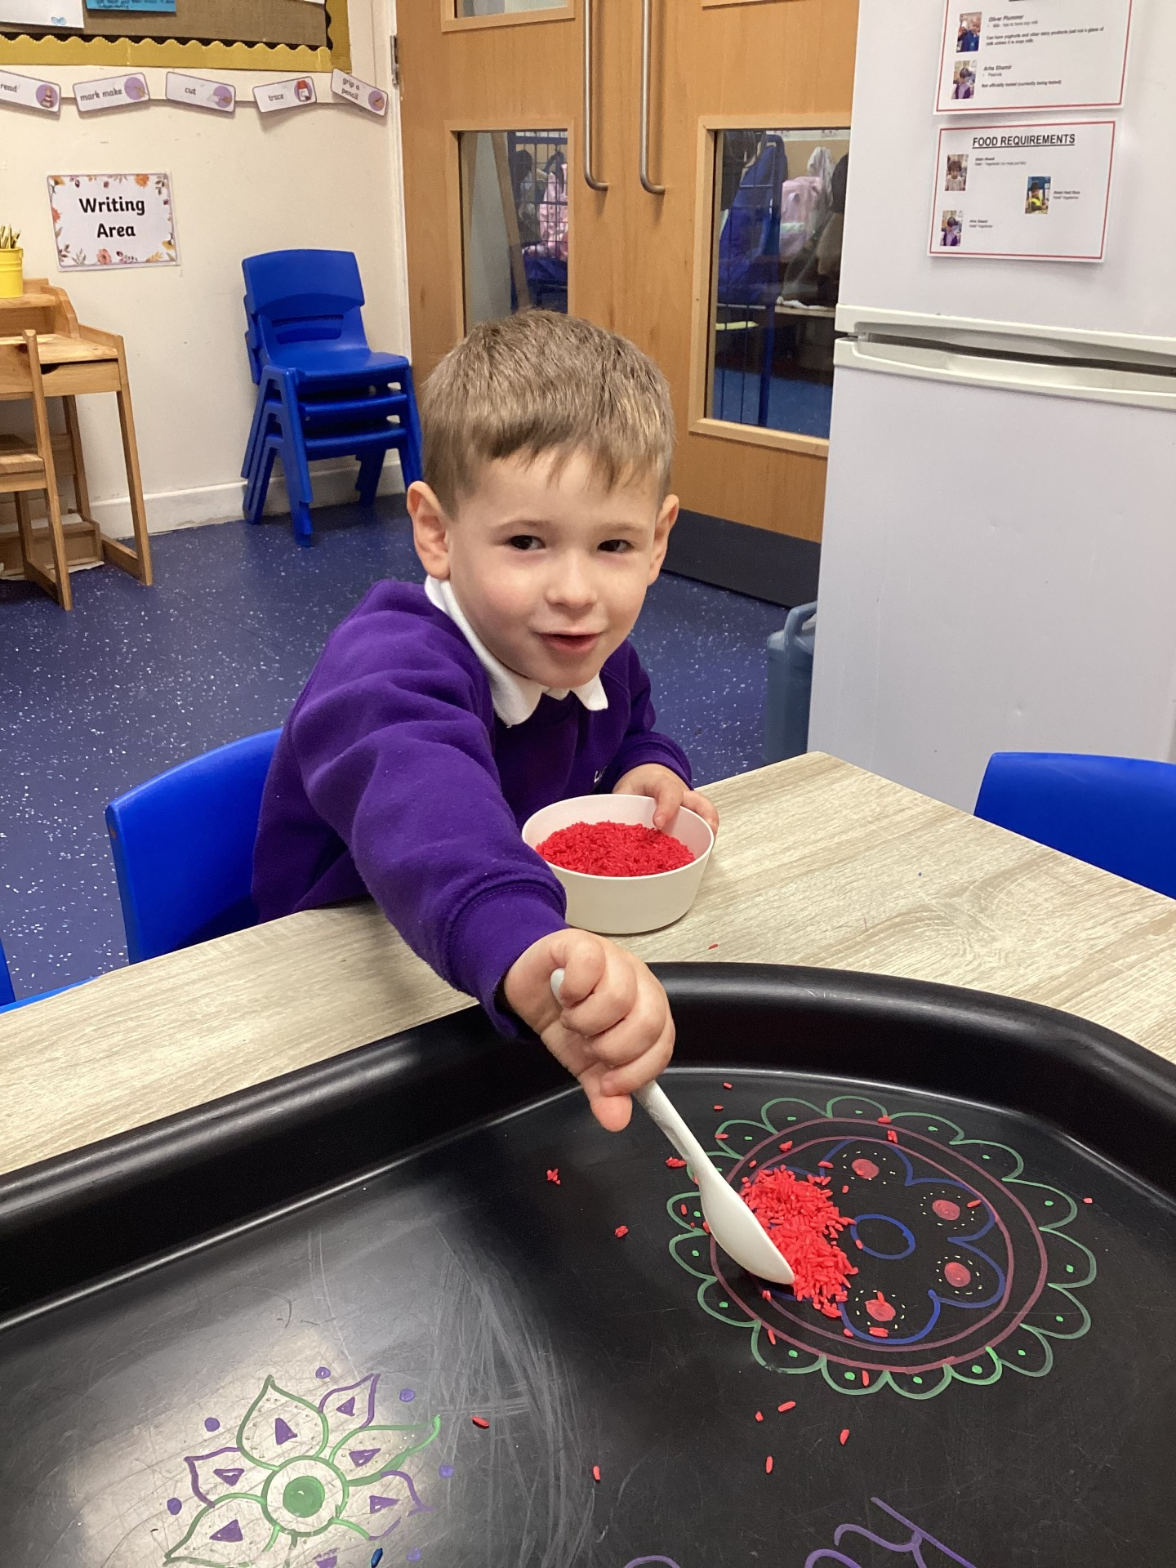
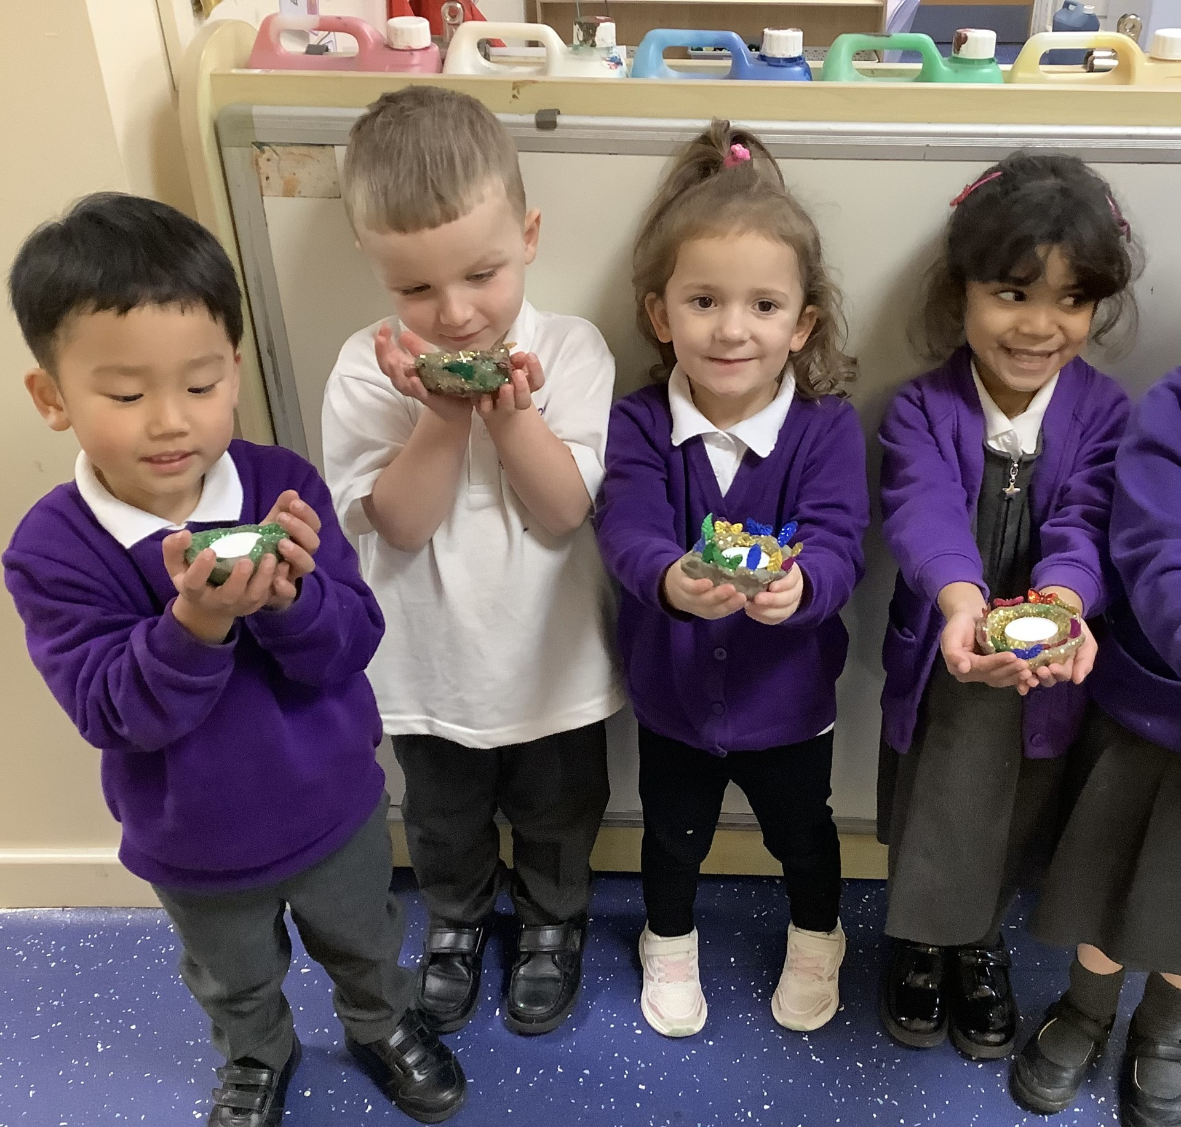
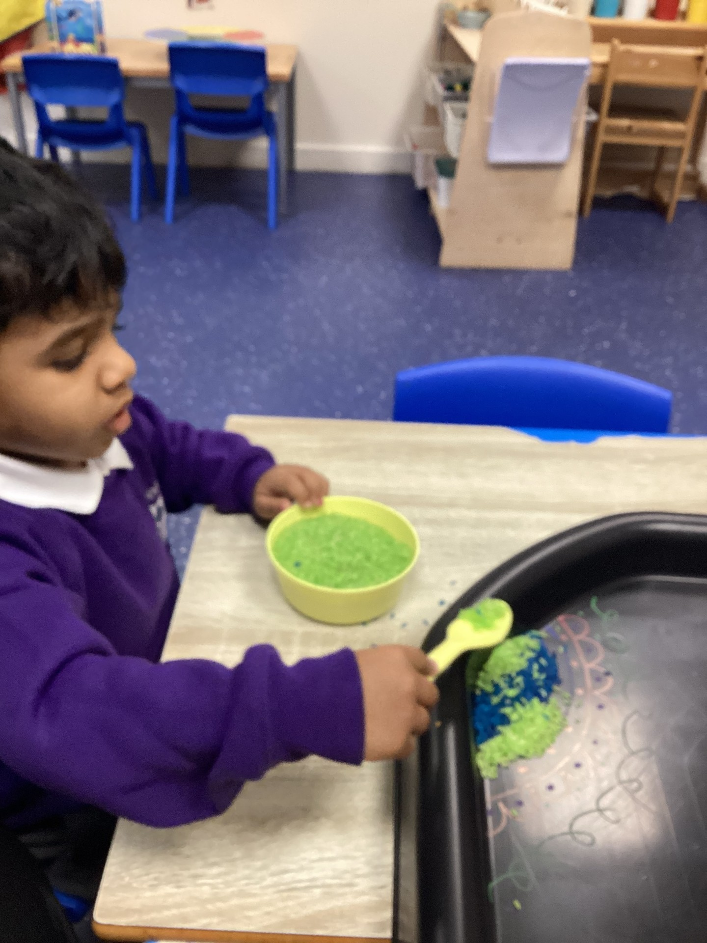
High Quality Work
EYFS
Nursery have explored harvest through making harvest soup. We spoke about the different ingredients and how we cut and chop vegetables and what order we need to put them in the pan. We developed lots of language to describe what the vegetables feel like and look like as well as linking this to the harvest festival.
Mix
Rishaan
“Pasta with sauce and peas”
Hafsa
Stir soup
Leo
Cut celery with knife
Hadi

Slide 23
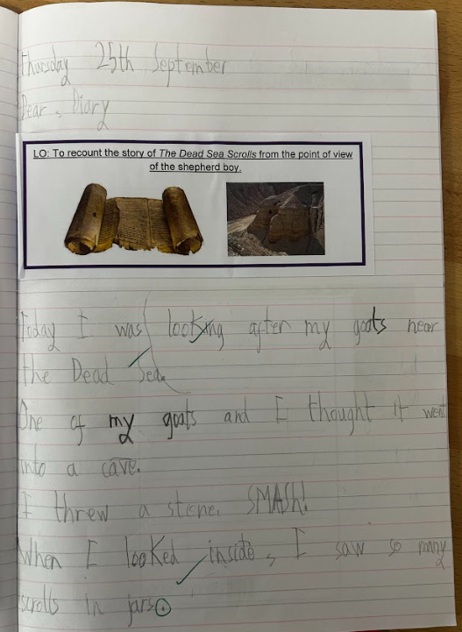
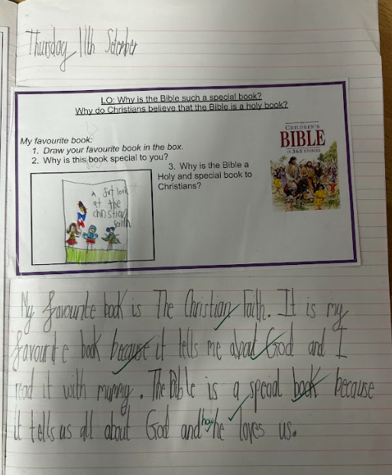
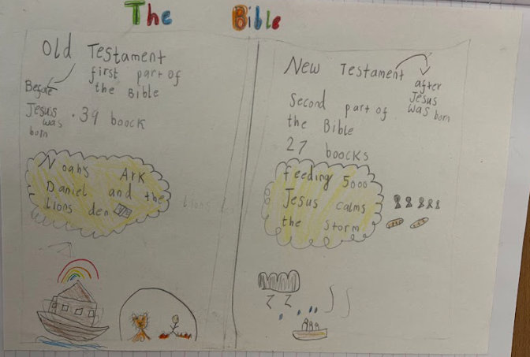
High Quality Work
KS1

Slide 24
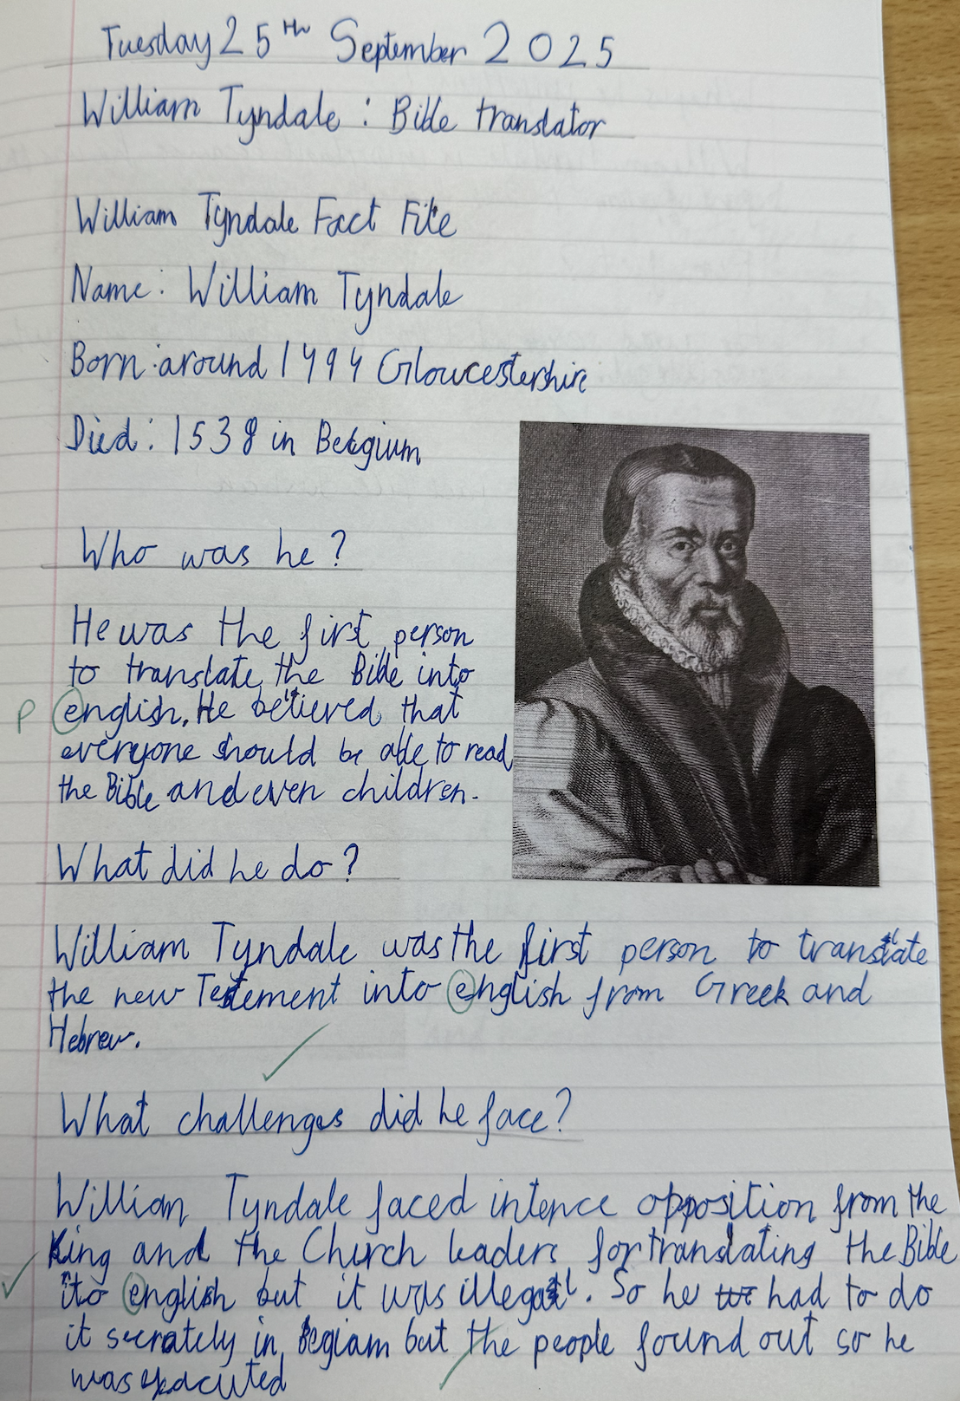
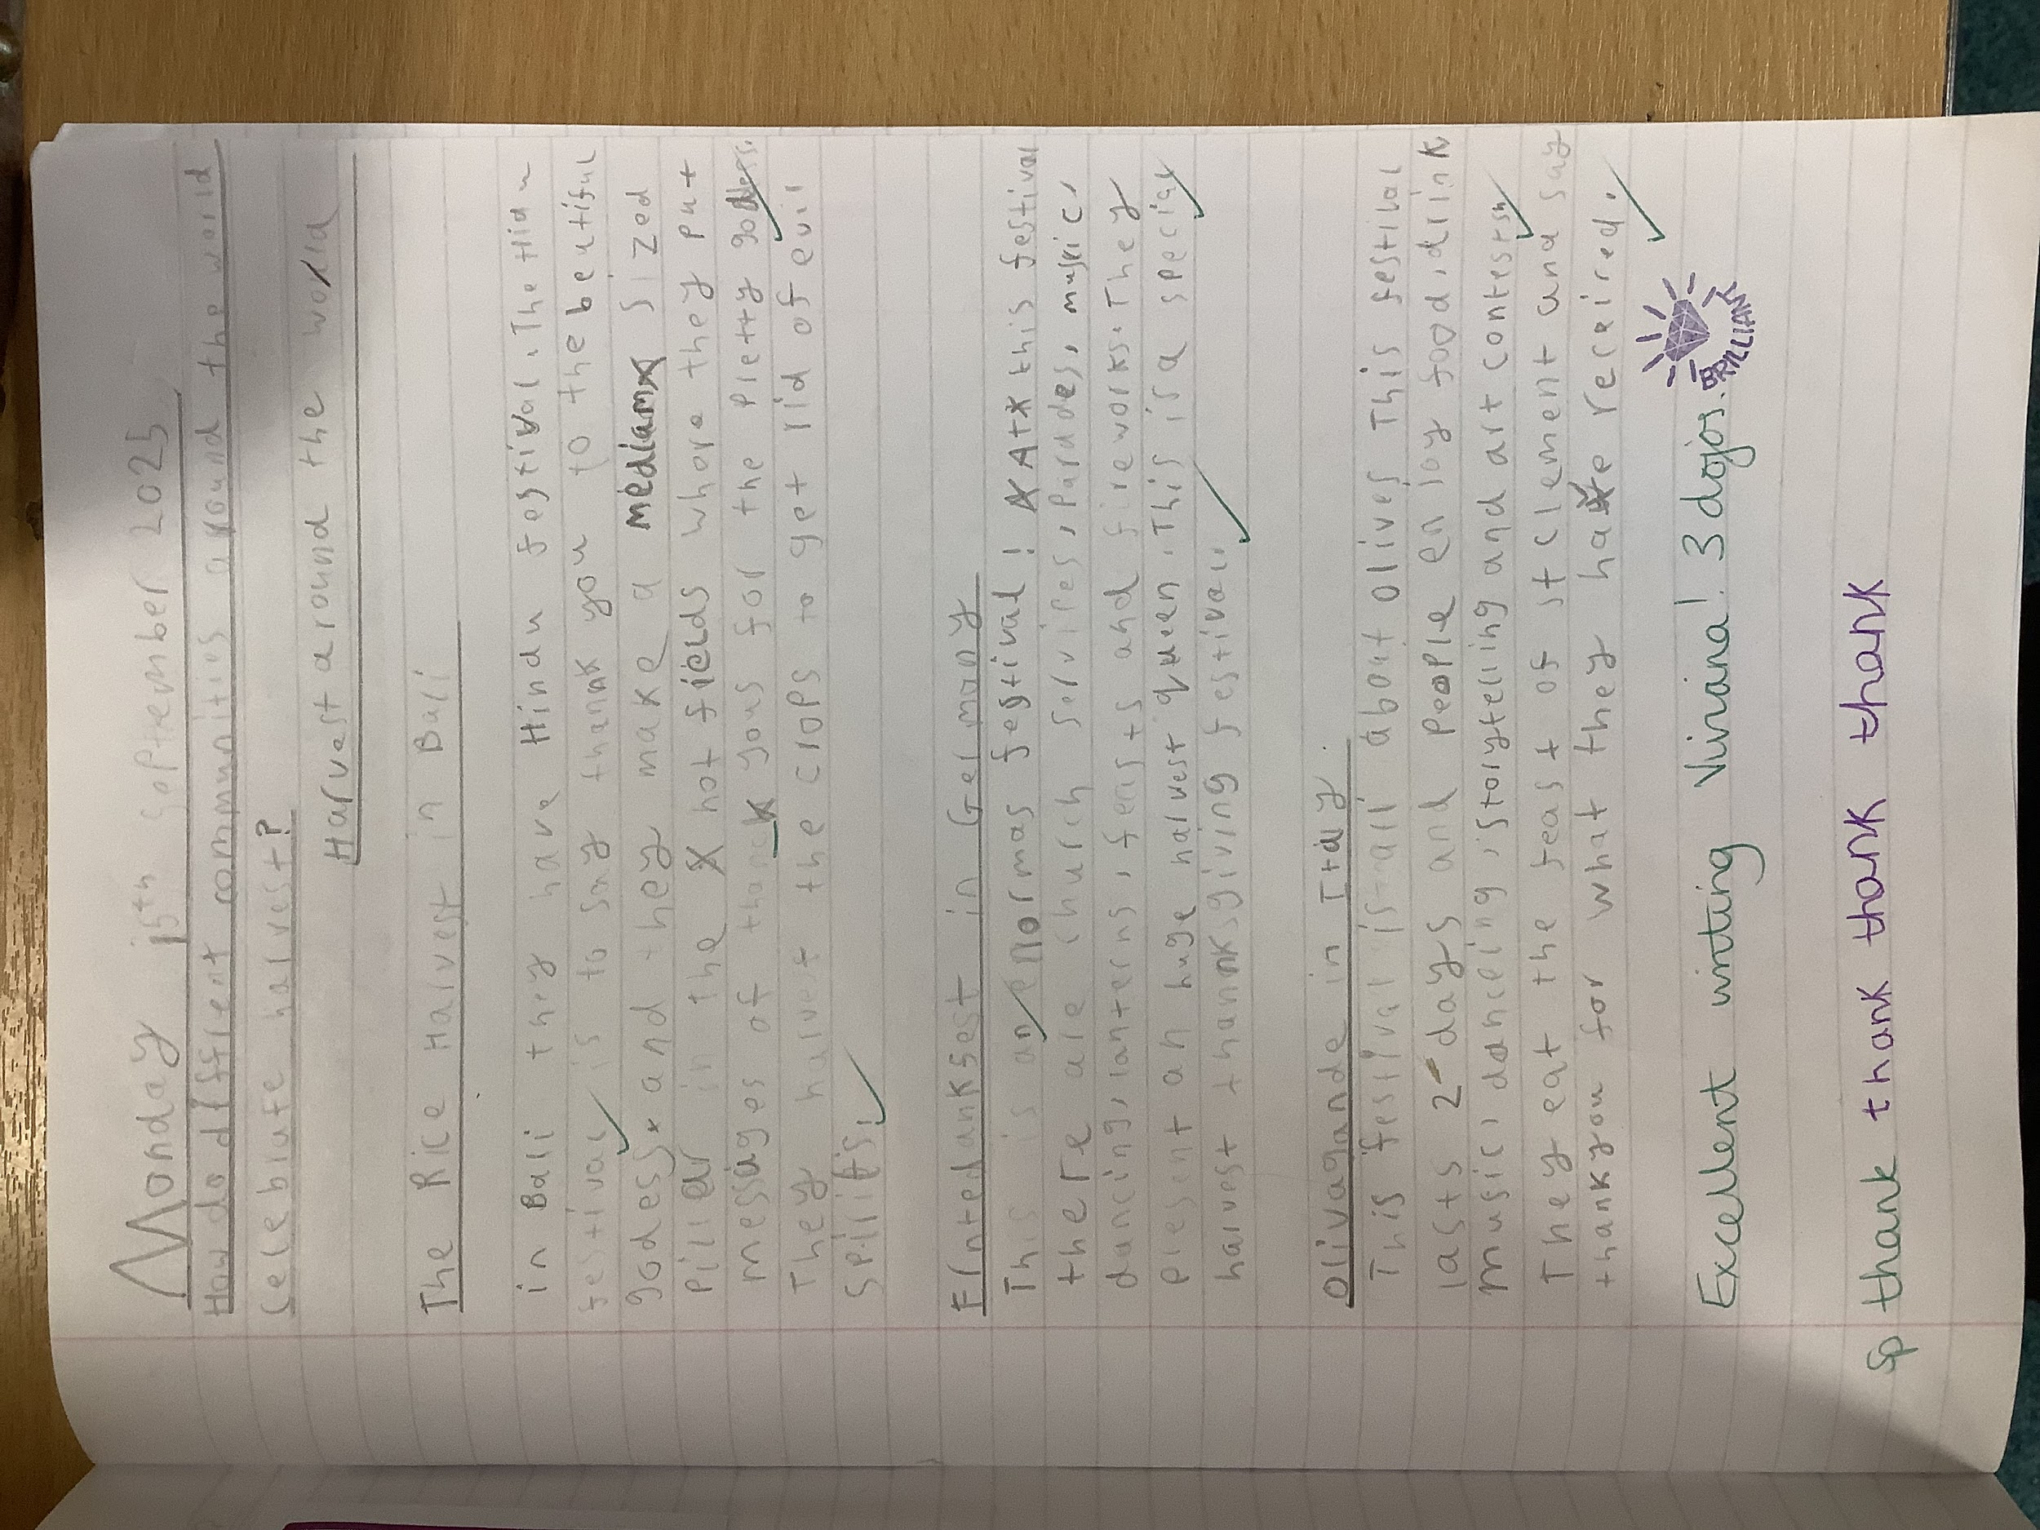
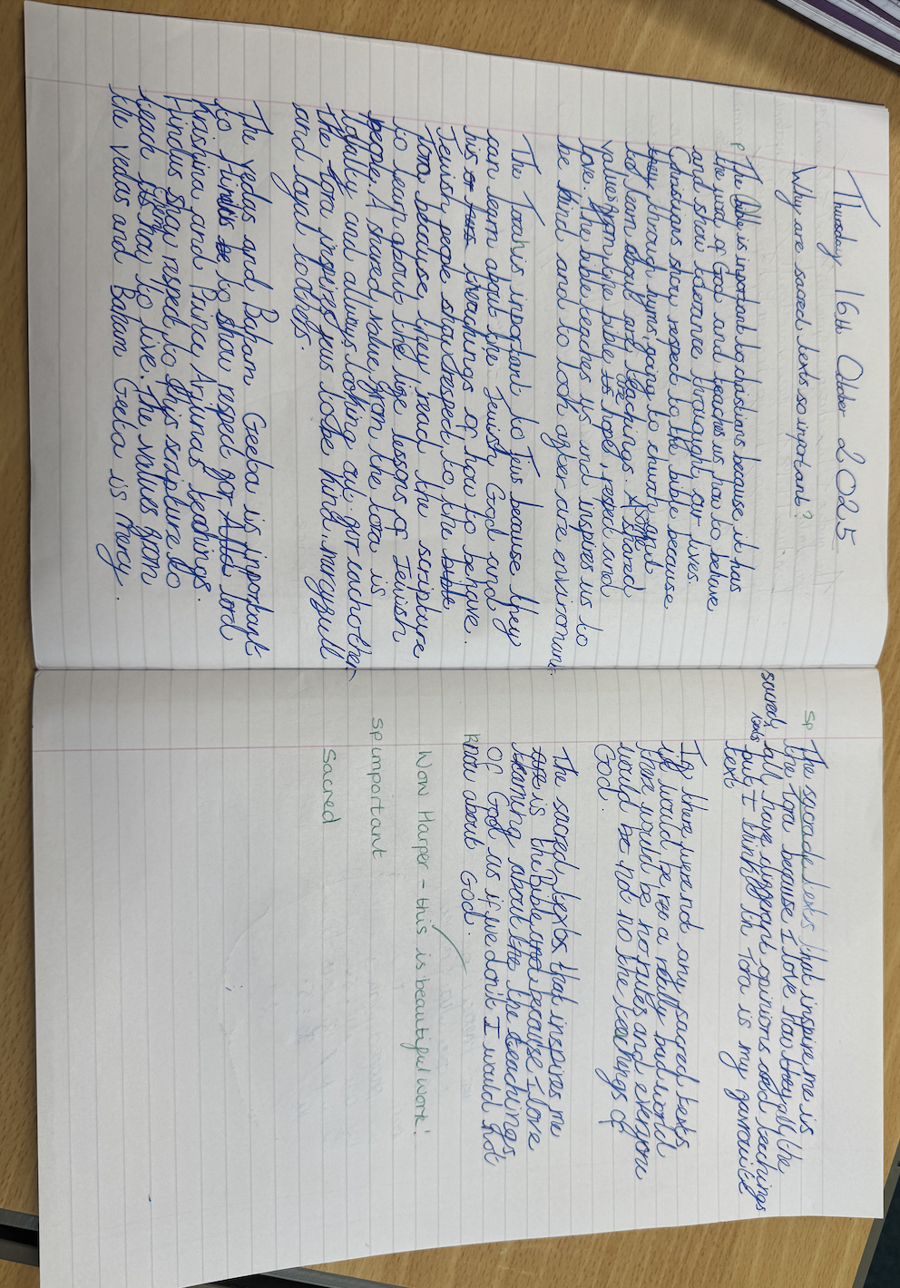
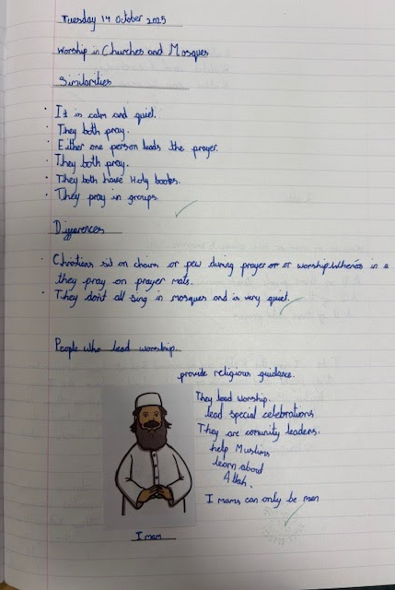
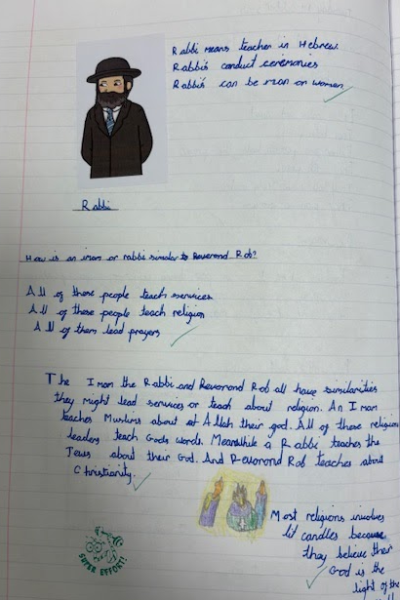
High Quality Work
KS2

