Slide 1


Slide 2
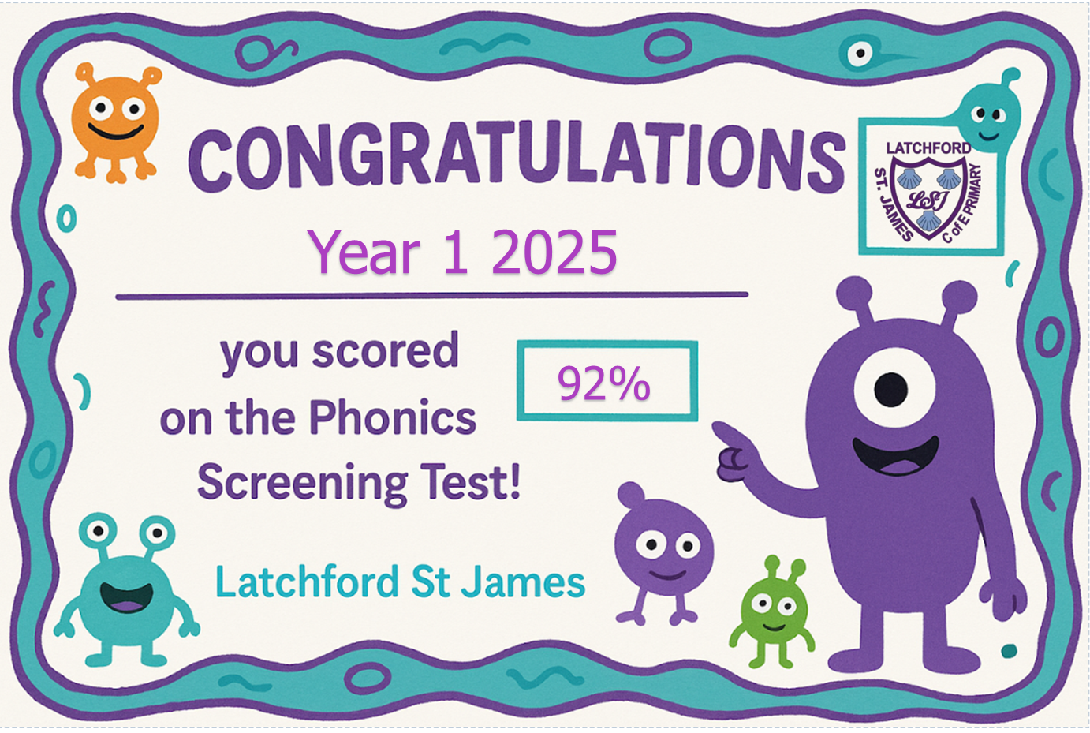
93%

Slide 3

Teacher
Miss Mellor
Support
Miss Clements-Paterson
PPA
Every other Friday.

Slide 4
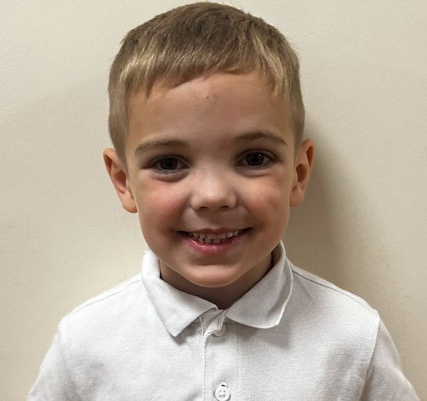
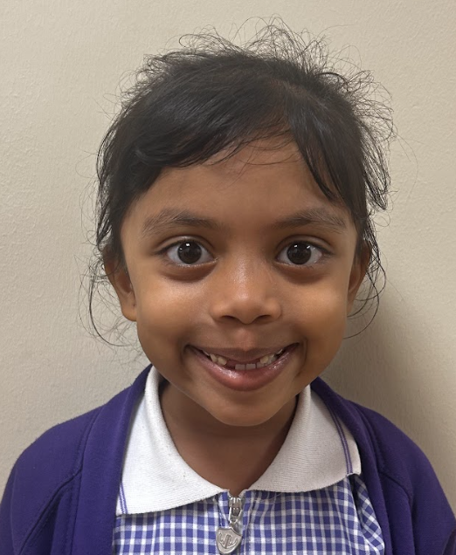
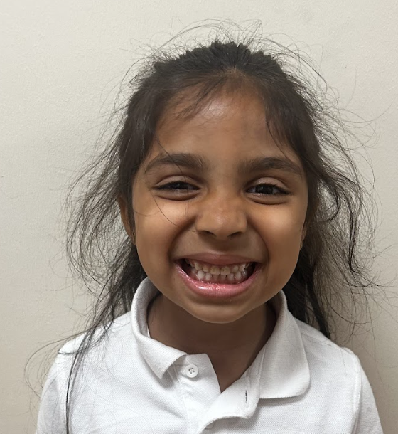
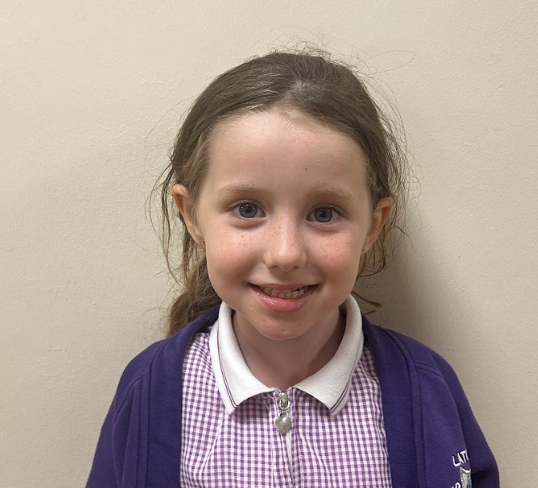
•Classroom doors open at 8.50am
•Pick up time is from the classroom door at 3.20pm
•Full school uniform and school shoes (not trainers)
•PE days: Tuesday & Friday (come to school in PE kit)
•Class dojo - communication

Slide 5
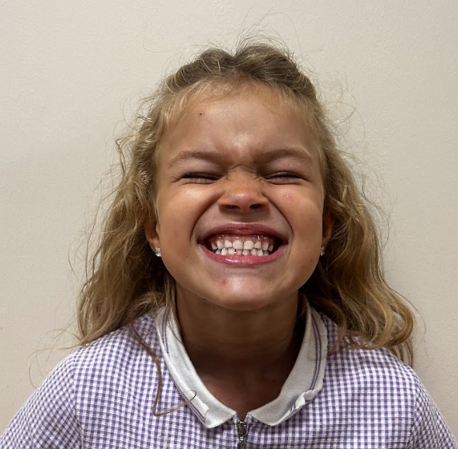
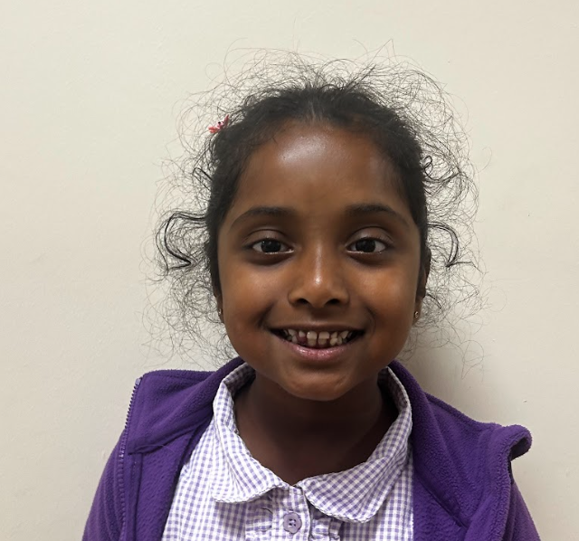
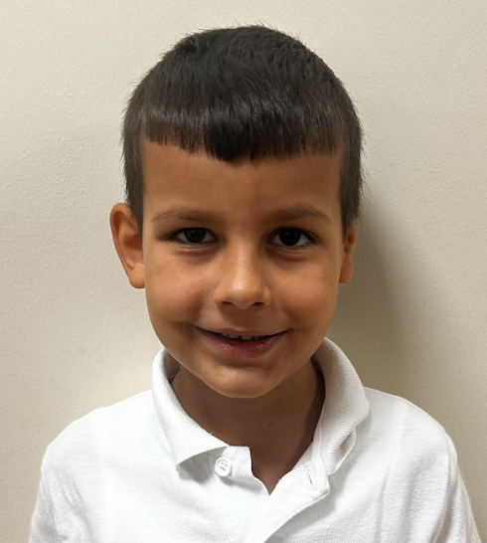
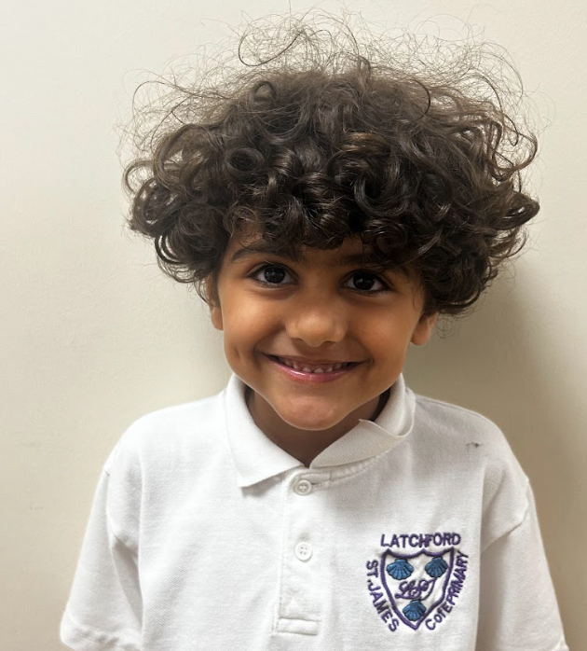
Awards
Dojo points = Weekly reward of Lenny James the bear.
Certificates weekly (always & learner)
Routine
•Playtime = 10.30am
•Lunch time for Y2 = 12:15-1pm
The children need a water bottle and reading book in school every day.

Slide 6
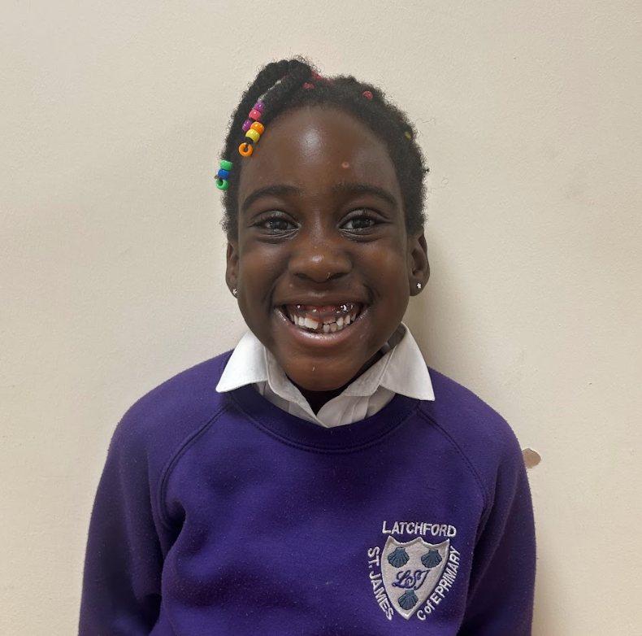
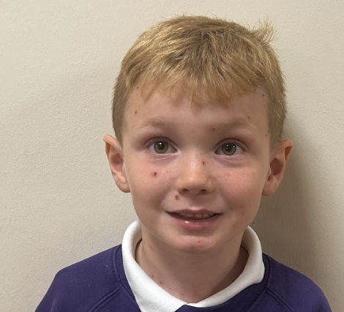
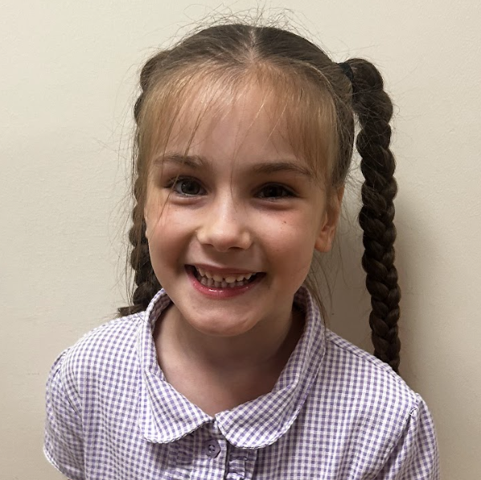
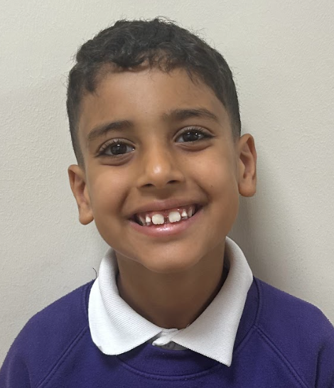
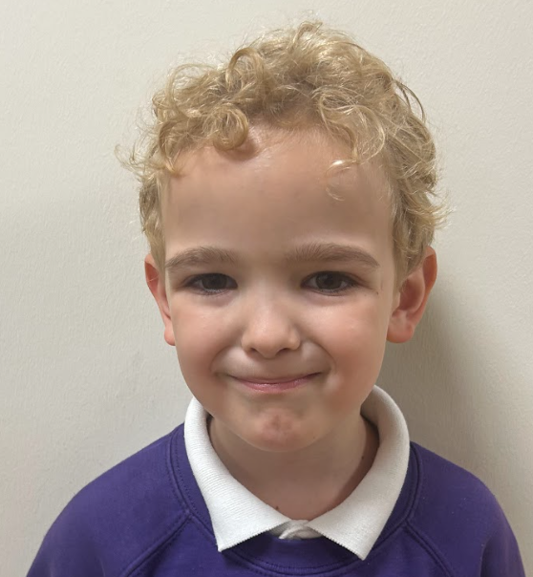
Just like last year,
•Please ensure you inform the class teacher/ office if your child is being collected by someone else. We are unable to release your child to another adult without this communication.
•Prescribed medicines to be taken to the office. (ANY INHALERS?)
•If your child is ill, you must communicate this to the school office – you can leave a voicemail message. 01925634967

Slide 7
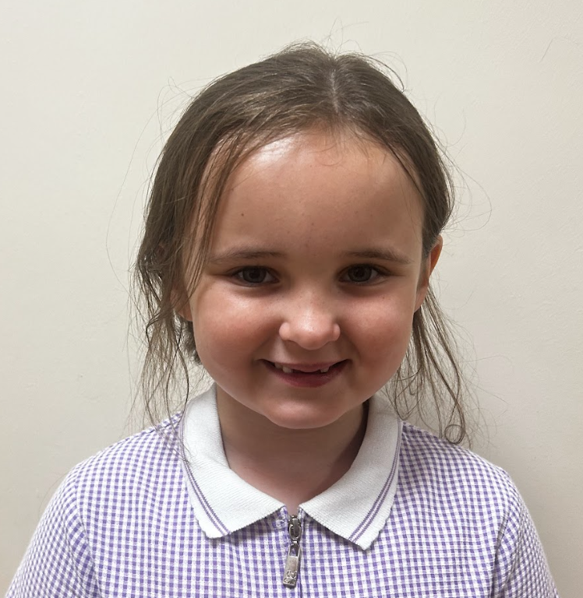
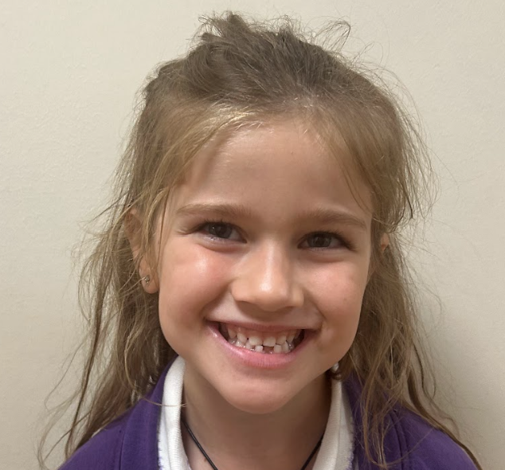
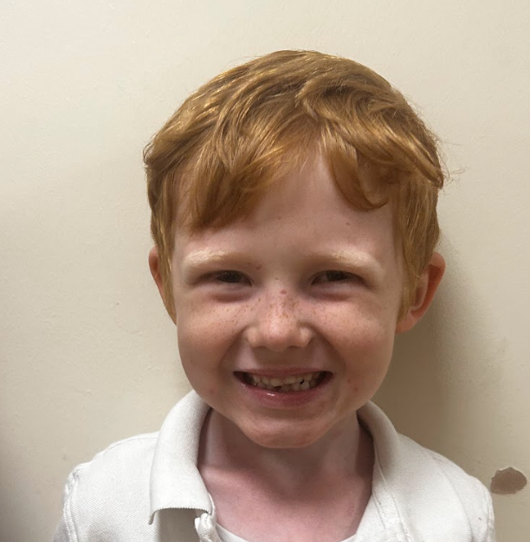
Reading at home
Please read at home daily.
Books will be changed on Tuesday. Please read the same book 3 times.
To develop understanding and comprehension, ask your child questions beginning with:
Who
What
Where
When
Why
Children have been assessed to make sure they have the most appropriate book band

Slide 8
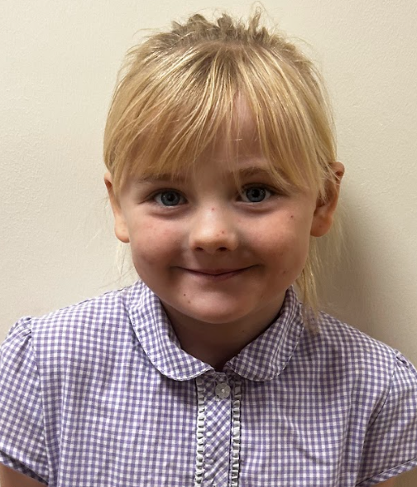
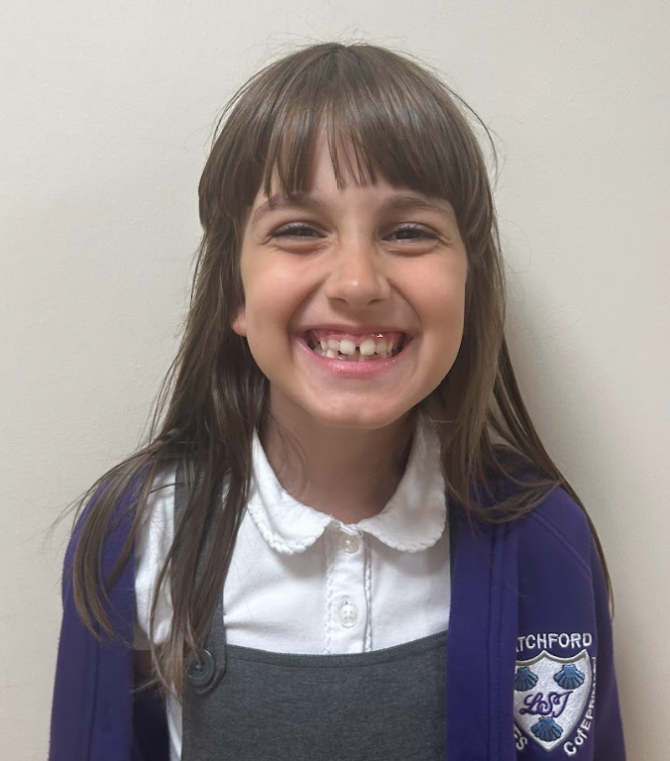
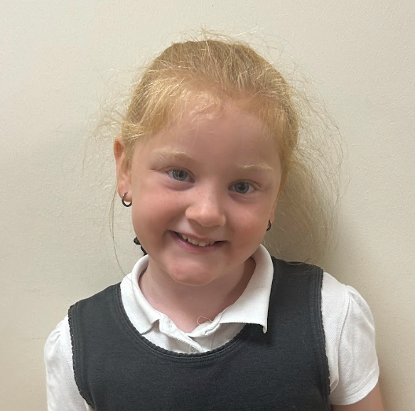
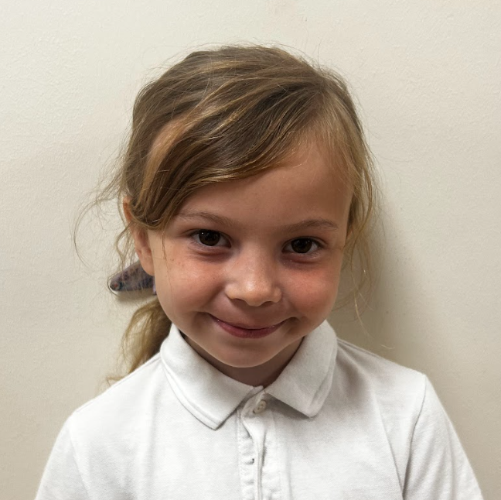
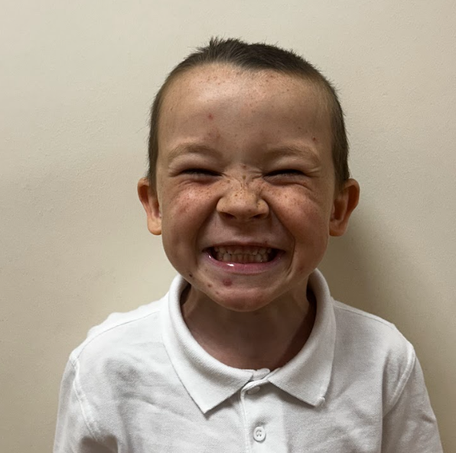
Year 2
Times tables - 2,5,10 and 3 (TTRS/ Hit the button)
Handwriting - Letter formation (ascenders and descender practice)> pre cursive > cursive.
Homework
Comprehension
Reading books
Arithmetic sheet.

Slide 9
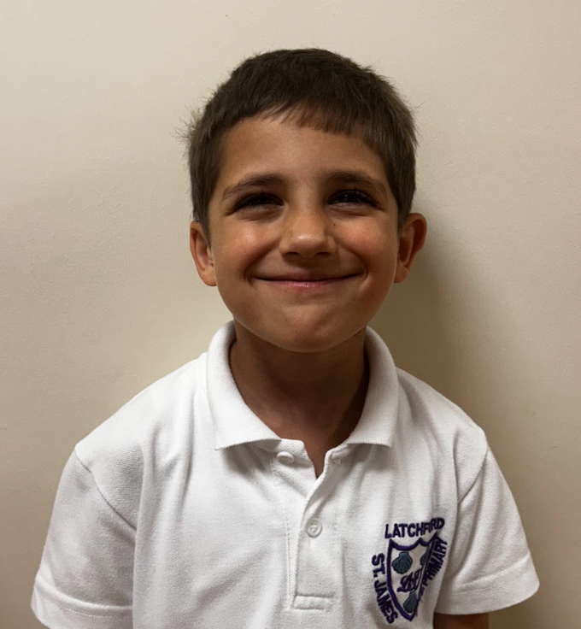
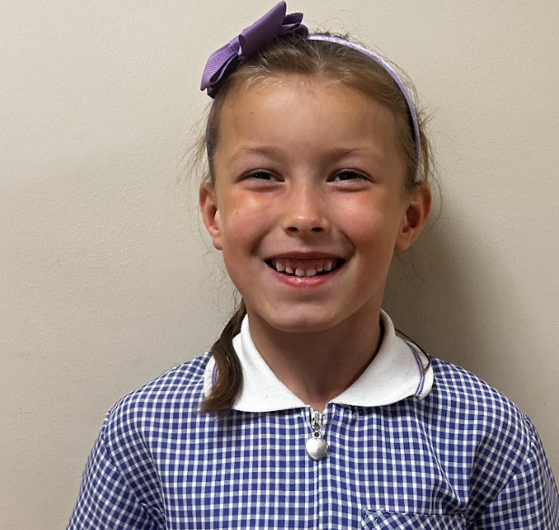
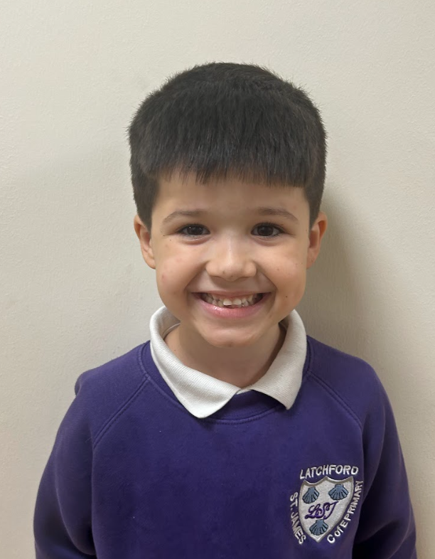
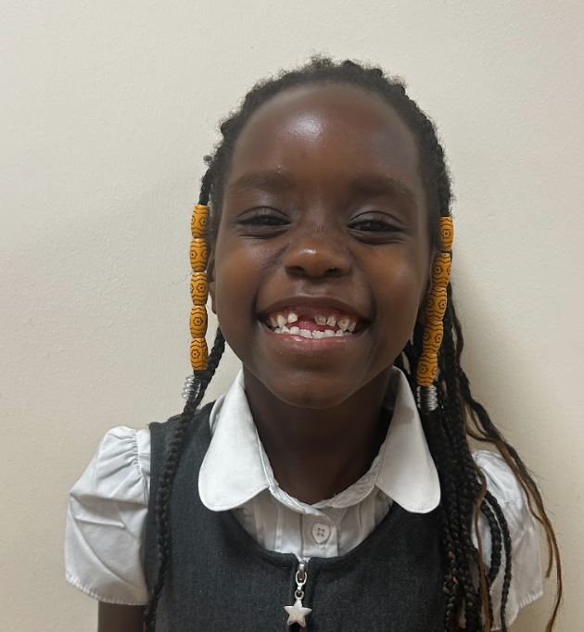
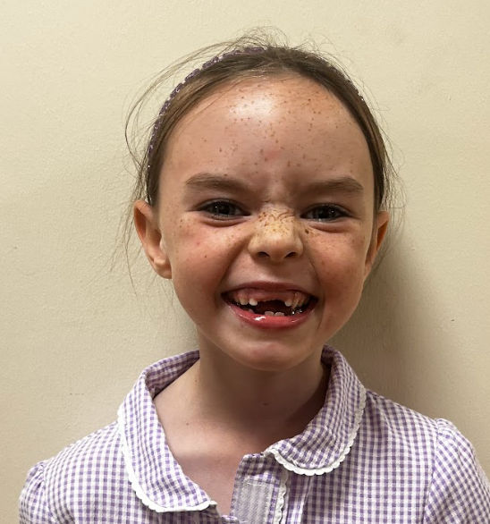
Planned trips/ to be planned:
Foxhowl - Tues 24/2/26- Wed 25/2/26 (overnight)
We will have a meeting closer to the time to discuss details.
Multi faith week (July) - Hindu Temple (Liverpool)- train
Crosby beach (October) - Geography - train

