Slide 1



MEET THE
TEACHER
Welcome to Nursery!

Slide 2

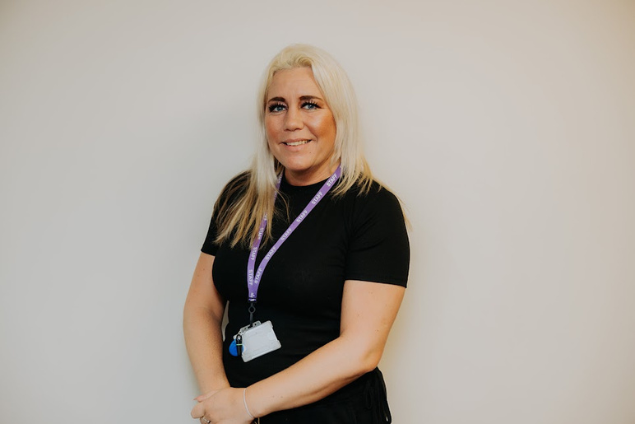
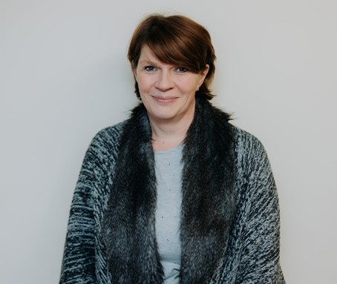
MEET THE TEAM
Miss Lea
Class Teacher
Mrs Bates
Teaching Assistant
Mrs Jevans
Teaching Assistant
Wed pm

Slide 3

PARENTS AS PARTNERS
Our home-school communication is very important to us. We use a range of tools to communicate with our parents:
  Class Dojo - I will post reminders, notices and regular updates of the children’s learning throughout the year. Please check this regularly. There is a message feature where you can send questions/ queries, I will get back to you as soon as possible (8am - 5pm). Your child will have an online Portfolio where observations of their learning will be uploaded by a member of staff.
  EYFS Facebook Page - Regular updates of our class learning will be uploaded to our EYFS Facebook page.
  Text messages/ Emails - Messages will be sent from the school office with important dates and key notices.
  Stay and Play sessions - we will invite you into school to see your child’s learning and play alongside them in our classroom. I will be in touch with a date for our first stay and play session (Autumn Term).
You are always welcome to come and speak to a member of the EYFS team with any questions/ queries.

Slide 4
SEPTEMBER 2025
This will be a big transition for our new and current children and parents, we will support you to ensure the transition to Nursery is a smooth one.
During the first few weeks of Nursery, the Nursery team will spend time in provision with your children building relationships and showing the children our new classroom. We will begin to develop the rules and routines within our classroom so the children can become confident and independent learners.
We will complete baseline assessments during the first few weeks in Nursery. This will help us to plan and tailor our learning to suit the needs and interests of our children.

Slide 5
Routines
Doors open at 8:45am. 15 hours children are to be picked up from the school office at 11:45am. 30 hours children are to be picked up from our classroom door at 3:20pm.
Lunch time is 11:45am – 1pm.
Please inform a member of staff if your child is being collected by someone else. Please also ensure they have the password you have set. We are unable to release your child without the password for safeguarding reasons.
Prescribed medication must be taken to the school office and a form filled out.

Slide 6
WHAT DOES MY CHILD NEED TO BRING TO SCHOOL?
  Reusable Water Bottle - Please bring this to Nursery everyday.
  Appropriate coat for the weather everyday.
  Book bag with reading book and reading diary - Please bring this to Nursery every Tuesday and Friday as reading books are changed on these days.
  Our PE day is Wednesday – children to come to school wearing PE Kit/ Sportswear every Thursday.
  Please send Wellies into Nursery - these are to remain in Nursery so the children can explore the outdoors in any weather. School provide puddle suits.
  Packed lunch (if your child stays for lunch and does not have a school dinner).
  Spare underwear/ clothes.
  In the event of hot weather - send your child into Nursery with a sun hat.
Please ensure ALL items of clothing (coats, cardigans/ jumpers, hats, gloves, shoes etc) are labelled with your child’s name. This prevents items getting lost and helps your child’s independence to find their own belongings.

Slide 7


READING
  Children will be sent home with a reading book to share with you at home. Reading books will be changed on a Monday and Thursday each week.
  It is recommended that children read the book with you 3 times to allow the children to become familiar with the story and the language. Please make a note in your child’s reading diary each time you have read with a comment.
  To help develop your child’s language it would be useful to ask questions about the story and to name different objects/ characters/ animals in the story. This will help with their understanding and language development and use the language in everyday life.
  In school, we will share books with the children as a whole class, in small groups and one-to-one. Our literacy topics are usually based around stories so the children have access to a range of books.
  Reading is an extremely important part of your child’s development, therefore we make reading as fun as possible, retelling the stories using actions.

Slide 8
Curriculum
    The Nursery Curriculum is made up of 7 areas of learning.
    Prime areas –
    Communication and Language
    Personal, Social and Emotional Development (PSED)
    Physical Development (PD)
    Specific areas –
    Literacy
    Mathematics
    Understanding the World (UTW)
    Expressive Arts and Design (EAD)

Slide 9




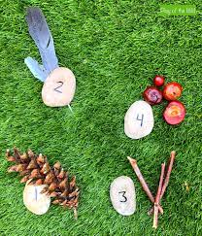
Curriculum
  Autumn 1 – Me and My Family
    Happy to be me
    Pete the Cat: I love my white shoes
  Autumn 2 - Let’s Explore Outside
    Wow said the Owl
    Hide and Seek
  Colours
  Matching
  Sorting (including shape)
  Number 1
  Number 2
  Patterns

Slide 10
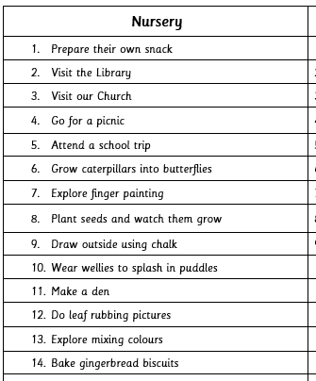
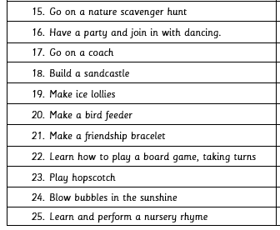
LATCHFORD BUCKET LIST
Alongside our Nursery curriculum, we have our Latchford Bucket List to give our children 25 life experiences during their time in Nursery.

Slide 11
REWARDS
We have a range of rewards to celebrate our children’s learning.
  Certificates (every Friday) - Dojo winner, Always Award, Learner of the Week.
  Dojo points
  Stickers
Our certificate winners will be presented in Celebration Worship on Friday’s.

Slide 12
THANK YOU
Thank you for attending our Meet the Teacher evening!
We are really looking forward to the year ahead in Nursery!
If you have any questions, please feel free to speak with me now, send a message on Class Dojo or catch me on the door.
Our Nursery door is always open!

